Slide 1
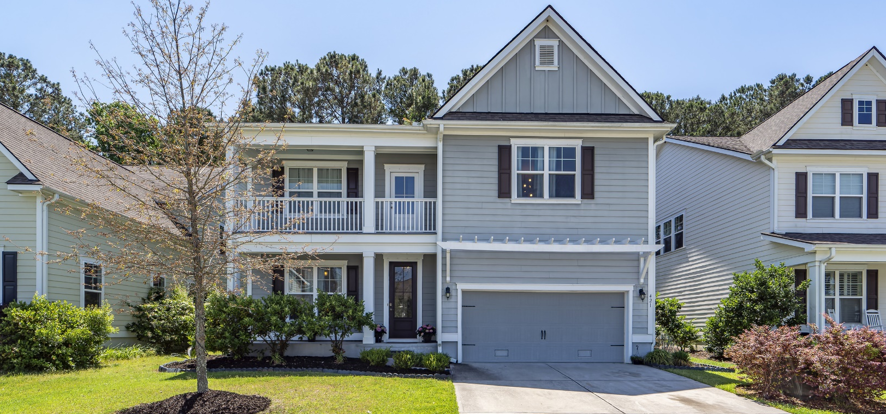
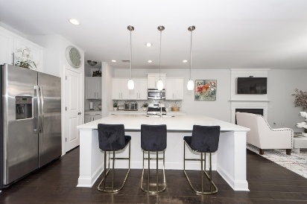
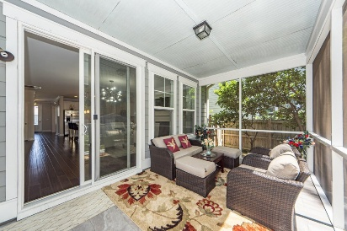
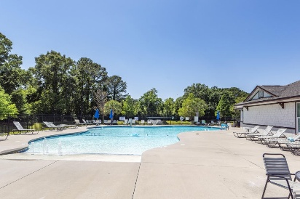

PRICE REDUCED TO $869,000 $20,000 TOWARD CLOSING COSTS OR RATE BUY DOWN AND AN ADDITIONAL $5,000 TO BUYER'S AGENT WITH RATIFIED CONTRACT BY SEPTEMBER 25TH
421 Turnstone Street
Tidal Walk | Mount Pleasant, SC 29464 | MLS# 25024207
GREAT home in a GREAT location. Second story loft can be used as a office or workout area! Home newly painted and owners have moved to their new home. New stove, new, refrigerator and new dishwasher.
Pictures reflected when owners lived in home. Easy to show! Home warranty until 2028!
Take a Virtual Tour
Lisa Deaton
843-224-7878
lisamdeaton@comcast.net
AgentOwned Charleston Group
902 Savannah Hwy
Charleston, SC 29407-7802

