Slide 1
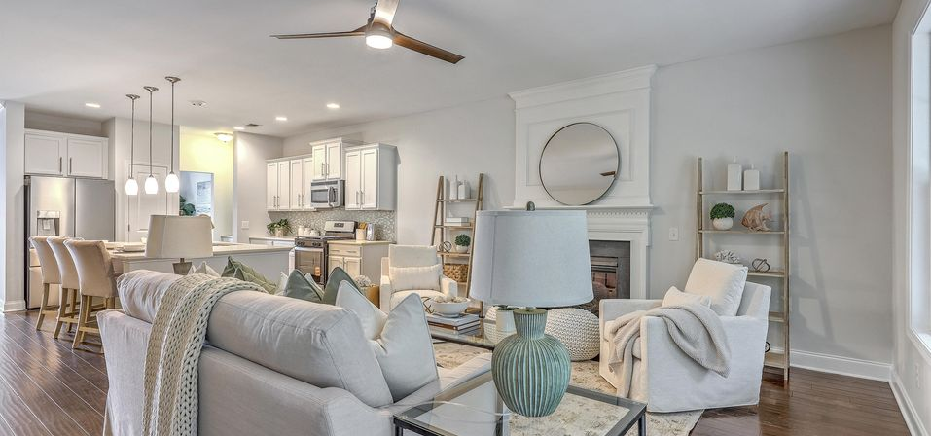
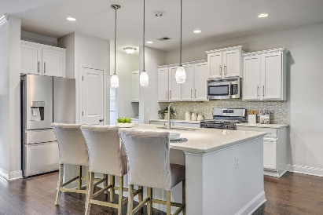
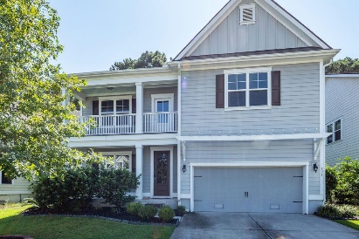
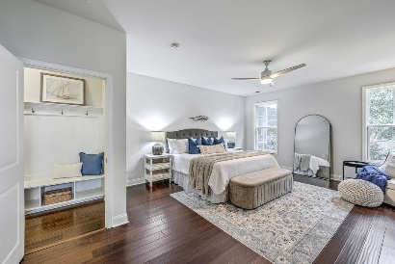
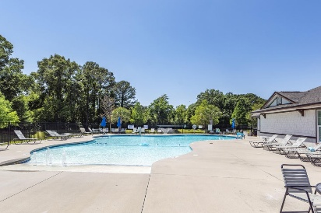

PRICE IMPROVED! NOW $839,000
421 Turnstone Street
Tidal Walk | Mount Pleasant, SC 29464 | MLS# 25024207
GREAT home in a GREAT location. Second story loft can be used as a office or workout area! Home newly painted and owners have moved to their new home. New stove, new, refrigerator and new dishwasher.
Home warranty until 2028!
Take a Virtual Tour
Lisa Deaton
843-224-7878
lisamdeaton@comcast.net
AgentOwned Charleston Group
902 Savannah Hwy
Charleston, SC 29407-7802

