Slide 1
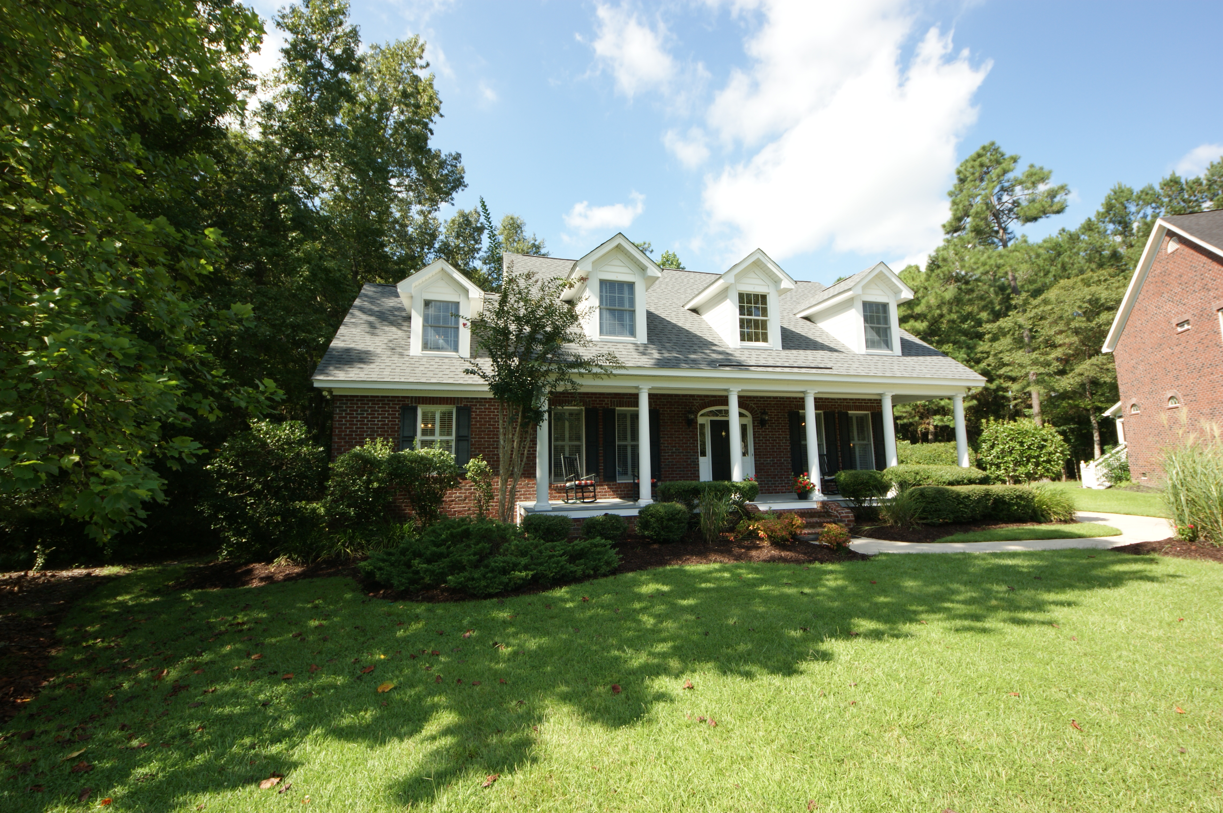
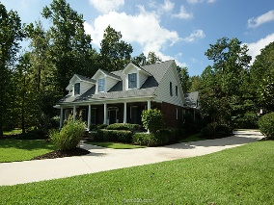
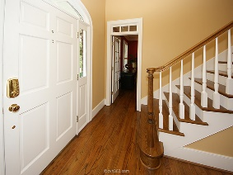
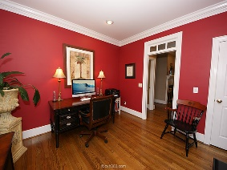
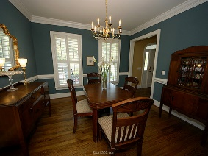
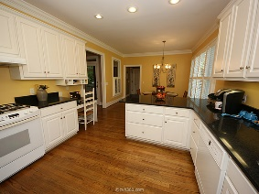
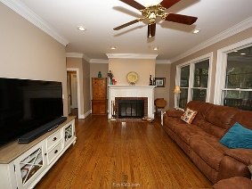
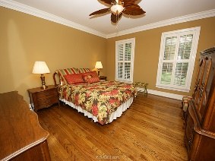
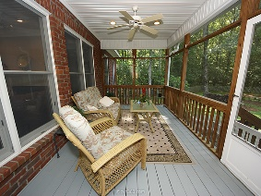
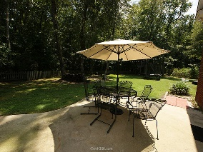
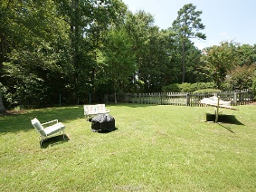


4222 Buck Creek Court Coosaw Creek Country Club ~ North Charleston MLS# 15021090 ~ $416,600
Owners Have Found New Home And Are Ready To Move
This beautiful custom 4/5 Bedroom home is located in Coosaw Creek Country Club, a centrally located Gated Community with a beautiful club house, a challenging golf course (rated 2014 Charleston Golf Course of the Year), a neighborhood pool, tennis courts, and play park. Nestled on a lovely wooded lot on a large cul-de-sac, the home features hardwood floors throughout except in the bathrooms (tiled), the Bonus Room (carpet), and the craft room (vinyl tile). A beautiful custom trim package includes 8'' baseboards thru/out, 7'' crown mold in all significant rooms downstairs, and deep chair rail in the dining room. There are plantation shutters in the living room, dining room, kitchen and master bedroom. When entering the 2-story foyer from the deep and long front porch, you are greeted by the dining room on the right and a living room/study on the left. The bright and airy kitchen off the dining room features white cabinets, new Cambria Quartz countertops and a dual fuel Dacor Range. The kitchen opens into the family room which overlooks the inviting screen porch, the patio, and the wonderfully private back yard. The Family room fireplace is wood burning and has a gas starter feature. Off the back kitchen hall is a pantry, a laundry room and the back stairway to the Bonus Room/5th bedroom which has its own bath and closet. The downstairs master bedroom features a large walk-in closet, a spacious bath with separate shower and garden tub, a linen closet, and a dual-sink vanity. The master bedroom looks out onto the beautiful back yard which also has a tree house for the kids. It is completely fenced (all wood except for the metal fencing along back property line). Upon returning to the foyer, there is a half bath and the front stairway which leads up to the additional 3 bedrooms. The upstairs bathroom features a garden tub, a separate shower, and a dual sink vanity. Also, there is a craft/flex room which connects to the bonus room. This is a fantastic home, perfect for family and for entertaining.
Sammye H Blackard O (843) 974-6265
M (843) 224-8422
sblackard@carolinaone.com
Carolina One Real Estate
900 N Main St.
Summerville, SC 29483

