Slide 1
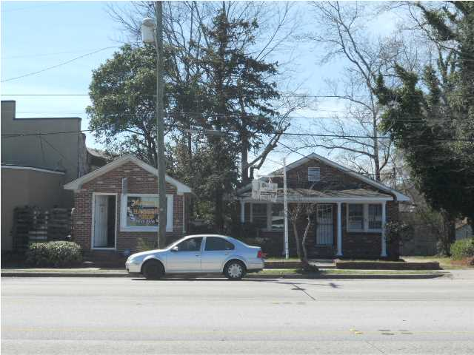
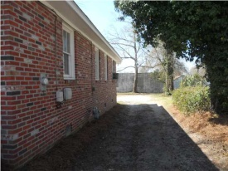
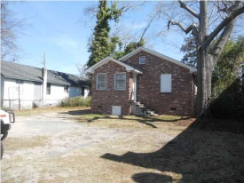


Income Producing Property!
4227 Rivers Ave
North Charleston, SC
MLS# 1500529
$199,000
Two separate buildings for sale on one lot.
Currently occupied with tenants in place.
The first building is a Barber Shop and second larger building is a Beauty Shop.
Great investment opportunity.
Tenants are very interested in remaining as tenants.
Connie White, Broker
C: 843-532-3356
conniesyouragent@gmail.com
Charleston Homes
111 Spring Hall Dr
Goose Creek, SC 29445

