Slide 1
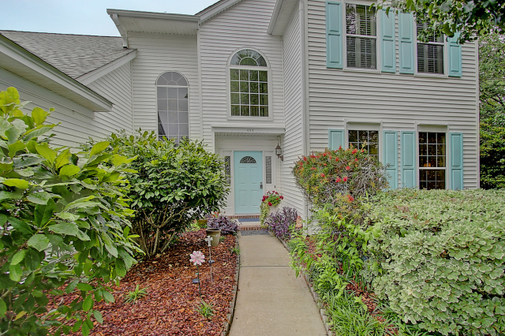
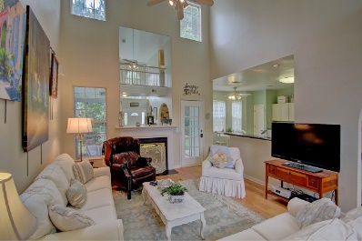
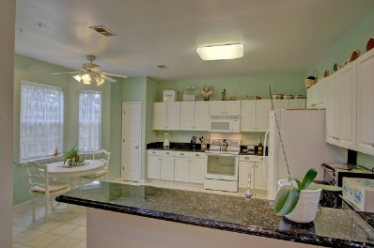
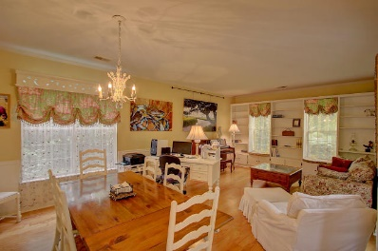
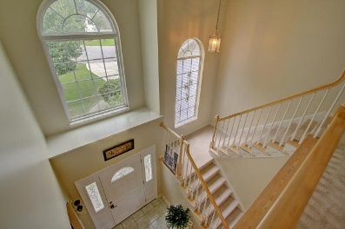
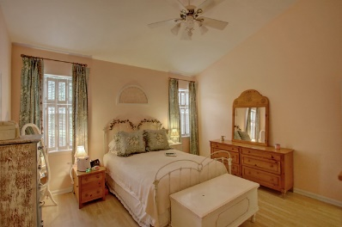
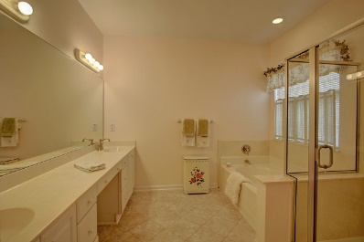
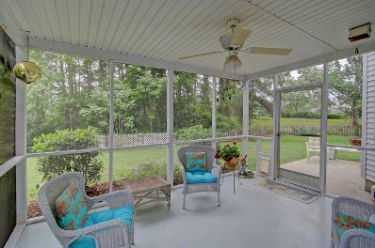
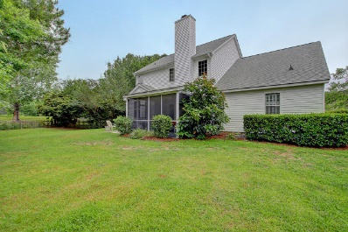


422 S Piazza Court
Belle Hall ~ Mount Pleasant ~ MLS# 16029442 ~ $445,000
Bonuses offered through 8/31/16:
Buyer - Free Wild Dunes Swim Social membership
Broker - $10,000 Selling Bonus at closing
This lovely home in The Veranda of Belle Hall Plantation is move-in ready! It offers something for everyone incl. walking/jogging paths, tennis, planned community events, swimming pool, playground, volleyball. You'll LOVE this floor plan! Home interior upgrades include smooth ceilings, granite, updated parlor bath, quality paint. Kitchen has an eat-in area and bar seating. Alternate living space on main level as library or den with built-ins and dining. Tub/Separate shower in Master Bed Bath. Upstairs - a large bonus/media or 4th bedroom w/closet. Garage w/Sink, Sprinklered yard and Screened Porch...Perfect! Newer Roof & Mechanicals! Please measure. Walking distance to Mt. Pleasant Jones Recreation Center (25-meter indoor heated pool - gym, skate park, batting cages, playground, softball & athletic field).
Listed by
Bill Donovan
843-991-0146
donovans@carolinaone.com
Renee Meyer
Mobile - (843) 991-0007
renee@carolinaoneplus.com
www.CharlestonHomesHotline.com
Carolina One Real Estate
1503 Palm Blvd
Isle of Palms, SC 29451

