Slide 1
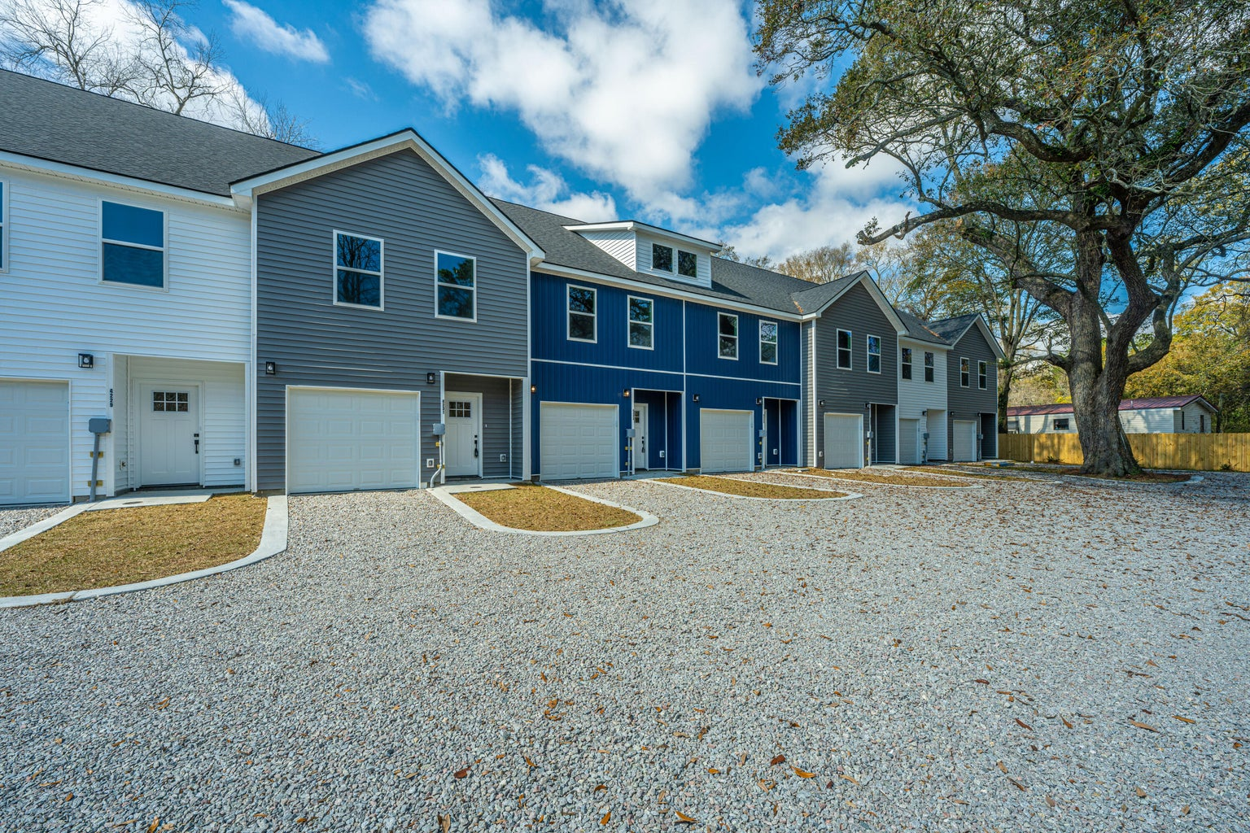
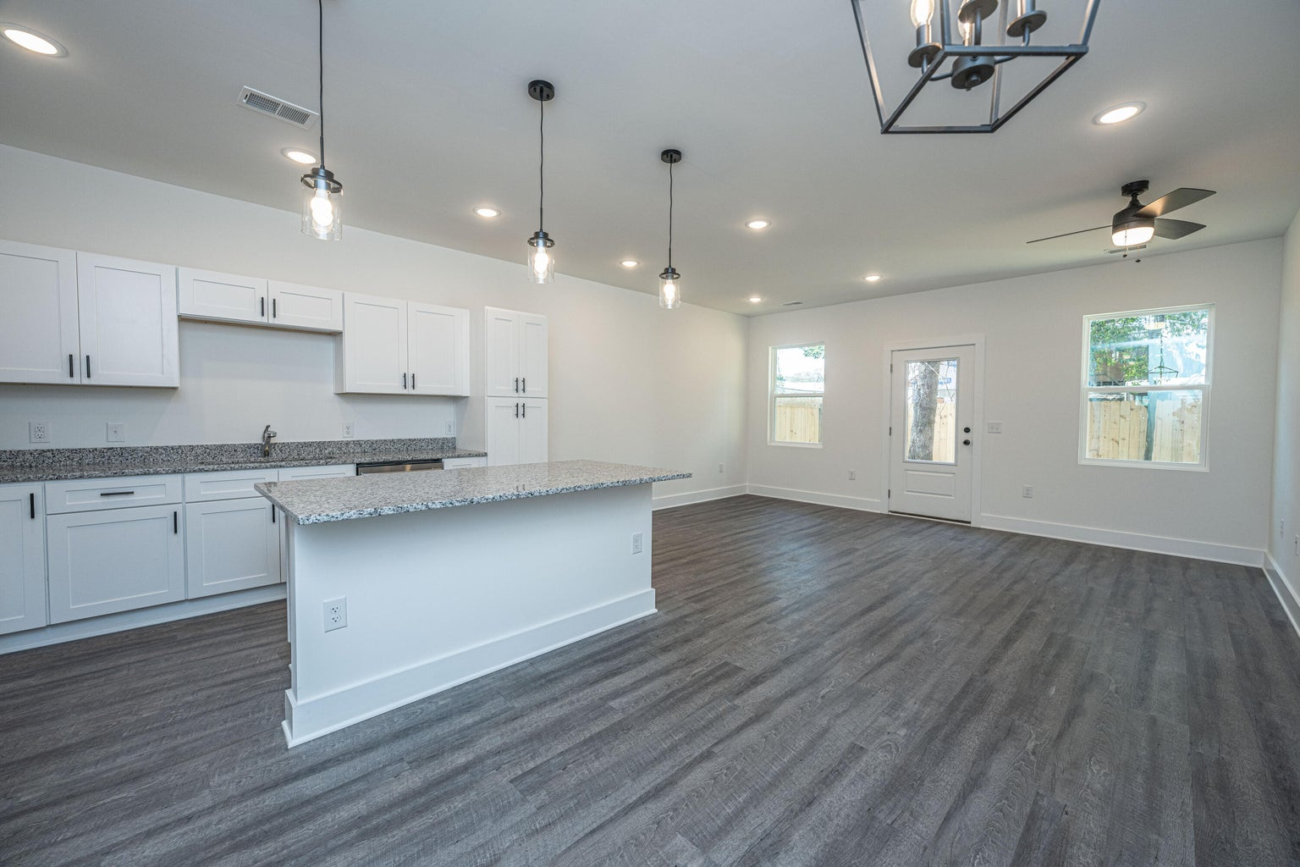
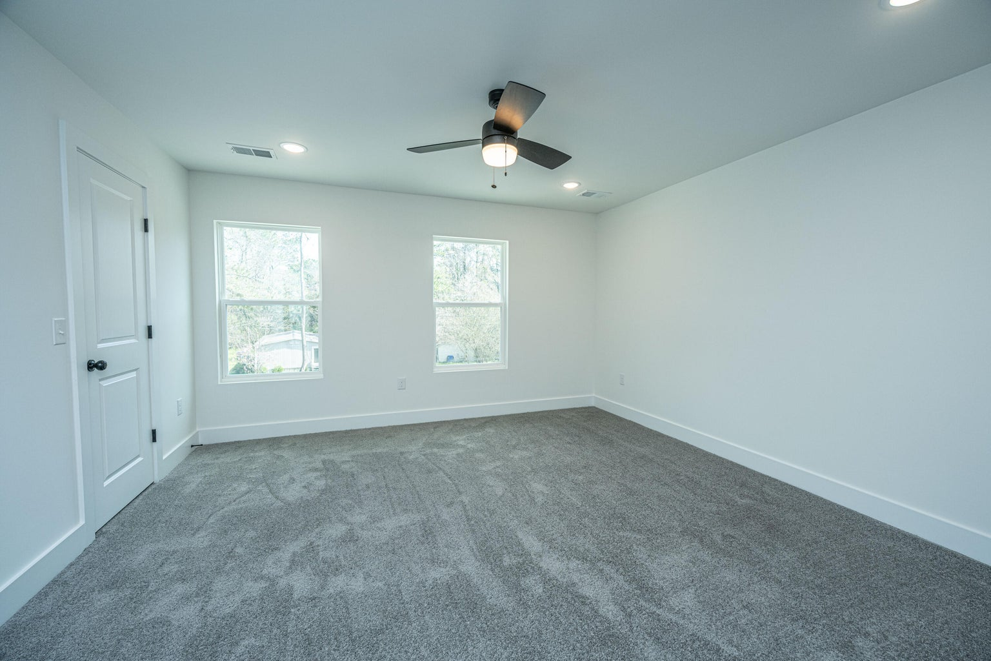

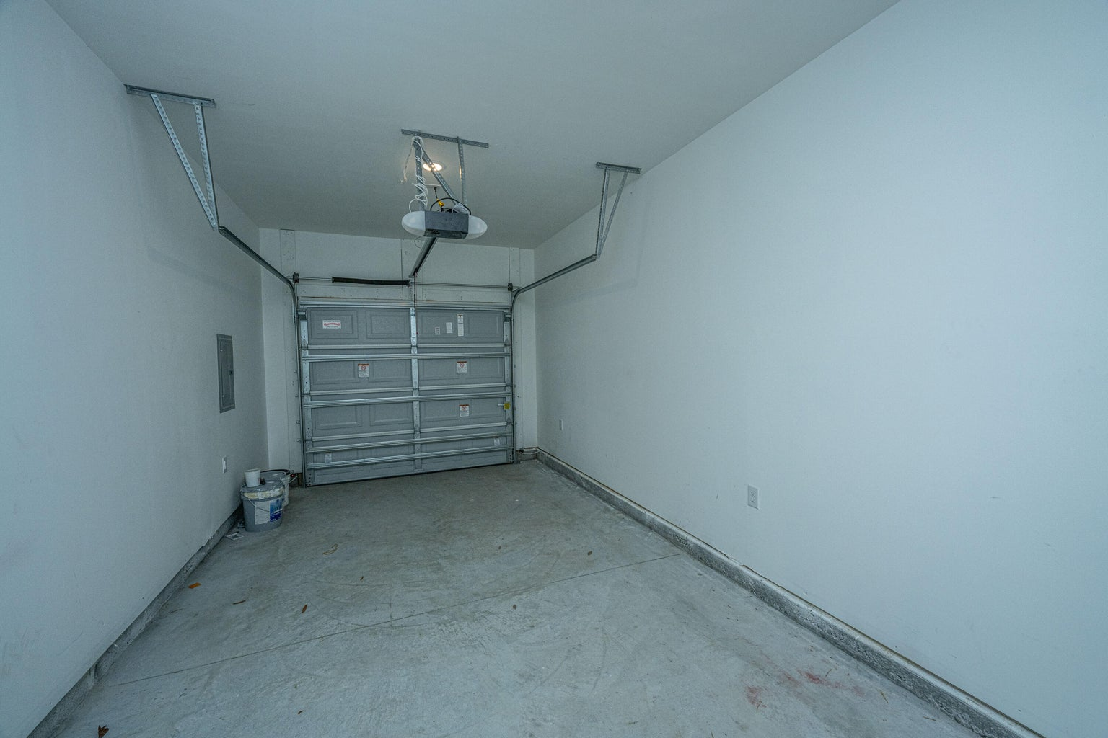
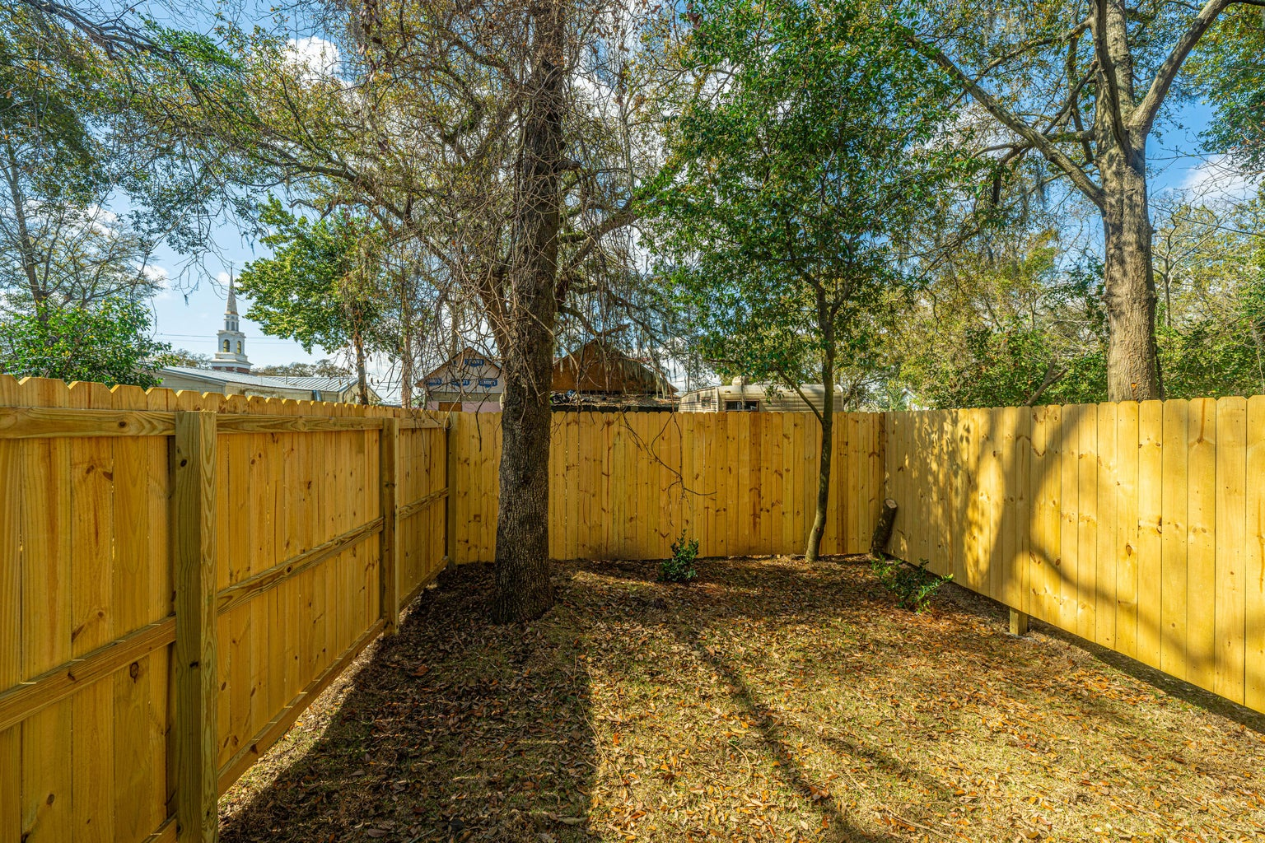
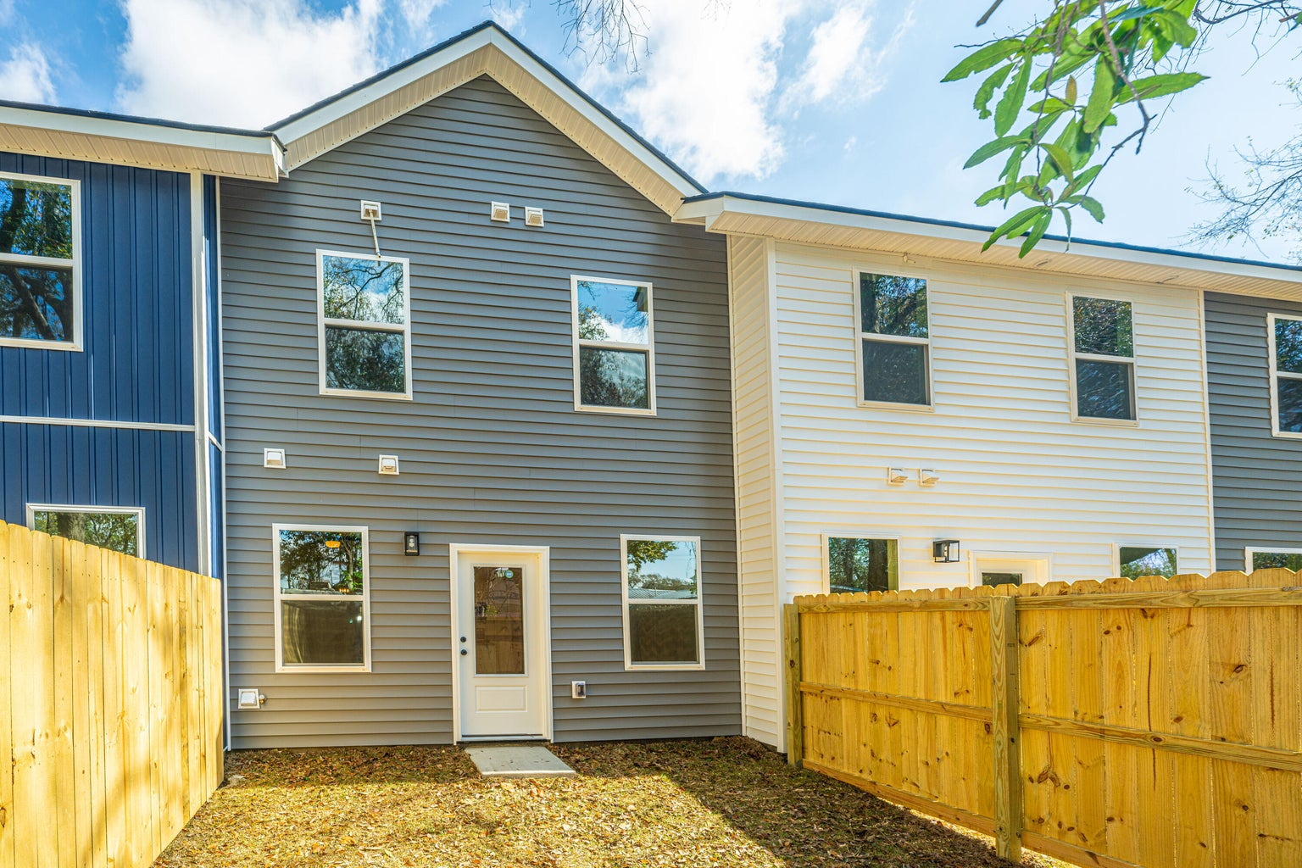

Amazing
Investments!
4231 Barnwell Avenue
North Charleston, SC 29405 | MLS# 24004836 | $350,000
Introducing Barnwell Breeze - Your Gateway to Modern Living in North Charleston!
Take your pick…7 Total Units Available!
These brand-new, 3-bedroom, 2.5-bathroom townhomes in the heart of North Charleston are just over a mile from the Park Circle area. No HOA fees give you the freedom to enjoy your space without constraints. These thoughtfully designed homes feature an attached garage, providing both convenience and security. The stylish kitchens boast granite countertops, soft-close drawers, and ample space for entertaining, making hosting gatherings a breeze. With a generous 1558 square feet of living space, you'll find the perfect balance of comfort and sophistication. Upstairs is a spacious primary bedroom with multiple closets and a large en-suite bathroom. There are two additional guest bedrooms, a full bathroom, and a laundry room for added convenience. Barnwell Breeze offers a fully privacy fenced yard for each home, creating a secluded oasis for relaxation and outdoor enjoyment. These townhomes are perfect for first-time home buyers, investors, or anyone looking for an affordable home that is close to everything.
Justin Jureka
843-290-3272
jjureka@carolinaoneplus.com
http://www.justinjureka.com/
Carolina One Real Estate
191 Rutledge Ave
Charleston, SC 29403

