Slide 1
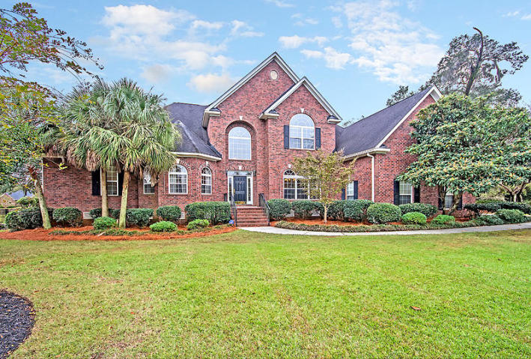
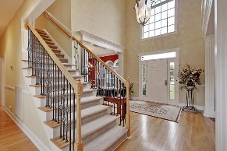
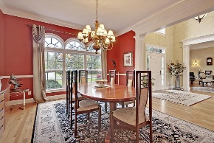
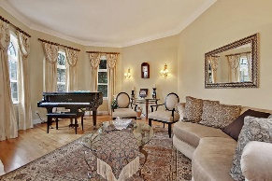
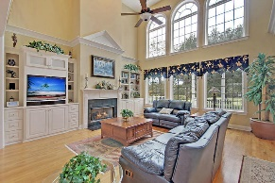
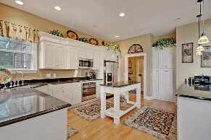
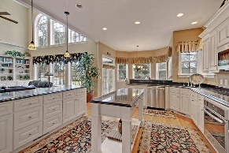
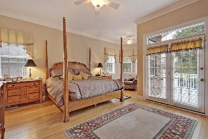
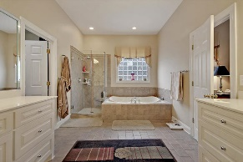
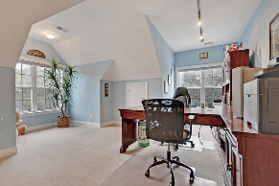
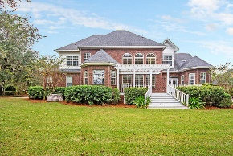
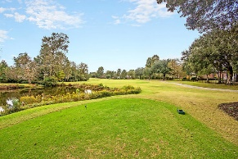



Stunning Golf Course Home in Gated Community
4232 Club Course Drive
Coosaw Creek Country Club
North Charleston, SC 29420
MLS# 18030426
$629,000
6 Bedrooms | 5 Baths | 4,700 sf
One of Coosaw Creek's most beautiful homes! This custom built 4,700 sq ft golf course home sits on a half-acre lot overlooking the seventh fairway and a pond. This spectacular home offers an open floor plan and many high end custom upgrades throughout. Upon entering, you'll immediately notice the high ceilings, wood floors and attention to detail. There is a formal living room to your left and a large dining room to your right. Great space for entertaining! The kitchen overlooks both the large family room as well as the eat in kitchen area. It has new stainless steel appliances, a breakfast bar, and pantry. The family room has great built in cabinetry and a gas fireplace. The large windows overlooking the golf course provide tons of natural light. The first floor master is a great size and has access to the back porch. The master bath has dual vanities, separate shower and tub and a very large walk in closet. On the other side of the first floor is another bedroom with a full bath. Perfect for guests! Upstairs, you'll find four more bedrooms and two jack and jill baths, and one bedroom with its own full bath. Every bedroom has access to a full bath! All bedrooms have ample closets and the design of the home provides many storage nooks. Then there is the huge FROG! What a great space that can be used so many ways! You'll never lack for space in this home. A full three-car garage also offers storage. This meticulously maintained home has too many extras to list. Buyers will be impressed! The neighborhood has 24 hour 7 day a week gated security, unlimited golf for all household members, and the location, wow...close to it all! Boeing, Bosch, AFB, Mercedes are all a short drive away. Come live the good life in a golf course community that has tons of activities and events, great food in the restaurant, great community pool with an award winning swim team, and the most beautiful golf course you'll ever play on!
Larry & Kathy Mazalatis
Larry Cell 843-693-0529
Kathy Cell 843-693-0159
Office 843-871-9133
AGENTOWNED PREMIERE GROUP | 1800 TROLLEY RD | SUMMERVILLE, SC 29485

