Slide 1
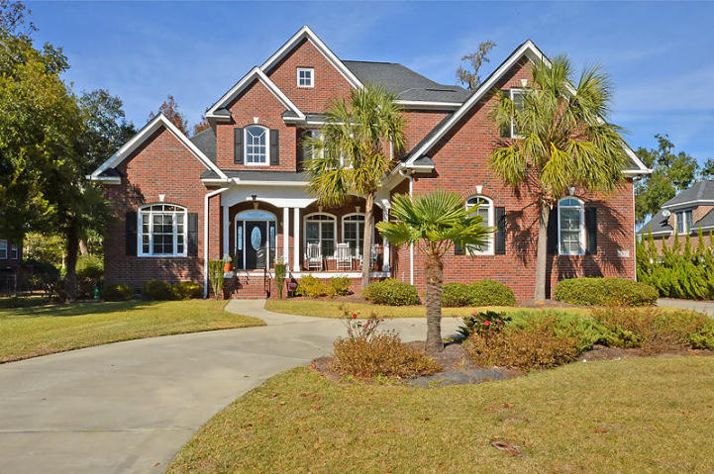
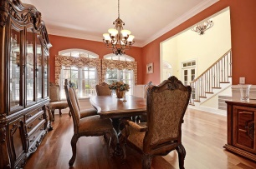
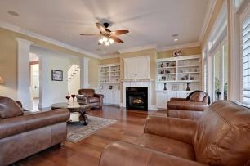
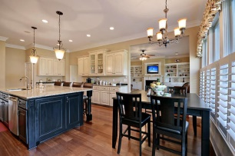
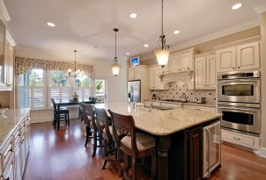
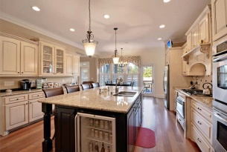
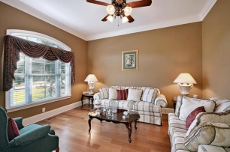
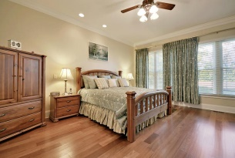
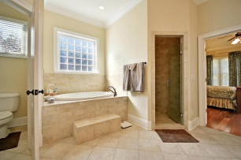
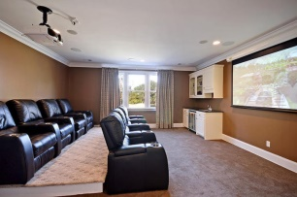
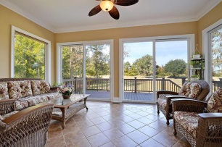
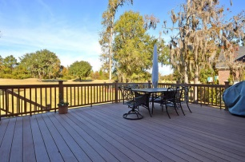
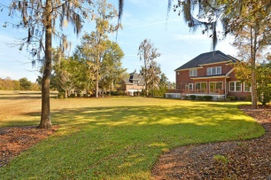


Open House Sunday 12-3
4237 Club Course Dr
Coosaw Creek Country Club
North Charleston, SC 29420
MLS# 14029845
$699,000
5 Bedrooms | 3½ Baths | 4,850 sf
This 4,850 Sq. Ft. custom brick, golf course home is on one of the nicest lots in the entire neighborhood and loaded with upgrades! This home is in IMMACULATE condition with beautiful Brazilian Cherry hardwood floors and 10 foot ceilings throughout! The kitchen is a cook and entertainers dream! The massive island offers a built in wine cooler, double sink, seating for four and a central vac kick plate! All the kitchen counters / island are granite and the appliances are stainless steel including the undermounted microwave / warming drawer, double wall ovens and five burner gas cooktop. Custom cabinetry with no expense spared, multiple sliding drawers plus some glass front cabinets. Recessed lighting, island pendant lighting, surround sound and an eleven foot auto lit pantry! This kitchen has it all! Downstairs, buyers will find a large separate dining room with extensive custom trim work, separate home office or formal living, a family room with built in shelving, gas fireplace and cabinets for storage, laundry room (with laundry chute from 2nd floor), eat in kitchen area and a tiled sunroom overlooking the 5th fairway with massive sliding glass Anderson doors. Plantation shutters on the back of the home for added privacy. The back deck is very large and overlooks the gorgeous backyard and amazing views of the 5th fairway! Both the front and back porches were built with TimberTech decking which has a much longer life and requires very little upkeep compared to other decking. Watch the Osprey carry snakes, fish and rodents to its nest in a live oak on the fairway just behind this home... Bald eagles have also recently been spotted! The large master bedroom is downstairs and offers a huge master bathroom with oversized tile shower (multiple shower heads), jetted tub, custom cabinetry and a large walk in closet. The sound system with speakers and volume control is in almost all downstairs rooms and the outside deck. Massive side load oversized 3 car garage (extra deep) with 3 separate garage doors, utility sink and painted floor. The yard offers professional landscaping w/ palmetto trees, a large circular driveway as well as lawn irrigation throughout and a front porch on the house with ceiling fans. Upstairs buyers will find an amazing home theatre room! Eight movie theatre power seats with cup holders, surround sound and a 100 inch projector screen, perfect for watching all your favorite films! This room also has a wet bar, cabinetry and a wine cooler/mini fridge. Media room seating and equipment can convey with an acceptable offer! This room can also be made in to a sixth bedroom if needed. Three additional large bedrooms are also located upstairs along with a massive FROG / playroom off of one of the bedrooms. Two bedrooms share a Jack and Jill bath, while the other has a full bathroom to itself. The playroom has built in desks and window seat toyboxes as well as 4 storage closets! The playroom is the fifth bedroom but can be used for many purposes. A huge walk-in attic space offers plenty of easy access storage. This home is a must see within Coosaw Creek! COOSAW CREEK OFFERS AN EXCELLENT CLUBHOUSE WITH RESTAURANT AND BAR, NEIGHBORHOOD POOL, TENNIS COURTS AS WELL AS AN EXCELLENT GOLF COURSE. PLANNED EVENTS AND MEALS IN THE VERY ACTIVE CLUBHOUSE ARE COMMON AND GOLF MEMBERS ENJOY THE NUMEROUS MONTHLY GOLF EVENTS OFFERED WITHIN THIS PRIVATE GATED COMMUNITY....
Larry & Kathy Mazalatis
Larry Cell 843-693-0529
Kathy Cell 843-693-0159
Office 843-871-9133
AGENTOWNED PREMIERE GROUP | 1800 TROLLEY RD | SUMMERVILLE, SC 29485

