Slide 1
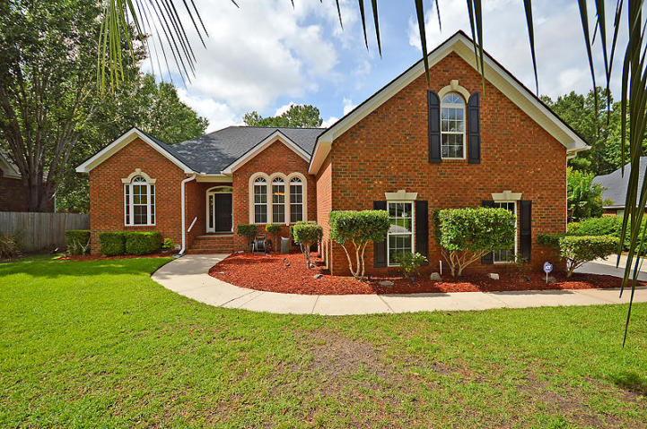
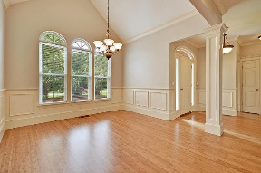
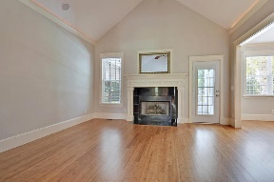
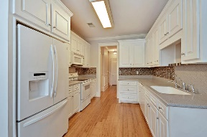
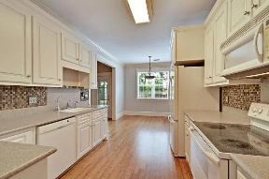
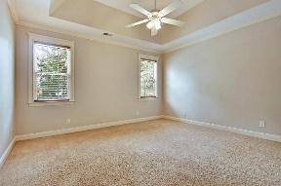
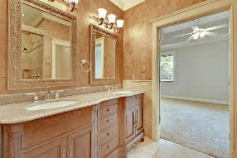
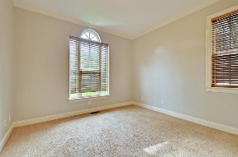
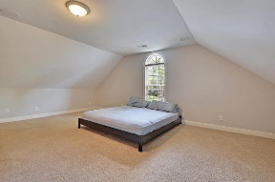
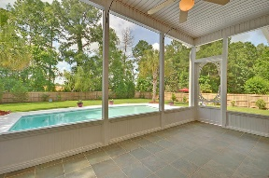
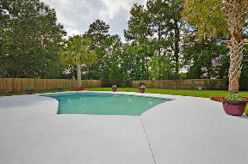
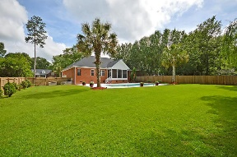



In-ground Pool In Gated Community Only $335,000!!
4237 Wildwood Landing
Coosaw Creek Country Club
North Charleston, SC 29420
MLS# 18015662
$335,000
4 Bedrooms | 3 Baths | 2,250 sf
One story home! In-ground pool! Gated golf course community!! This custom built, brick home has the perfect layout! In addition to that, fresh paint, new flooring, upgraded bathrooms...you just need to move in! Upon entering, the large dining room will be to your right. Extensive trim work starts there and continues down the hall. The dining room is a perfect size for entertaining. Straight ahead is the family room which offers a vaulted ceiling, gas fireplace and access to the screened in porch. The kitchen is right off the family room and has corian countertops, tiled backsplash and eat in area overlooking backyard. On the left side of the home are two bedrooms with hall access to a full bath. On the right side of the home is the master suite.
The master offers an updated bathroom with dual vanities, large shower, jetted tub and walk in closet. The master also overlooks the backyard oasis. Wake up every morning overlooking your beautiful pool and lovely palmetto trees. Upstairs is a real treat! This large bonus room has so many possibilities. This could be your fourth bedroom, media room, playroom, teen suite, mother in law suite, you name it! It has a full bath with large dual shower head shower, wet bar sink with room for a beverage center and counter space. There is also a very large closet. Cleaning is made easy by the central vacuum system!! Back downstairs and outside, sit in the screened in porch before heading out to the pool! There is also a large patio area perfect for grilling. Having this backyard will be like a vacation every day! Not only do you get a great house, you get to live in an awesome neighborhood! The neighborhood has 24 hour 7 day a week gated security, unlimited golf for all household members, and the location, wow...close to it all! Boeing, Bosch, AFB, Mercedes, Volvo... are all a short drive away. Come live the good life in a golf course community that has tons of activities and events, great food in the restaurant, great community pool with an award winning swim team, and the most beautiful golf course you'll ever play on!
Larry & Kathy Mazalatis
Larry Cell 843-693-0529
Kathy Cell 843-693-0159
Office 843-871-9133
AGENTOWNED PREMIERE GROUP | 1800 TROLLEY RD | SUMMERVILLE, SC 29485

