Slide 1
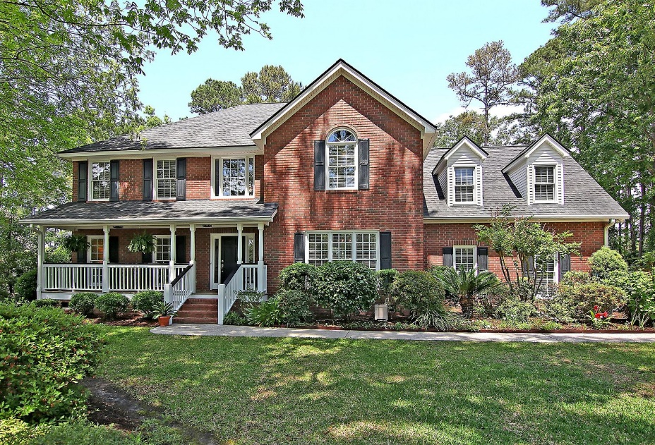
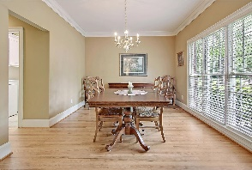
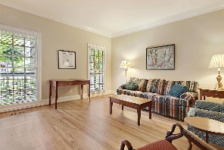
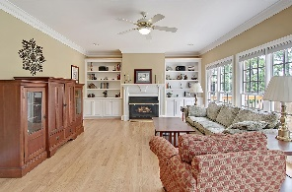
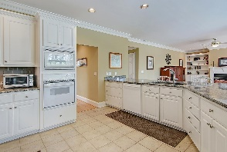
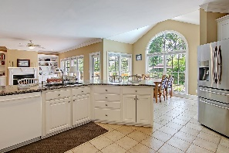
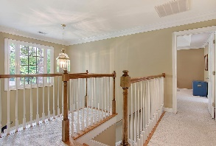
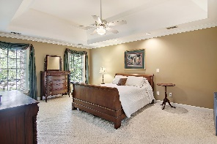
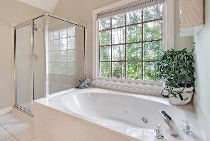
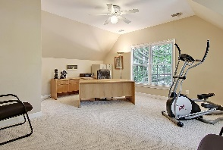
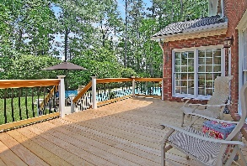
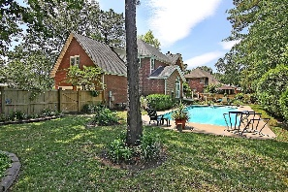
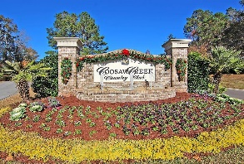
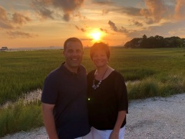

Gated Golf Community! In-ground Pool!
4239 Persimmon Woods Dr
Coosaw Creek Country Club
North Charleston, SC 29420
MLS# 21012098
$459,000
4 Bedrooms | 2½ Baths | 3,112 sf
Get ready to spend the summer poolside! This lovely home is located in the gated golf course community of Coosaw Creek! The welcoming front porch and lovely landscaping give this home great curb appeal. Upon entering, you'll notice the beautiful wood flooring. To your left is the formal living room, which could be used as a home office. To your right, the large dining room, perfect for entertaining. Walk down the hall and get ready for the great view of the in-ground pool from the expansive windows on the back of the home. The kitchen has tons of cabinetry, a large breakfast bar, an eat in kitchen overlooking the pool and a walk in pantry. The kitchen overlooks the family room which has built in shelves and cabinetry and a fireplace. Head upstairs and you'll find the large master suite and master bath. The master bath has a shower, separate jetted tub and large walk in closet. Down the hall, you'll find two more good sized bedrooms. A full bath is off one of the bedrooms and connects to the hall. The FROG is a great space; this could be your fourth bedroom, game room, exercise room, you name it! Head back downstairs and in to the backyard to your outdoor oasis. Sit on the brand new deck while overlooking your private backyard with an in-ground pool! Gorgeous landscaping surrounds the pool area. This home has been well maintained and is ready for you to move right in! Coosaw Creek is an amazing place to live! The neighborhood has 24 hour 7 day a week gated security, unlimited golf for all household members, and the location, wow...close to it all! Boeing, Bosch, AFB, Volvo, Mercedes are all a short drive away. Come live the good life in a golf course community that has tons of activities and events, great food in the restaurant, great community pool with an award winning swim team, tennis courts, basketball courts, playground and the most beautiful golf course you'll ever play on!
Larry & Kathy Mazalatis
Larry Cell 843-693-0529
Kathy Cell 843-693-0159
Office 843-871-9133
AGENTOWNED PREMIERE GROUP | 1800 TROLLEY RD | SUMMERVILLE, SC 29485

