Slide 1
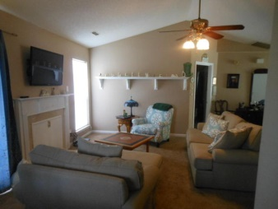
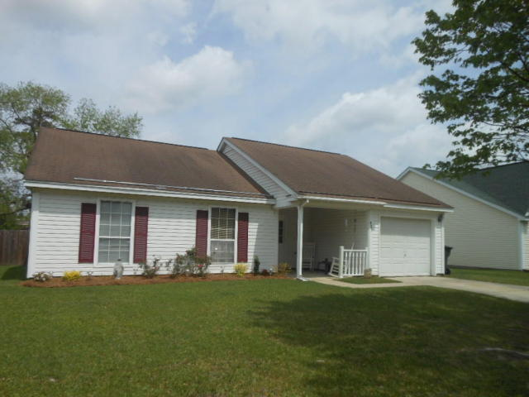
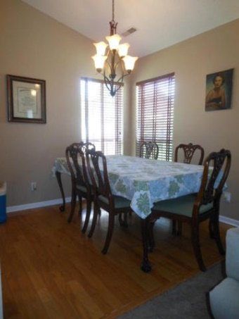
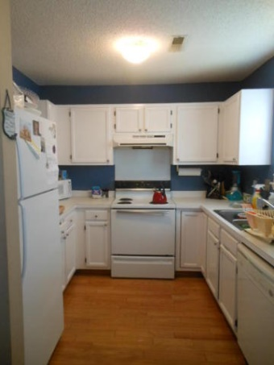
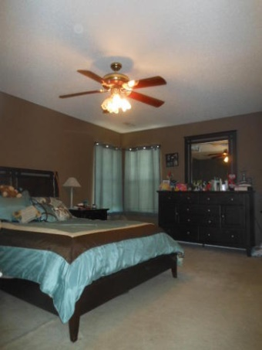
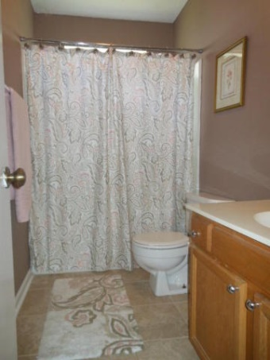
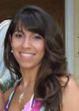

423 Courtland Drive Sangaree ~ Summerville MLS# 15009469 ~ $132,000
PRICE REDUCED! MOTIVATED SELLER!
Bring your buyers and bring your offers! Welcome home! Enjoy this 3 bedroom 2 bathroom gem in Sangaree. The floor plan is open and inviting featuring a fireplace that has never been used, vaulted ceilings, large master suite with a walk-in closet, and a large fenced backyard.
This home is move-in ready so don't miss out!
Brittany Soldano, REALTOR
Cell - 843-324-0183
bsoldano1217@gmail.com
Beresford Appraisals, LLC of Wando 295 Seven Farms Dr, Ste C-114 | Wando, SC 29492

