Slide 1
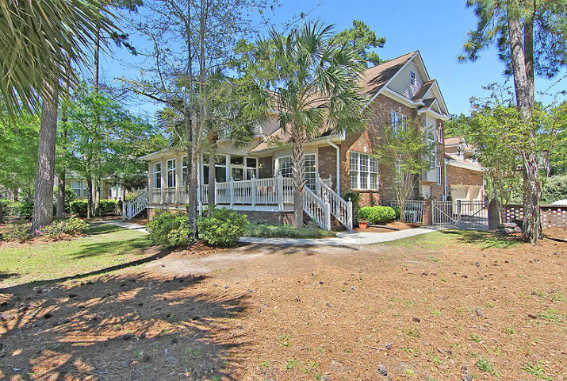
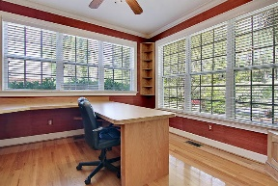
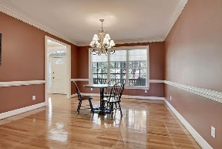
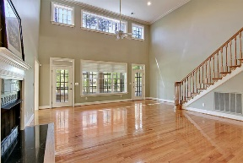
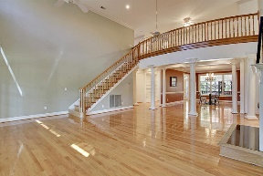
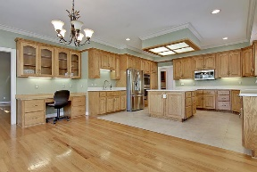
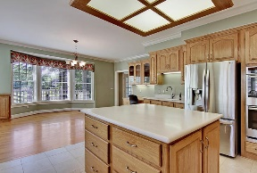
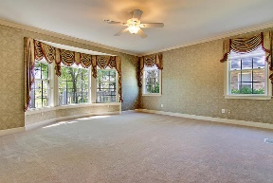
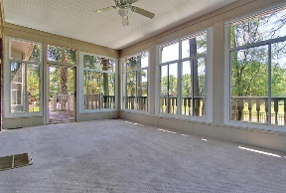
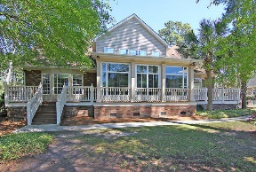
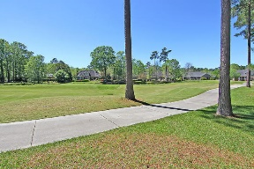
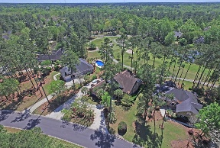
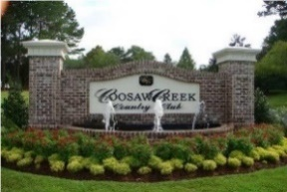


$15,000 Seller Paid Closing Costs
4244 Persimmon Woods Dr
Coosaw Creek Country Club
North Charleston, SC 29420
MLS# 16032128
$499,900
5 Bedrooms | 4½ Baths | 5,571 sf
Now offering $15K towards buyers closing costs and membership fees! Expect to be impressed with this beautiful 5,571 sq. ft. home in the gated golf course community of Coosaw Creek. From the moment you enter this executive home, you can see the extra touches. Built-in shelves on both sides of the foyer make entering this home very welcoming. A home office is set off to the right with built-in cabinets, desk and a walk-in closet filled with built-in cabinets and drawers. A large dining room is to your left with crown molding, columns and a butlers pantry with a wet bar. Perfect for entertaining! The living room has vaulted ceilings, gas fireplace, built-in cabinets, shelves and large windows looking out to the gorgeous view of the golf course. Next, enter into the kitchen which has a large eat-in area, built in desk space with glass cabinetry, double ovens, large island, vegetable sink and large pantry. The master bedroom is located on the first floor and offers tray ceilings, large master bath with dual vanities, jacuzzi tub and large his/her closets. Upstairs, you'll be impressed with four more large bedrooms, three full bathrooms, large loft area and a huge FROG. Each bedroom offers something unique. Two of the bedrooms each have huge walk-in closets. One bedroom has a cedar closet located off of it! The FROG has a built-in entertainment center and a full bath. Storage is never an issue in this home ~ just walk up to the third floor attic space! You'll also find plenty of storage in the 3 car garage! The beautiful sunroom overlooks the wrought iron fenced-in yard and the gorgeous par 3 third hole of the Arthur Hills golf course. Coosaw Creek is close to it all! Boeing, Bosch, AFB,...great location if you are looking for a short commute to work! This executive home is dream come true!
Larry & Kathy Mazalatis
Larry Cell 843-693-0529
Kathy Cell 843-693-0159
Office 843-871-9133
AGENTOWNED PREMIERE GROUP | 1800 TROLLEY RD | SUMMERVILLE, SC 29485

