Slide 1
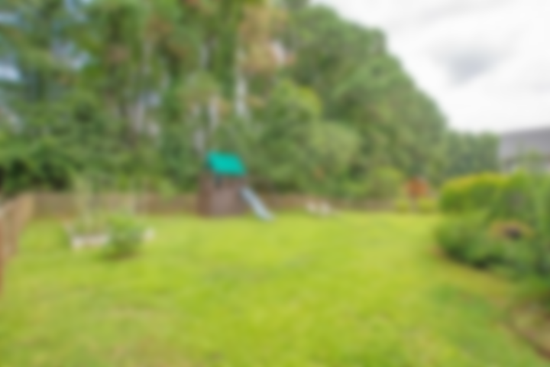
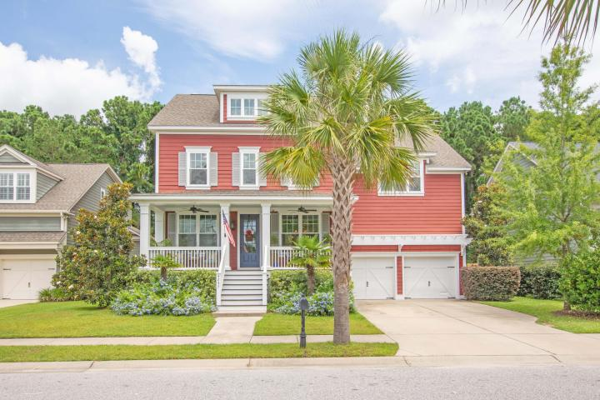
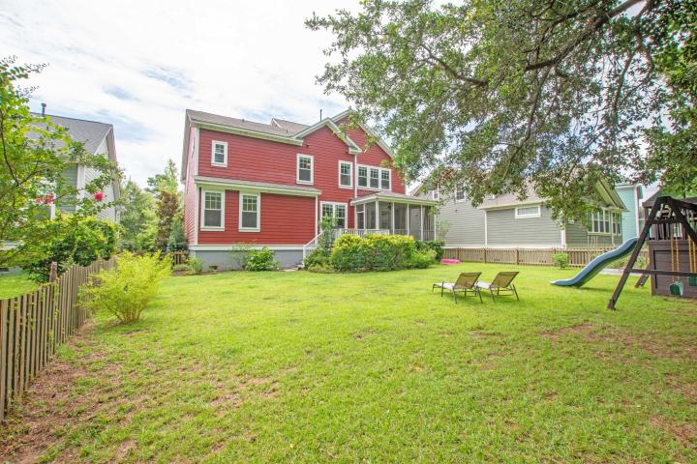
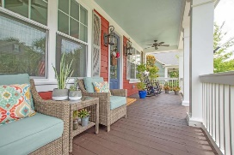
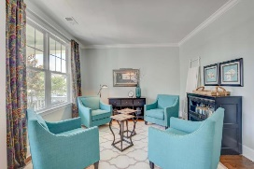
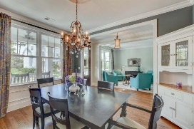
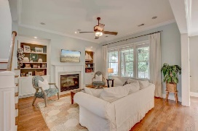
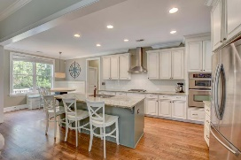
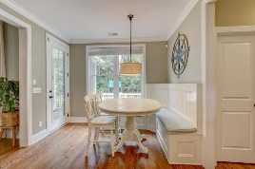
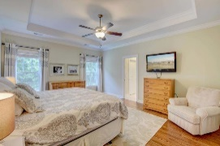
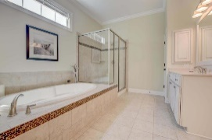
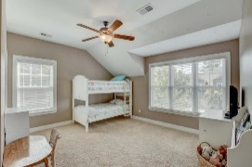
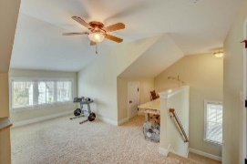
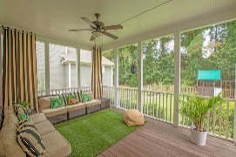
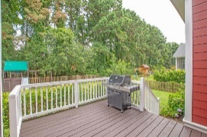

AGENT BONUS - BRING ALL OFFERS! 6 Bedroom/5 Bath for Under 740k in Mt Pleasant
4245 Coolidge Street
Hamlin Plantation | Mount Pleasant, SC 29466 | MLS# 18025392 | $739,900
This is a must see move in ready home! Welcome to lowcountry living at its finest in this fantastic 6 bedroom, 5 bath, 3 story home built in 2011. This beautiful home is located in the highly sought after Waverly Section of Hamlin Plantation. Large open concept family living with traditional formal dining and bright sitting room/or office space. Gorgeous kitchen that has granite counters, over sized center island, stainless steal appliances AND walk in pantry. Guest suite on first floor with a full bath and spacious closet. Hardwood floors throughout the main living space. Screened in porch over looking private landscaped fenced in back yard! Second floor features an impressive master suite with his and her walk-in closets with dual vanities and over size and separate tube. Large bedroom that is en suite and two additional bedrooms that share a full bathroom. The bonus room is currently being be used as media/play room, laundry room conveniently located on this level. The third level features another bedroom with full bath - perfect for teenager, office or playroom! You won't run out of room with this impressive house! Generous storage throughout the house and two car garage!
Hamlin Plantation amenities include a clubhouse, pool, playground, tennis courts, miles of waking/jogging trails and more.
Marthe Teixeira (917) 325-8033
marthe@agentownedrealty.com
AgentOwned Preferred Group
824 Johnnie Dodds Blvd
Mt Pleasant, SC 29464

