Slide 1
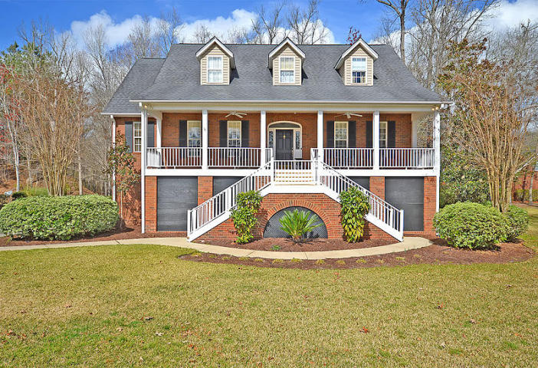
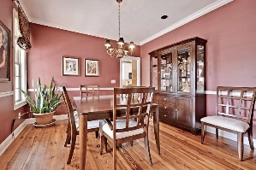
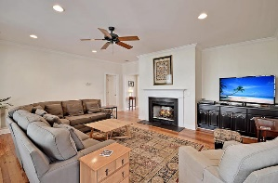
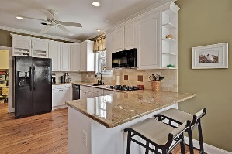
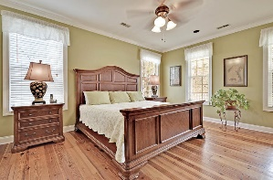
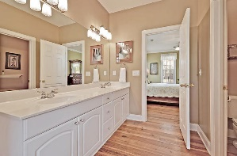
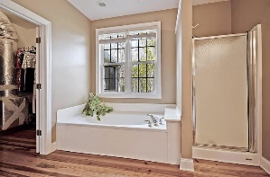
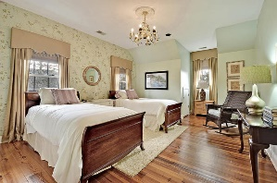
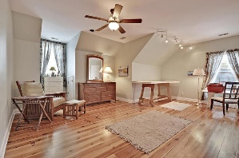
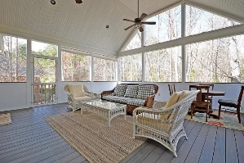
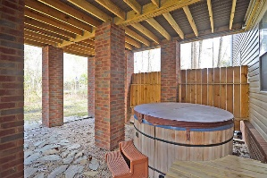
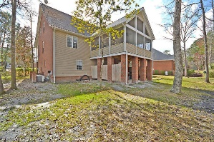



Southern Charm in Coosaw Creek!
4245 Wildwood Landing
Coosaw Creek Country Club
North Charleston, SC 29420
MLS# 16006634
$399,900
4 Bedrooms | 3½ Baths | 3,270 sf
Lowcountry living at is best! This home has so much to offer! Curb appeal galore, this southern charmer has you intrigued from the moment you pull in the driveway! Start off by noticing the great double staircase that leads to the full front porch, which offers ceilings fans for hot days. Upon entering, you'll immediately notice the wood flooring throughout. The dining room will be to your left, plenty of room for entertaining. The family room offers a gas fireplace and large windows overlooking the HUGE screened in porch. This 20'X22' porch (a $50K addition) overlooks a private, wooded backyard and has 15 foot ceilings. Great for entertaining! The kitchen has gorgeous granite counter tops, oversized sink, double ovens, desk space, built in wine rack, ample cabinet space and large pantry. Off the kitchen, you'll find even more storage space as well as the laundry room. Also, on the main floor, you'll find the master bedroom. This large bedroom offers wood floors, walk in closet, dual vanity, shower and separate jetted tub. Upstairs, you'll find two more spacious bedrooms, both offering large closets, plenty of storage space in the attic (you'll never have to worry about storage in this home) and a full bath that has a dressing area and separate vanity area. Downstairs buyers will find a large finished ground floor which has so many possibilities! This huge living space can be a billiard room, game room, downstairs family room... There's also a bedroom and full bathroom! Downstairs is perfect for a guest, older child or mother in law suite. Need extra garage space? This garage has storage galore! Underneath the entire length of the front porch, you'll find lots of space to store all your extras. Out back, you'll find a great hot tub area, wooded, private backyard. Coosaw Creek is a gorgeous gated golf course community conveniently located near the airport, Boeing, Mercedes, AFB. Drive to work close by, then come home to great country club living!
Larry & Kathy Mazalatis
Larry Cell 843-693-0529
Kathy Cell 843-693-0159
Office 843-871-9133
AGENTOWNED PREMIERE GROUP | 1800 TROLLEY RD | SUMMERVILLE, SC 29485

