Slide 1
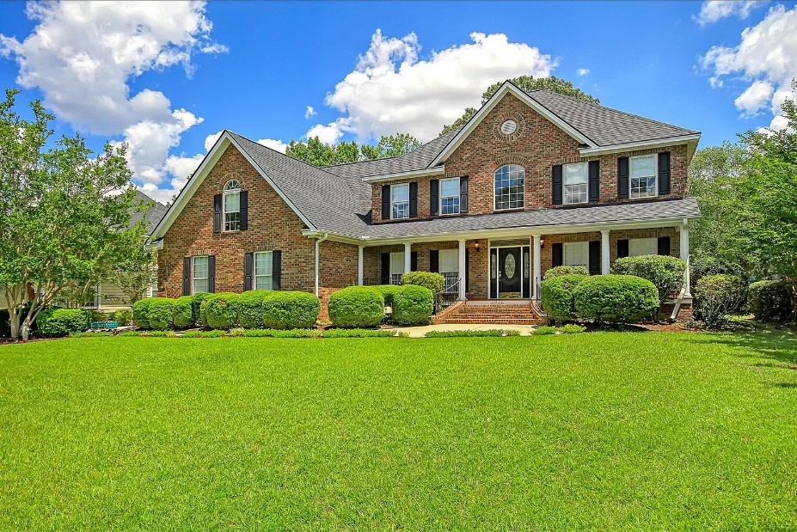
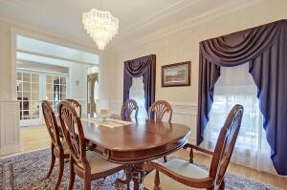
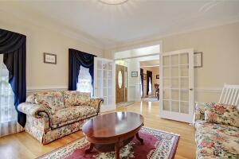
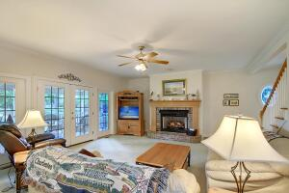
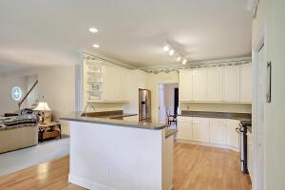
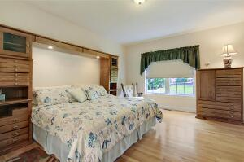
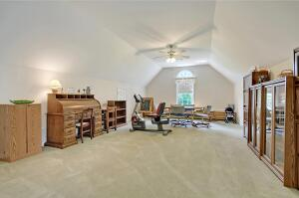
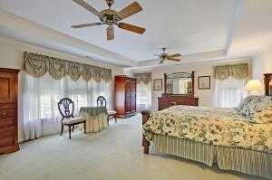
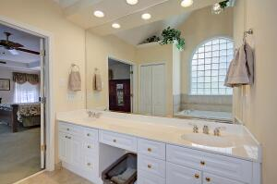
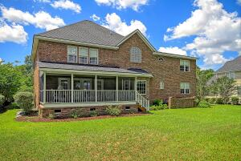
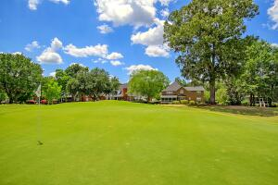
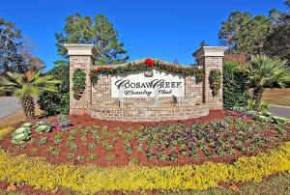
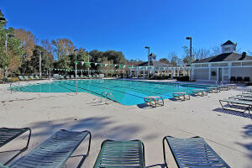
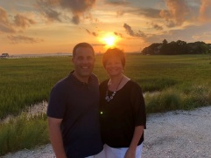

Coosaw Creek Beauty on Golf Course!
4246 Club Course Drive
Coosaw Creek Country Club
North Charleston, SC 29420
MLS# 22014448
$769,000
5 Bedrooms | 3½ Baths | 4,346 sf
Welcome home to 4246 Club Course Dr in the beautiful gated golf course community of Coosaw Creek! This home is exactly what you've been waiting for! And it's on the golf course! Walking in to this custom built home from the full front porch, you have a formal living/office to your right with french doors and transom window above. To your left is the dining room with extensive trim work and a great size for entertaining. The dining room leads right in to the kitchen. The kitchen offers a gas range and ample cabinetry. The kitchen overlooks the eat in kitchen and living room which has french doors out to the huge screened in porch! Great golf course views! Laundry and access to the three car garage are also on the first floor!
Off of the kitchen you'll find a first floor bedroom with a full bath in the hall. This would make a great mother in law suite! Heading upstairs, you'll find a huge master bedroom suite, master bath with separate tub and shower and large walk in closet. There are three more large bedrooms upstairs and another full bath. Also upstairs, a large FROG that can be used as a media room, workout room, toy room...you name it! Built in window seats with storage, a wet bar area with sink. This home is a must see! Dorchester District 2 schools, a short drive to Bosch, Boeing, Mercedes and the airport, Coosaw Creek has so much to offer! Unlimited golf green fees for all household members, tennis courts, basketball courts, pickle call courts, playground and a super active Club with tons of special events, restaurant and clubs.
Larry & Kathy Mazalatis
Larry Cell 843-693-0529
Kathy Cell 843-693-0159
Office 843-871-9133
AGENTOWNED PREMIERE GROUP | 1800 TROLLEY RD | SUMMERVILLE, SC 29485

