Slide 1
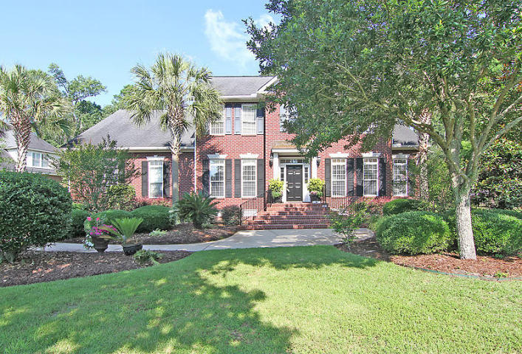
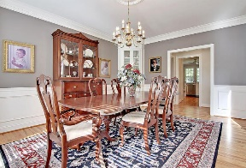
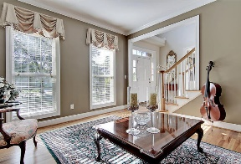
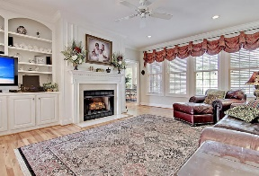
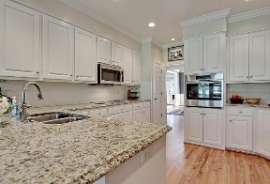
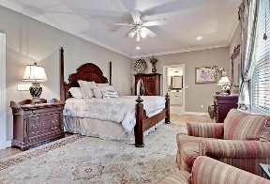
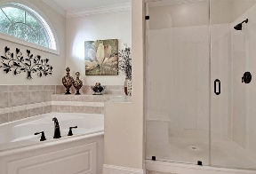
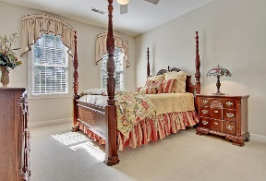
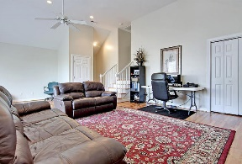
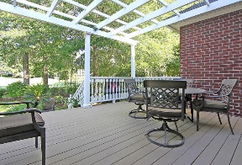
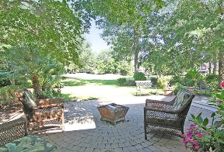
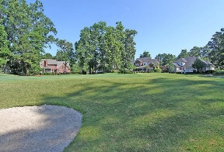
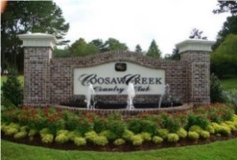


Golf Course Beauty in Gated Community!
4247 Club Course Drive
Coosaw Creek Country Club
North Charleston, SC 29420
MLS# 16014575
$532,000
5 Bedrooms | 3½ Baths | 4,527 sf
This beautiful, brick, custom built home offers 4,500+ Sq. Ft., 5BR, 3.5BA and sits on a great golf course lot! The kitchen offers granite counter tops and a large eat-in-kitchen area overlooking the golf course. Downstairs, buyers will find a large dining room, family room with fireplace and custom built-in cabinetry, formal living room, crown molding and a spacious master bedroom. The master bedroom offers a walk-in closet as well as a master bathroom with a large glass shower, dual vanity and a jetted tub. Much of the home has been professionally re-painted recently and many lighting fixtures have been updated as well. Upstairs, buyers will find 3 spacious bedrooms, a large media room or upstairs family room, a bonus room currently used as an office as well as a HUGE FROG which can be a 5th bedroom, playroom, exercise room or practically anything you want! The home features a 3 car garage, lawn irrigation, a back deck and a HUGE stone patio overlooking the large backyard with golf course beyond. Just 30 minutes to downtown Charleston, the all acclaimed Dorchester 2 schools and convenient to shopping, restaurants, Boeing, Mercedes, Air Force Base, and Airport to name a few. This is the life and it is waiting for you!
Coosaw Creek offers an excellent clubhouse with restaurant and bar, neighborhood pool, tennis courts as well as an excellent golf course. Planned events and meals in the very active clubhouse are common and golf members enjoy the numerous monthly golf events offered within this private gated community...
Larry & Kathy Mazalatis
Larry Cell 843-693-0529
Kathy Cell 843-693-0159
Office 843-871-9133
AGENTOWNED PREMIERE GROUP | 1800 TROLLEY RD | SUMMERVILLE, SC 29485

