Slide 1
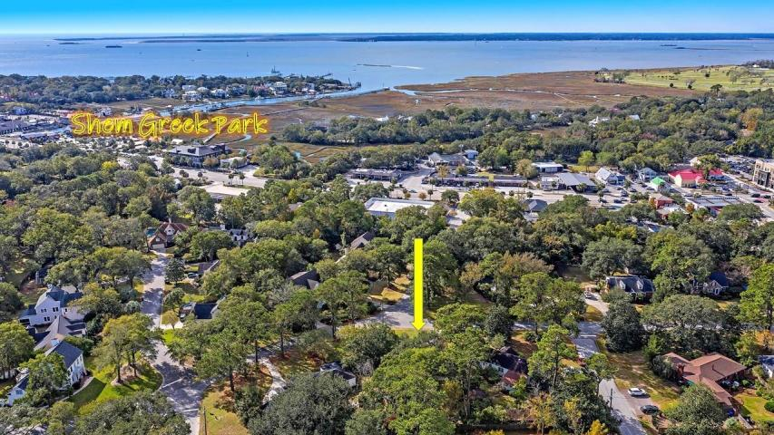

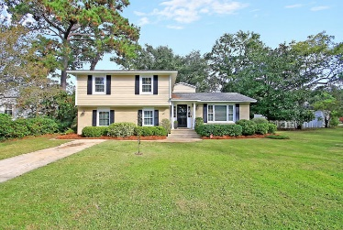
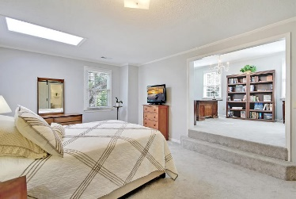
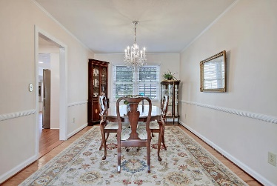
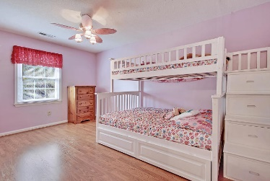
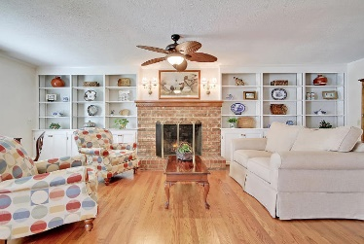
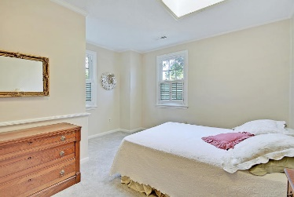
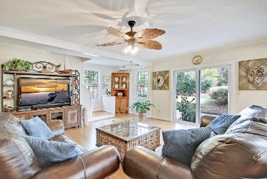
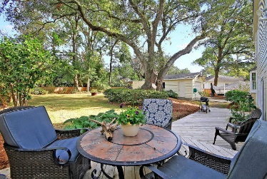
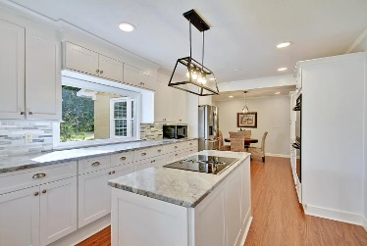
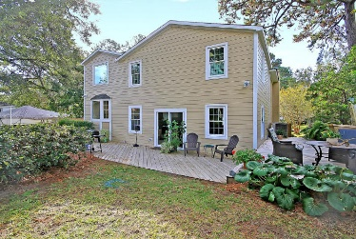
Price Reduced!
Open House
Thursday, Oct 24, 4:30-7:00
Price Reduced!
424 Japonica Road
The Groves ~ Mount Pleasant, SC 29464
MLS# 19031665 ~ $799,000
This sprawling, renovated home that is walking distance to Shem Creek has a fantastic location that is tough to beat! This home boasts a practically new, renovated kitchen, all bathrooms have been beautifully renovated, new hardy plank siding, new gleaming solid oak hardwood floors and all new hurricane rated thermal windows. This floorplan has great natural light and is perfect for entertaining with many spacious rooms to spread out in which spills out into outdoor living on the patio and new side deck. The master suite features a large sitting room/office and a barn door leading to the en-suite bath. The lush backyard has a mature oak as the centerpiece, an irrigation system and a detached one car garage. Take advantage of this desirable established neighborhood so close to the water!
Additional features include:
Off the foyer is a den with built-in shelving on either side of a stately brick fireplace
Large family room overlooking the backyard flows into the bright and airy kitchen and has a second staircase
Spacious, remodeled eat-in kitchen with tile backsplash, white cabinetry, granite countertops, and recessed lighting
Upstairs are 4 bedrooms and a large bonus space
Close to Shem Creek, schools, shopping, dining, and Downtown Charleston
Book your showing today!
True Edwards true@trueedwards.com 843-442-6253

