Slide 1
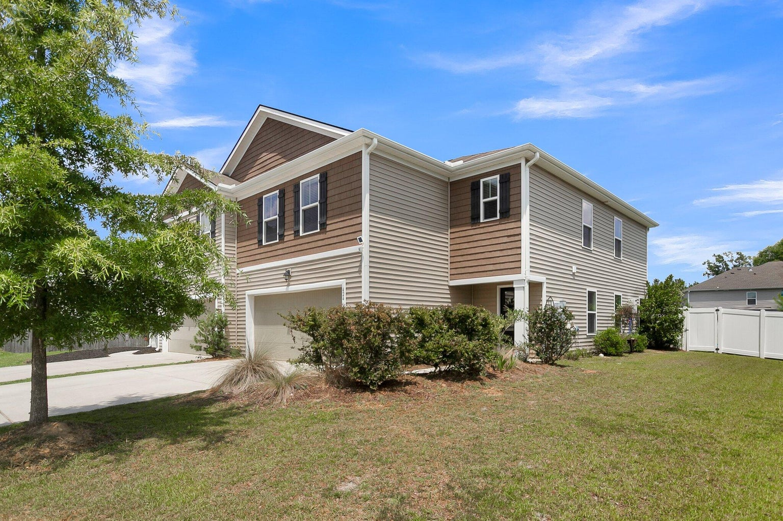
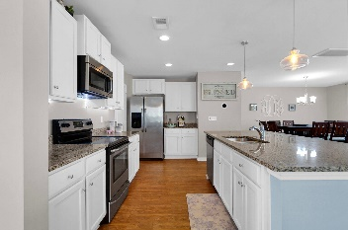
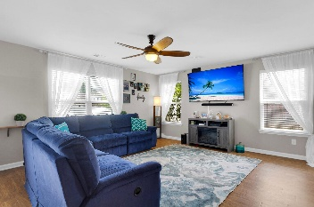
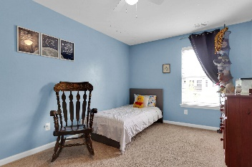
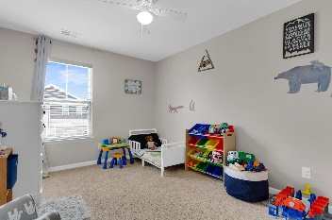
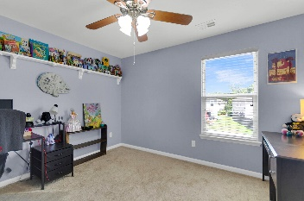
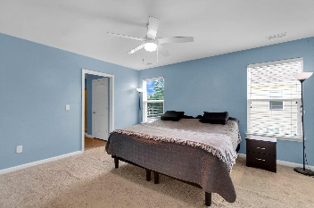
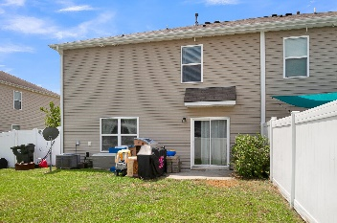
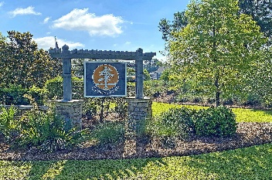

424 Cypress Knees Lane
Cypress Ridge · Moncks Corner, SC 29461
MLS# 24015933 · $325,000
Just Listed Townhouse That Lives Like a House!!
FABULOUS 4 bedroom 2.5 bath townhouse with awesome curb appeal featuring a gourmet kitchen, open floor-plan, loft and 2 car garage with 220 outlet for charging electric vehicles and extra long driveway for additional parking! Upon entering the beautiful home your are greeted with smooth ceilings, dazzling floors, and an abundance of natural light. The chef-inspired gourmet kitchen has a large island with breakfast bar, stunning granite counter tops, stainless steel appliances, and plenty of storage including a huge pantry. This flows to the dining area and family room. The family room has bright windows and lots of room for a large sectional couch to spread out and relax. This main level open floor-plan living is perfect for entertaining family and friends.
At the top of the stairs is loft which is ideal for an office, playroom, or 2nd floor living area. The primary bedroom suite boasts sunny windows, a walk-in closet, and a fantastic ensuite full bath with dual vanity and standing shower. The second level has three more spacious bedrooms, all with great closet space that share a full bath! The backyard is large, fenced-in, with a patio! The fence is vinyl which means an easy upkeep! This is the quintessential yard for kids, pets, grilling and entertaining! Located in charming Cypress Ridge neighborhood that features a pool, clubhouse, play park, exercise area, and so much more. You will be close to schools, shopping, restaurants, and just a quick trip to Summerville and a short drive to the airport and beaches. Call today, this townhouse will not last.
Stan Huff
843-670-2835
stan.huff@agentowned.com
Jill Marcacci
843-297-5590
jill@agentowned.com
www.agentownedrealty.com
AgentOwned Realty Co. Preferred Group, Inc. | 824 Johnnie Dodds Blvd | Mt Pleasant, SC 29464

