Slide 1
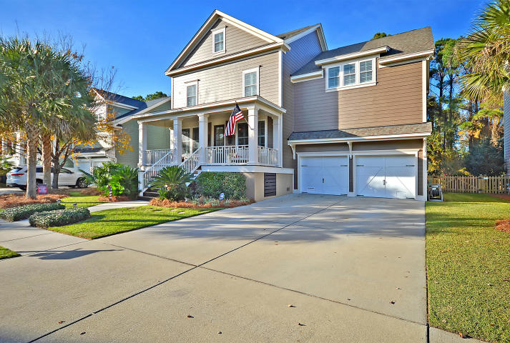
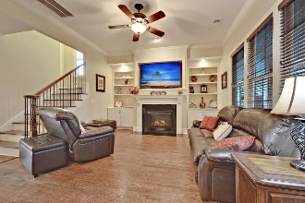
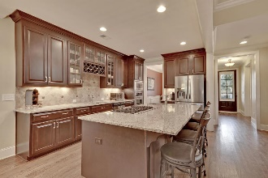
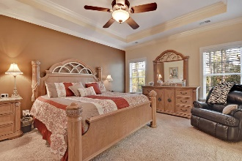
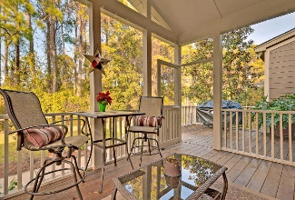
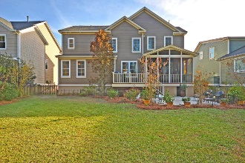


PRICED BELOW RECENT APPRAISAL!!!
$15,000 Agent Bonus
with ratified contract by 4/15/18
4253 Coolidge Street
Hamlin Plantation
Mount Pleasant
MLS# 18031970
$696,150
Welcome to 4253 Coolidge! Upon entering your home from your spacious front porch, you are greeted with a hardwood flooring along with an office and formal dining room. Continuing down the hall, you flow into a large open floor plan including an inviting living room (with gas fireplace), massive kitchen with an island, and an everyday eating area. The downstairs also offers a guest suite and full bath. Up the wooden stairs on the second floor you have a loft/media room, three guest bedrooms along with two full baths, a laundry room, and the master suite! In the spacious master suite are his and hers closets, a tremendous ensuite with his and hers sinks, soaking tub, and a tiled shower! On the third floor is another guest bedroom and ensuite.
The home also offers a luxury backyard including a screened-in porch, an uncovered grilling porch, a patio and a fully fenced in yard! The owners have taken meticulous care of the home and have done many upgrades:
Foam insulation
Painted exterior of the home in April 2018
New sod in May of 2018
Painted some interior walls in April 2018
Added plantation shutters
Storage available under both front and rear porches
Full storage system in garage
Utility sink in the laundry room
Added pocket doors
Multiple TV outlets in every bedroom
Under stair storage
Storage on third floor/attic
Added cabinets on the island
Under cabinet lighting
Schedule your preview before this home is gone!
Mason Thurber
(843) 709-5109 – C (843) 576-2699 – O
mason@theeverettgroup.net
RE/MAX Pro Realty, 9209 University Blvd, Charleston, SC 29406

