Slide 1
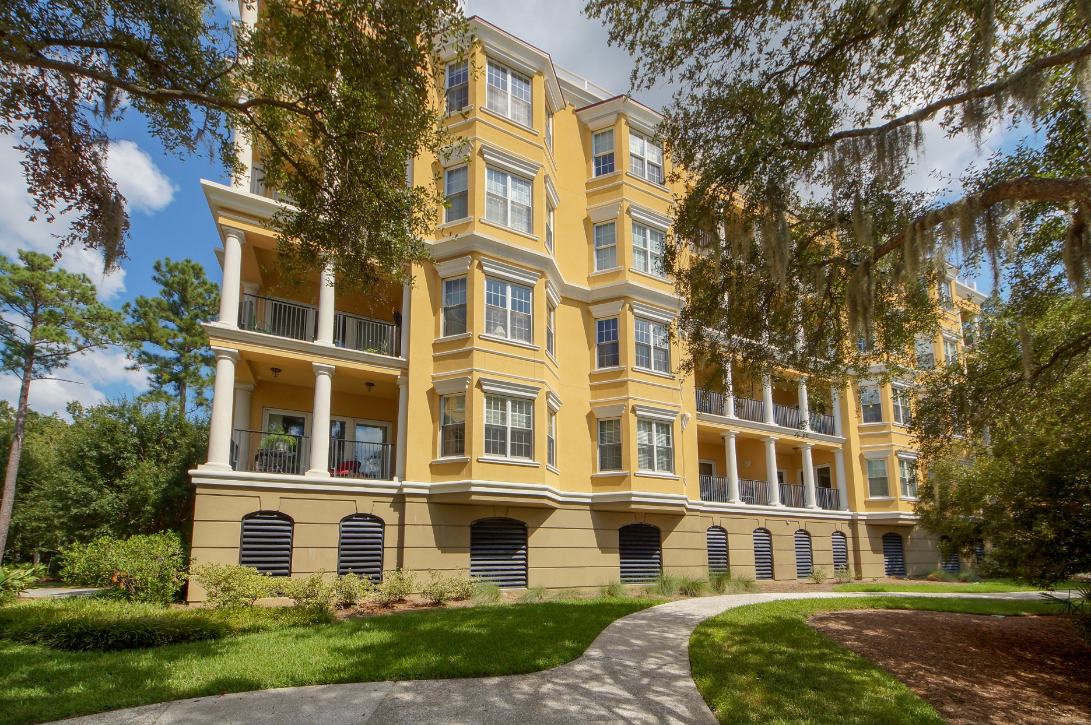
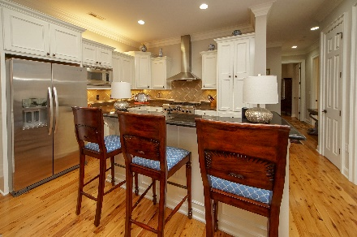
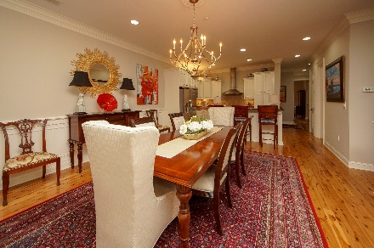
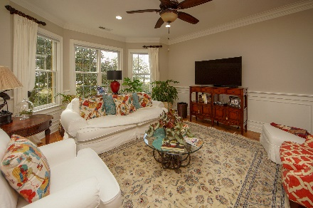
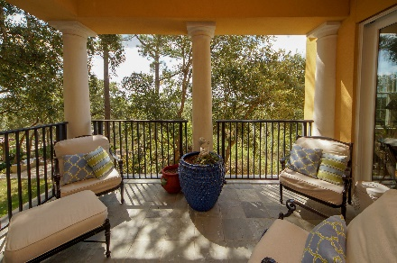
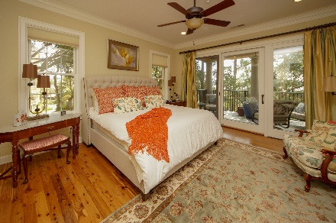
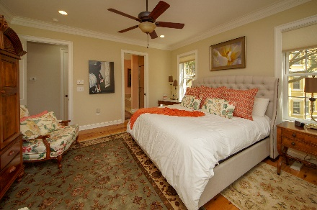
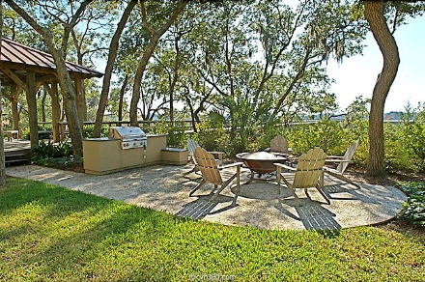
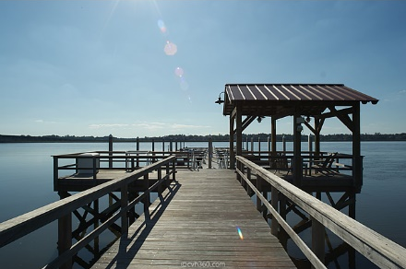


Luxury Living on the Ashley River
4254 Faber Place Drive #3201 Reverie On The Ashley | N Charleston | MLS# 18026778 | $548,500
Elegant and luxurious 3 BR/2BA condo on deep waterfront of the Ashley River. Beautiful views from inside and out! It has the feeling of a tree house from inside. Beautiful Australian Cypress wood floors throughout except baths with ceramic tile. Large Master BR on one side for privacy has luxury bathroom and huge walk in closet that has been professionally outfitted from end to end with wood shelving, hanging bars and even a dresser with granite top. Jetted soaking tub in the Bath as well as a large shower. Double vanity with a great storage tower between. Pocket door leads to the bath and closet. Master bedroom has beautiful views from the large sliding doors that lead to the spacious deck outside. There is also access to the Living Room from the deck.
Lovely Living Room open to the Dining Room with views of the trees and river. High smooth ceiling and large windows to let the sun come in. Neutral paints that have been recently done. New granite on the island in the kitchen. Kitchen is a chef's dream. 6-Burner gas range, built in microwave, dishwasher and fridge in stainless steel. Beautiful backsplash and crushed quartz counters. Tons of cabinet space!
Two additional bedrooms are roomy and have a bath to share. Bedroom 3 that the seller was using for an office, has two custom built book shelves that were just recently installed.
Laundry Room near the kitchen for convenience with cabinets and an extra storage area. Existing window blinds to convey. Sprinkler system in place.
New HVAC in 2014. New Hot Water Heater in 2018. Nothing to do but move in! If furniture is needed, the sellers will consider leaving that too!
~~Make your appointment today to see this lovely home!~~
Susan Weeks
(843) 813-0495
susanweeksdesign@gmail.com
www.agentownedrealty.com
AgentOwned Charleston Group
902 Savannah Hwy
Charleston, SC 29407-7802

