Slide 1
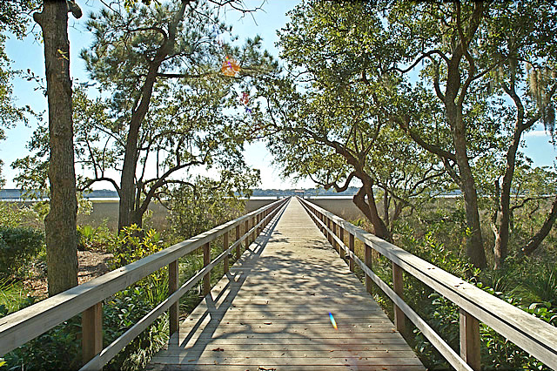
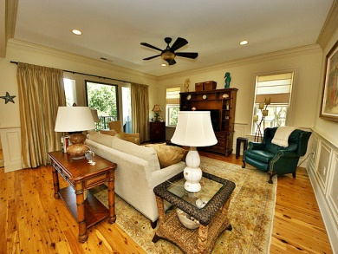
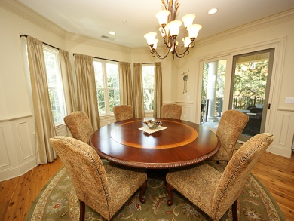
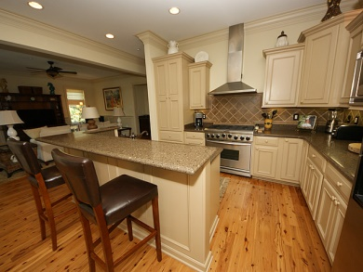
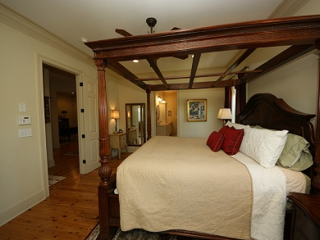
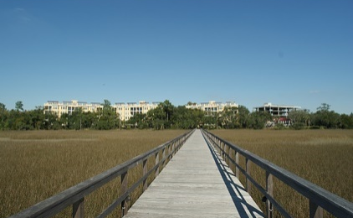
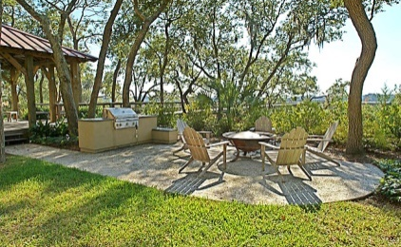
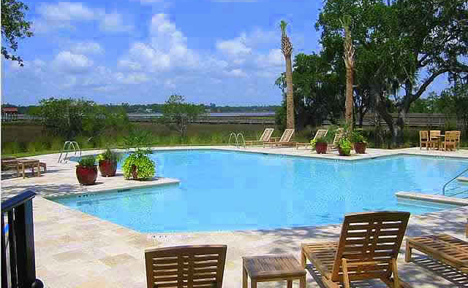
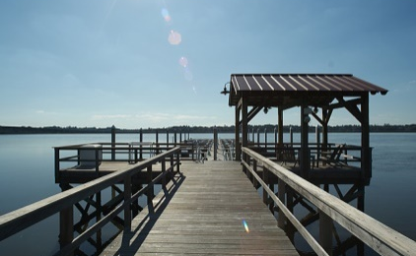


$2,500 BUYER'S AGENT BONUS!!!
4255 Faber Place Drive #4304 ~ Reverie On The Ashley
North Charleston, SC 29405 | MLS# 1422739 | $545,000
Beautifully elegant waterfront condo on the scenic Ashley River with spectacular views of the surrounding marsh and waterway. This is a corner unit with views of the waterways from this third floor retreat. AMAZING sunsets to be enjoyed from your veranda in the evenings. This condo includes all the luxuries one would expect including an all stainless gourmet kitchen with a six top burner stove, quartz counter tops, 10'ceilings, slate tiled balcony, high end faucets and shower heads, 8 foot solid core doors, terrazzo tile in the bathrooms and laundry room, Brazilian Cypress hardwood flooring, beautiful moldings and countless other luxuries.....Not only that, this unit comes almost completely furnished! There is an attached list of the lovely pieces that can convey to the new owner. Amenities at Reverie on The Ashley include walking trails, pool with cabana, a large multi-slip pier style dock, fire pit with grills, garage parking, ELEVATOR. The monthly HOA covers: exterior maintenance, landscaping, exterior homeowners insurance, water, security system, phone, broadband internet, 165 Direct TV satellite channels, it does not include (gas, electricity and contents insurance) This condo is conveniently located close to Boeing and the Charleston International Airport as well as downtown Charleston and the beaches.
Susan Weeks
(843) 813-0495
susanweeksdesign@gmail.com
www.agentownedrealty.com
AgentOwned Charleston Group
902 Savannah Hwy
Charleston, SC 29407-7802

