Slide 1
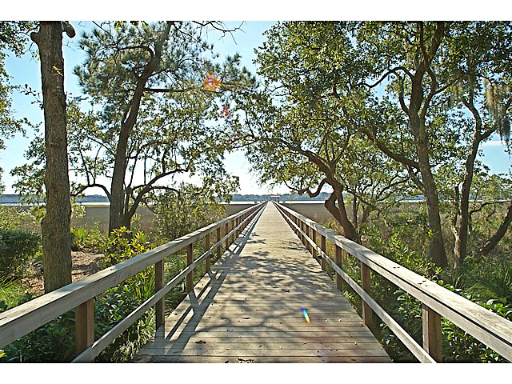
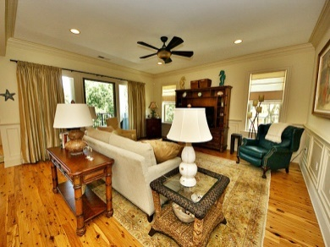
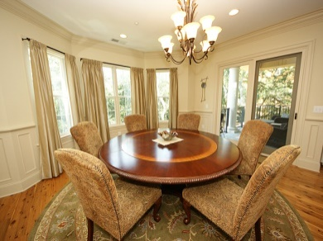
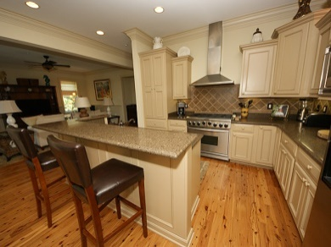
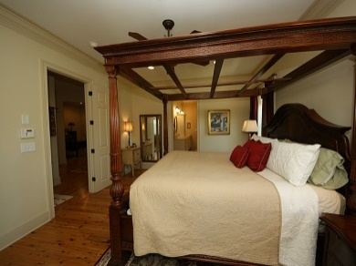
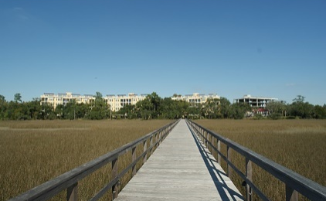
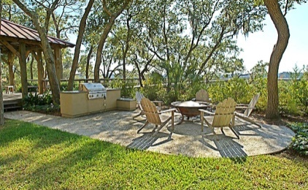
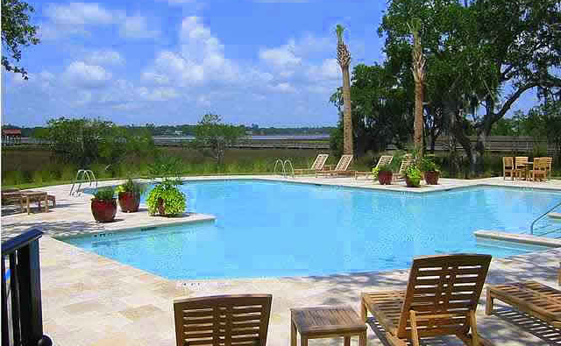
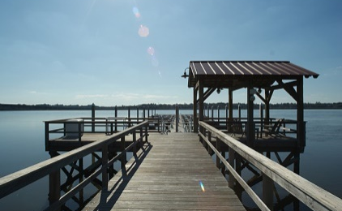


$5,000 BUYER'S AGENT BONUS!!!
4255 Faber Place Drive #4304 ~ Reverie On The Ashley
North Charleston, SC 29405 | MLS# 1422739 | Reduced to $539,000
Beautifully elegant waterfront condo on the scenic Ashley River with spectacular views of the surrounding marsh and waterway. This is a corner unit with views of the waterways from this third floor retreat. AMAZING sunsets to be enjoyed from your veranda in the evenings. This condo includes all the luxuries one would expect including an all stainless gourmet kitchen with a six top burner stove, quartz counter tops, 10'ceilings, slate tiled balcony, high end faucets and shower heads, 8 foot solid core doors, terrazzo tile in the bathrooms and laundry room, Brazilian Cypress hardwood flooring, beautiful moldings and countless other luxuries.....Not only that, this unit comes almost completely furnished.
Susan Weeks
(843) 813-0495
susanweeksdesign@gmail.com
www.agentownedrealty.com
AgentOwned Charleston Group
902 Savannah Hwy
Charleston, SC 29407-7802

