Slide 1


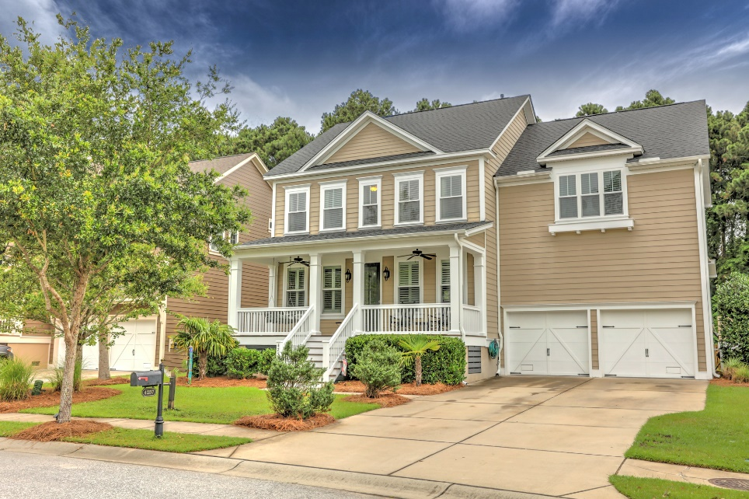
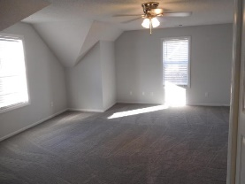
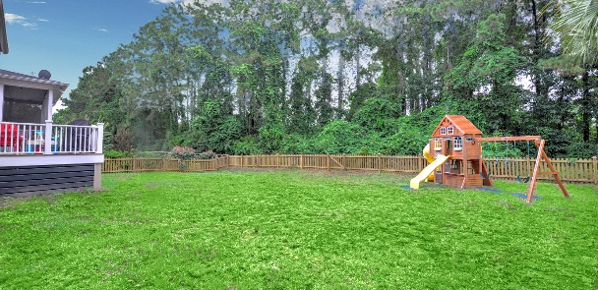
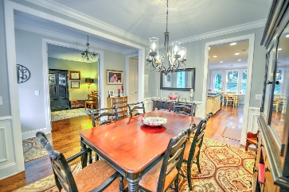
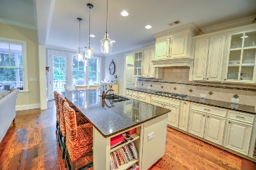
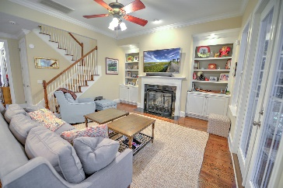
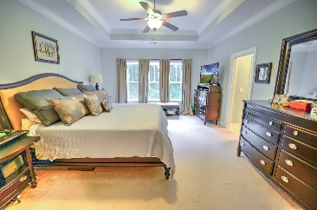
Kim Katich
(843) 754-8060
kimsellschs@gmail.com
Beautiful Home
In Hamlin Plantation
4257 Coolidge Street
Hamlin Plantation
Mount Pleasant, SC 29466
MLS# 19015444
$670,000
Welcome to this wonderful open floor plan 4 bedroom, 4 bathroom residence in the Waverly subsection of Hamlin Plantation. The home has 3,222 sqft of living space, plus an attached 2 car garage with extra storage added that is accessible via stairs. The kitchen is a chef's delight with granite counter-tops, a large island, a gas range and is equipped with double ovens. The first level open concept is perfect for entertaining. There is an eat-in breakfast area, family room, formal dining, and office space/study in the main living area all with hardwood flooring. A bedroom or guest suite resides on the first level with a full bath. French doors in the family room open to a large screened in porch and a grill deck. The backyard is surrounded by a beautiful buffer area that provides plenty of privacy. The backyard is sizable enough to create or build an outdoor living area and the playground can convey with the purchase. A unique feature of this property is the size of the bedrooms on the second floor. The home offers 3 over-sized bedrooms on the second level plus a bonus room/media room. The spacious Master Suite is equipped with amazing views of the buffer area, tray ceiling, dual closets, and a spectacular en-suite bathroom. The master bath boasts a large Jacuzzi tub, subway tiled shower, and dual vanities. Both guestrooms upstairs have en-suite bathrooms and the size of these two rooms is best conveyed in person as pictures cannot do these rooms justice. The laundry room is conveniently located on the second floor. The bonus room on the second floor is an ideal playroom/media room or can serve as another option for guests. The added garage storage is perfect for keeping holiday decorations, beach toys and any other items readily available. There are so many options with this wonderful home and it has truly been well maintained as you will see during your visit. The crawlspace has been screened off, sealed and pipes insulated. The Hunter Pro-C irrigation system is fully functional. The backside of the house has added glass doors and windows to take advantage of the wooded buffer area. Added to the house since last purchased includes: gutters and gutter guards, plantation shutters and custom fit blinds, new lighting in kitchen, storage in garage, painted entire exterior trim, and painted 4 rooms and 3 bathrooms. The home is move-in ready and zoned for amazing schools. Cannot say enough great things about the home, Hamlin Plantation neighborhood and amenities, the quiet street where the home is located and the amazing neighbors that live here.
Real Estate Advocates LC
7613 Hwy 544 | Myrtle Beach, SC 29588
www.realestateadvocates.com

