Slide 1
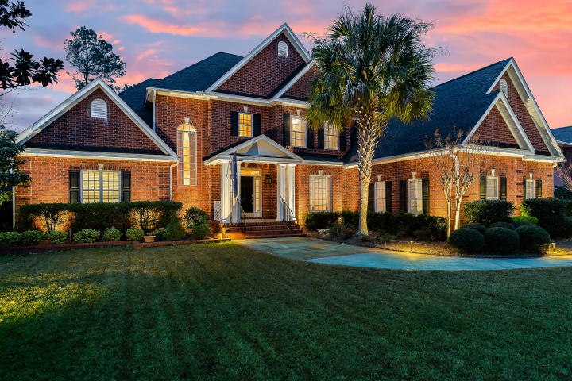
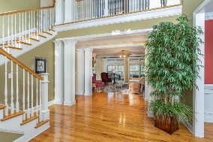
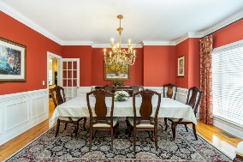
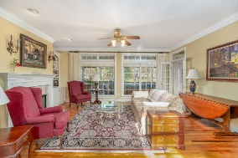
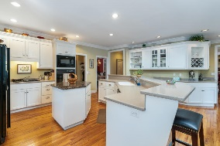
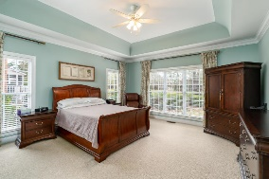
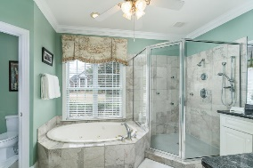
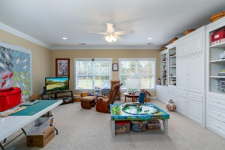
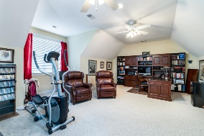
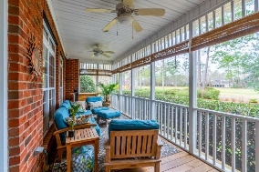
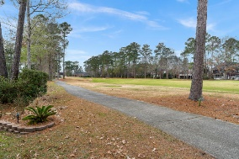
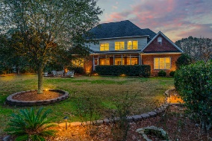



Gated Golf Course Community Stunner!
4259 Club Course Drive
Coosaw Creek Country Club
North Charleston, SC 29420
MLS# 20001936
$599,000
4 Bedrooms | 3½ Baths | 4,406 sf
Elegance galore in this golf course home located in the gated community of Coosaw Creek! Upon arriving at this home, you'll immediately notice the well appointed landscaping and three car garage. The grand two story foyer offers tons of natural light. To your right is the large dining room, perfect for entertaining. Straight ahead is the formal living room with built ins, gas fireplace and golf course views! The kitchen is a cooks delight! Large island with breakfast bar, eat in kitchen area, keeping room, large pantry and wet bar. Off the kitchen is a large laundry room offering even more cabinet space and storage. This home has both a large screened in porch as well as a smaller grilling porch both off the kitchen. On the other side of the house is the first floor master suite.
The master suite offers a tray ceiling, multiple closets, dual vanities, oversized shower and separate tub. Head upstairs and you'll find a huge walk in attic, perfect to store it all! Then down the hall is a great media/game room. This room offers an entire wall of built ins and surround sound. Three more bedrooms, one with its own full bath, all having large closets. There is also another full bath in the hall. At the end of the hall is a huge FROG which could be a fifth bedroom if needed! It also has some attic storage off of it. This home has it all and is a must see! The neighborhood has 24 hour 7 day a week gated security, unlimited golf for all household members, and the location, wow...close to it all! Boeing, Bosch, AFB, Mercedes are all a short drive away. Come live the good life in a golf course community that has tons of activities and events, great food in the restaurant, great community pool with an award winning swim team, tennis courts, basketball courts, playground and the most beautiful golf course you'll ever play on!
Larry & Kathy Mazalatis
Larry Cell 843-693-0529
Kathy Cell 843-693-0159
Office 843-871-9133
AGENTOWNED PREMIERE GROUP | 1800 TROLLEY RD | SUMMERVILLE, SC 29485

