Slide 1
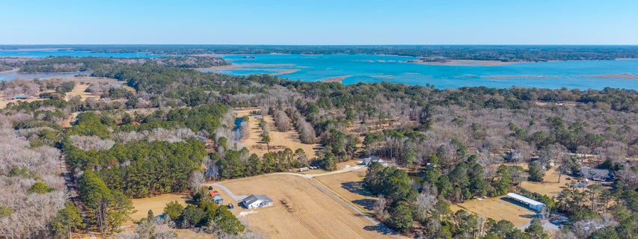
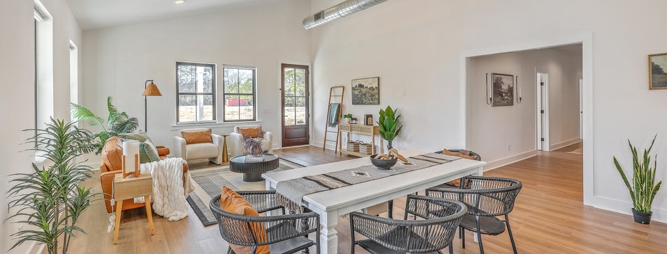
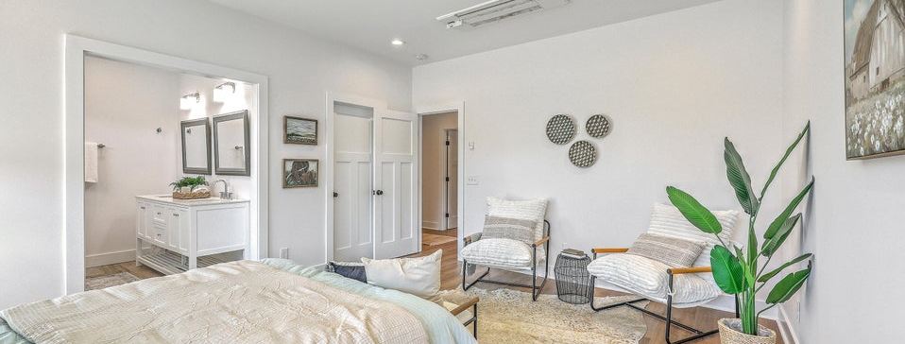

New Price for 5+ Acres - $25k Price Reduction
JUS
9714 ROSEBERRY STREE
MOTIVATED SELLER!
/
7
1/
ii
Get away from the hustle and bustle and stretch out in this better-than-new custom-built home, completed in 2021 and barely lived in by the original owner.
4260 Flat Dutch Court
Meggett, SC 29449 | MLS# 26003760 | $749,900
�
$749,000
4 BED
2.5 BATH
2,028 SQ FT
5.39 ACRES
Set on 5.39 acres of fully cleared land, this private property is tucked away off a quiet road with minimal neighbors, offering peace, privacy, and room to grow, yet still just approximately 45 minutes to Downtown Charleston. No HOA. This thoughtfully designed one-level home features 4 bedrooms and 2.5 bathrooms, over 2000 sf, with tall ceilings and an open-concept layout ideal for everyday living and entertaining. The kitchen opens seamlessly to the main living area and offers white cabinetry, stainless steel appliances, and generous workspace. Easy accessibility throughout the home with no stairs makes this home comfortable and functional for all stages of life. Enjoy morning sunrises and evening sunsets from the wrap-around porch, the perfect spot for a rocking chair and quiet Lowcountry evenings surrounded by nature. Watch deer and turkeys roam while soaking in the peaceful setting. Built with energy efficiency in mind, the home features spray-foamed attic roofline, spray-on vapor barrier, Mitsubishi HVAC systems with a dedicated unit for the primary suite, tankless water heater, 250-gallon underground propane tank, and a new reverse osmosis whole-home water filtration system. Utility bills have never exceeded $100/month. Additional highlights include brand-new LVP flooring, fresh interior paint throughout (including trim and doors), walk-in closets in all bedrooms, and a heated and cooled stand-up attic offering excellent storage or future flexibility. Fiber-optic internet available. The land offers endless possibilities, ideal for horses, livestock, a small farm, or homestead living, with plenty of room for boats, RVs, trailers, and toys. Storage containers convey and provide convenient on-site storage, and the property allows for additional structures such as barns, garages, workshops, or even another home. The property can be subdivided, offering future flexibility or investment potential. A rare opportunity to own a custom, move-in-ready home with acreage, privacy, and modern systems in a quiet Meggett setting offering true country living without sacrificing access to Charleston.
Scott Baskin
THE SCOTT BASKIN TEAM
843-324-4139
scott@explorecharlestonrealestate.com
SCOTT BASKIN TEAM

