Slide 1
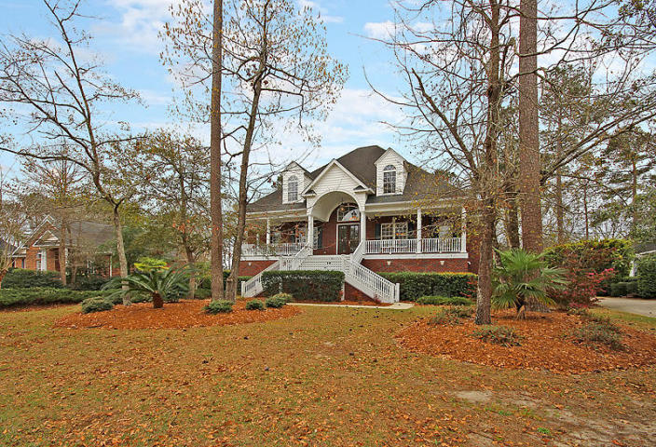
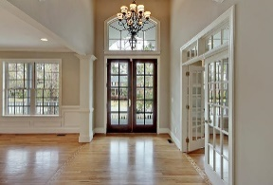
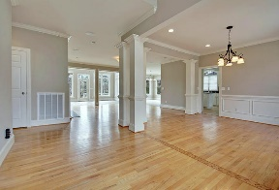
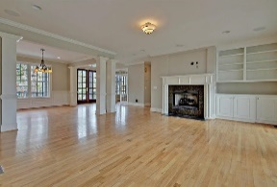
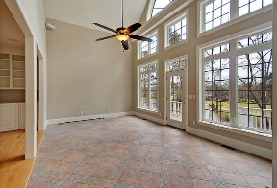
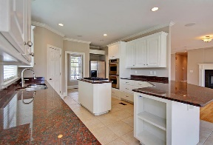
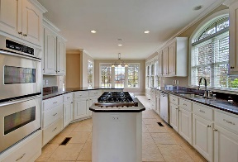
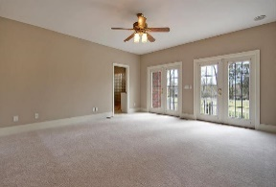
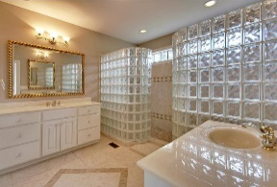
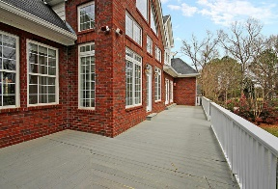
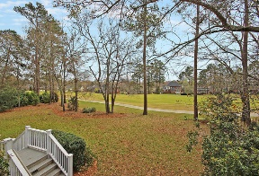
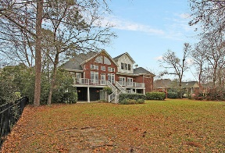



Six Bedroom Home on Golf Course
4266 Club Course Drive
Coosaw Creek Country Club
North Charleston, SC 29420
MLS# 17006578
$698,000
6 Bedrooms | 5½ Baths | 5,357 sf
Stunning executive home located on the golf course in the lovely gated community of Coosaw Creek Country Club! This home is a must see with three full stories of living space including a ground floor mother-in-law suite and huge three car garage! Curb appeal galore, you’ll immediately be drawn to the huge front porch and welcoming dual staircase. Upon entering, you’ll immediately notice the open floor plan, gorgeous wood floors and tons of natural light. On the main floor you’ll find a large office or formal living room with built in shelving. A large dining room is open to the family room. Perfect for entertaining.! In the family room, enjoy the gas fireplace, built in shelves and cabinetry. Off the family room is a gorgeous sun room overlooking the golf course. The kitchen is a chef's delight, with a gas cooktop, double oven, large pantry, breakfast bar and eat in kitchen area. Off the kitchen is a large laundry room with a pet bath! No more worrying about lifting your dog in to a tub, this pet bath is conveniently located right in your laundry room! Also on the main floor, is a bedroom with a full bath. Then down the hall you will find the master suite. French doors off the master lead to the back porch with stunning golf course views. The master bath is amazing! Dual vanities, a bidet in the water closet, large walk in closet and a double master shower with body sprays and shower heads on each end of the shower!! Head upstairs and you find an awesome bonus room with built in shelving and cabinetry. This room can be a media room, a toy room…the choice is yours! Off of it you'll find a closet and some great attic space for storage. Down the hall is a very large bedroom with its own full bath! Two more very large bathrooms connected by a jack and jill bathroom complete the third floor of the home. Head down to the ground floor and get ready to be even more impressed!! Completely finished ground floor with two huge rooms, a full bathroom and a bedroom with a closet. There is outside access from the ground floor out on to the covered patio. It doesn't end there! Another room perfect for storage or a workout room is also located off the patio area. This room has tons of possibilities! Don't forget to check out the enormous three car garage! You will never have to look for places to store things in this home! The garage has a huge storage area!! This home has it all! Great gated golf course community with unlimited golf for household members, close to Boeing, Bosch, the Air Force Base! This centrally located community is a gem! This house is the wow house you've been waiting for! Come see it today!!
Larry & Kathy Mazalatis
Larry Cell 843-693-0529
Kathy Cell 843-693-0159
Office 843-871-9133
AGENTOWNED PREMIERE GROUP | 1800 TROLLEY RD | SUMMERVILLE, SC 29485

