Slide 1
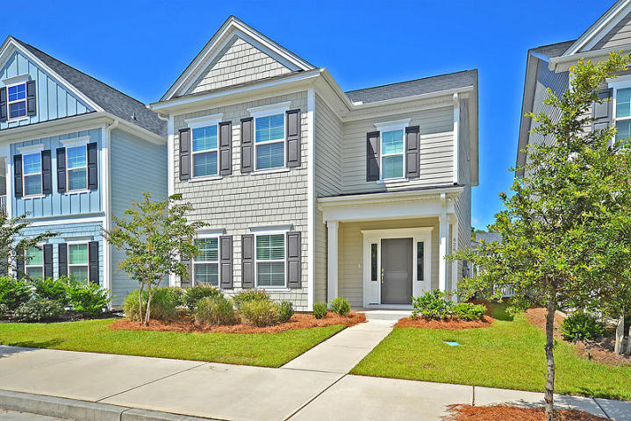
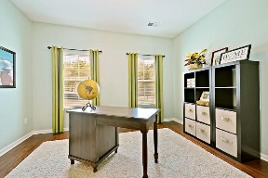
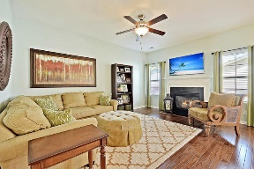
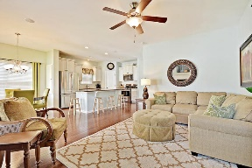
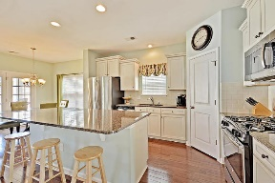
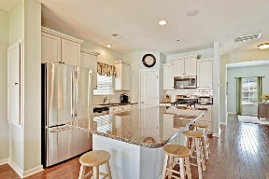
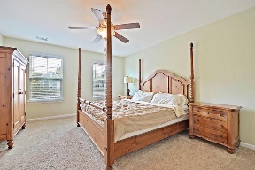
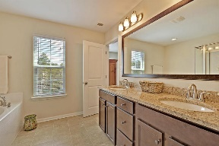
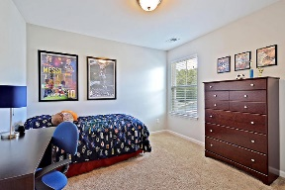
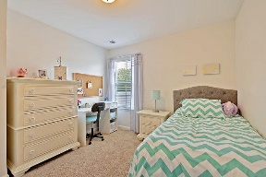
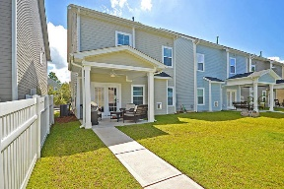
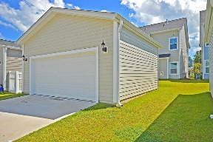


White Gables Cream Puff!
426 Verbena Ave
White Gables
Summerville, SC 29483
MLS# 17024761
$225,000
3 Bedrooms | 2½ Baths | 1,782 sf
Why wait for new construction when you can move right in to this White Gables charmer? Curb appeal galore with this gorgeous home! Upon entering, you'll notice the gorgeous wood floors. To your left is the dining room, which could also be used as a home office if needed! The kitchen is a cook's delight!! Huge island offering extra seating space, large pantry, gas range, gorgeous granite countertops and ample cabinet space. There's also a large eat in kitchen area - all this overlooking the family room. The family room is a great size with a gas fireplace. Upstairs, you'll find a large master bedroom with a gorgeous master bath. Dual vanities, separate tub and shower and large walk in closet. Out in the hall, you'll find the laundry room, which has extra cabinet storage.
Two more good sized bedrooms both with ample closet space are also on the second floor. These two bedrooms share the hall full bath which also has dual sinks. In the backyard, you'll find a covered patio as well as a large detached two car garage. White Gables is a lovely sidewalk lined neighborhood, conveniently located just three miles from downtown Summerville. It has a great community clubhouse, pool, playground, tennis courts and walking trails around the entire neighborhood. Dorchester District 2 schools service this neighborhood. Come see this home today, just a little over a year old, new construction without the wait!!
Larry & Kathy Mazalatis
Larry Cell 843-693-0529
Kathy Cell 843-693-0159
Office 843-871-9133
AGENTOWNED PREMIERE GROUP | 1800 TROLLEY RD | SUMMERVILLE, SC 29485

