Slide 1
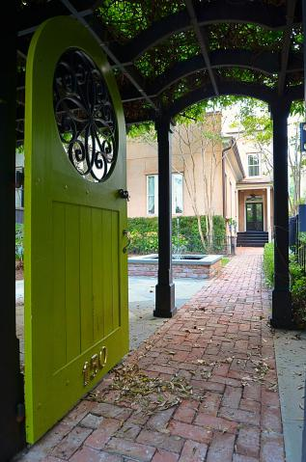
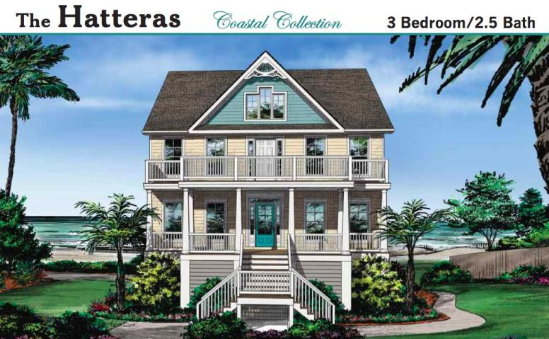
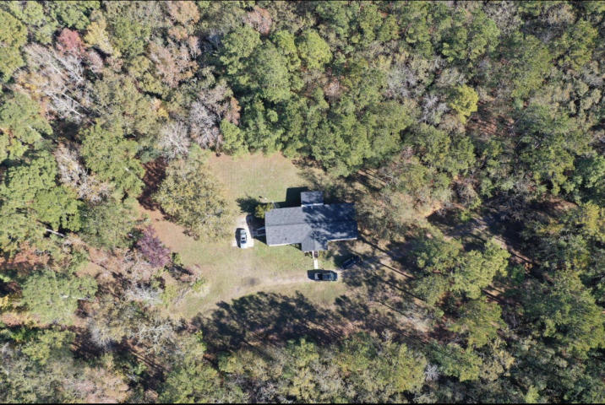
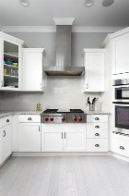

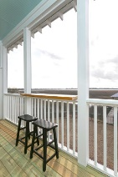
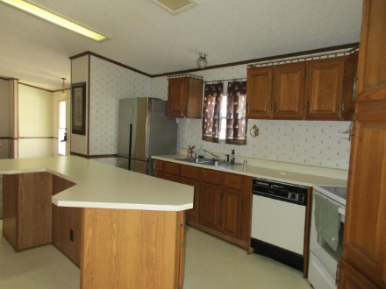
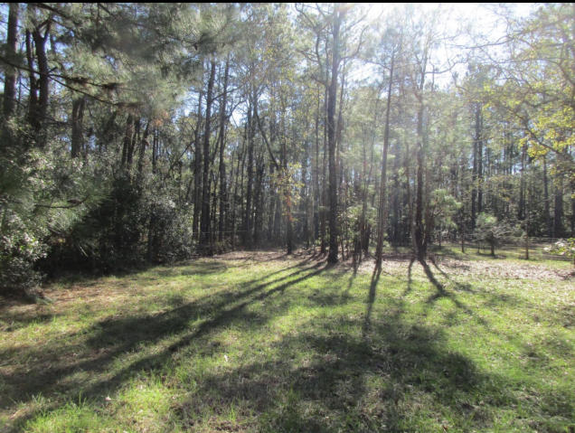
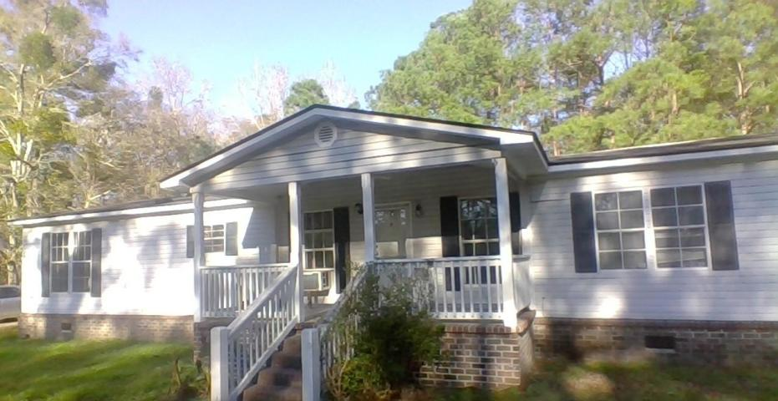
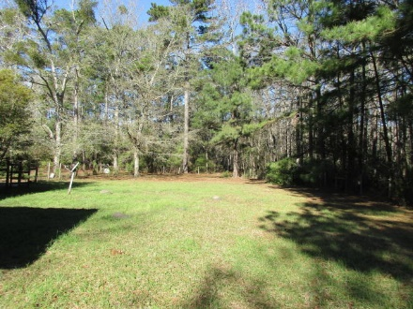
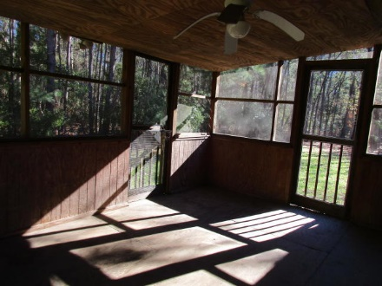



4276 Sebago Road
Quigley Farms ~ Meggett, SC 29449
MLS# 20012121 ~ $194,000
$1,000 Agent Bonus!
Just Listed
+
Open House
Saturday, March 24th 11-1
**PRICE REDUCED**
Schedule your showing today to see this beautiful 4 acre lot located in Quigley Farms in beautiful Meggett. So much potential, quiet and secluded. Bring your horses. There is a manufactured home on a brick foundation that needs some updating but is livable! Could be a great starter home, investment property, or live in while you build your dream home. Please see MLS#: 19034506 for home info. Home is being sold AS IS. This is an estate sale.
Andrew Sorrentino
(843) 371-6218
andrew.sorrentino@agentowned.com
Kelly Rozier
(843) 209-3129
kellywrozier@gmail.com
Brand Name Real Estate
4 Carriage Lane Suite 106
Charleston, SC 29407

