Slide 1
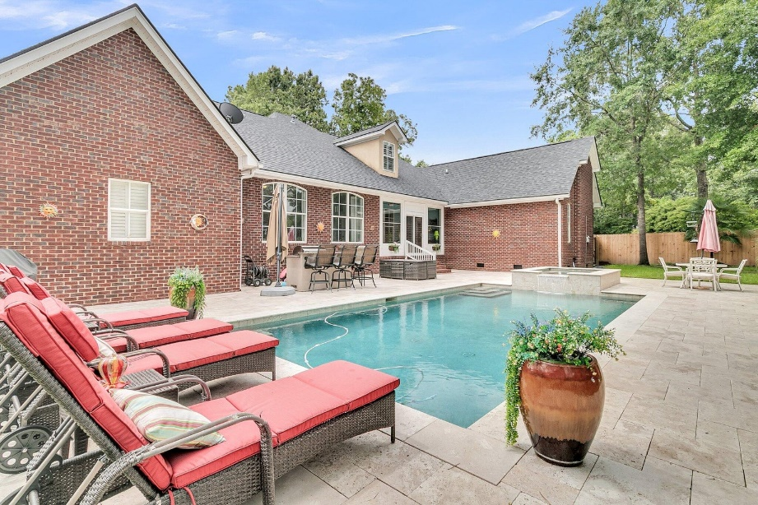
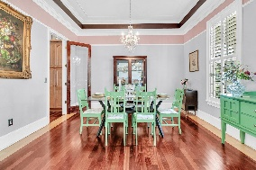
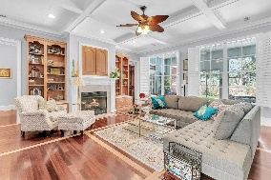
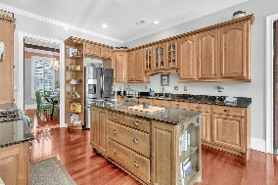
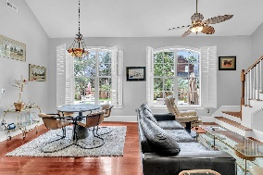
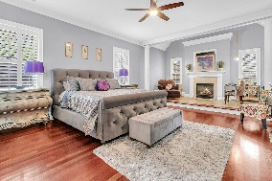
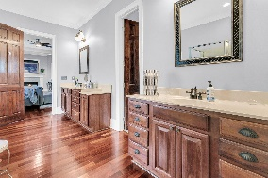
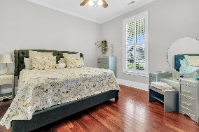
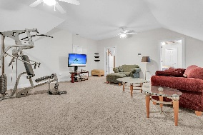
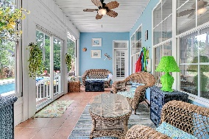
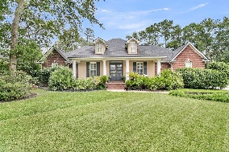
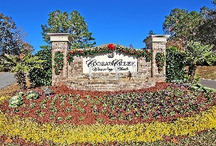
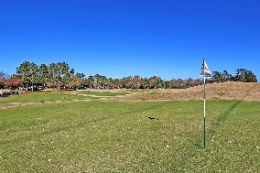
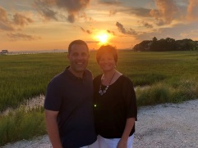

Stunning Home in Coosaw Creek!
4279 Persimmon Woods Drive
Coosaw Creek Country Club
North Charleston, SC 29420
MLS# 24019144
$769,000
4 Bedrooms | 3½ Baths | 3,820 sf
Looking for a wow house? Look no further than 4279 Persimmon Woods Drive! This gorgeous Coosaw Creek Country Club home is ready for you to move in! This home offers you your own piece of paradise and makes coming home feel like you are on vacation! When you first arrive at the home, you'll notice the great curb appeal, large driveway and welcoming front porch. Inside, you enter in to the lovely foyer, which instantly makes you feel at home. You'll then notice the stunning Brazilian cherry flooring with maple inlays, 9ft ceilings and the plantation shutters throughout the home. To your right, is the dining room with extensive molding and a tray ceiling. Continue straight ahead and enter the great room which offers a gas fireplace, coffered ceiling and built in cabinetry. Off the great room is the lovely kitchen which has both an eat in area and a keeping room/seating area. The kitchen has an island, vegetable sink, gas range and beautiful custom cabinetry. Off the kitchen is the large laundry room with a sink, a half bath, garage entry and side entry to the house. Back on the other side of the house are two large bedrooms with ample closet space as well as a full bath in the hall. In the back of the home is the primary bedroom, which is huge and has a seating area with a vaulted ceiling and gas fireplace. The primary also has access off of it to the sunroom. The primary bath has two separate vanities, water closet, a jetted tub, large shower and huge walk in closet. Off of the kitchen is a staircase that leads to what could be a mother in law or teen suite. The suite has a large living room area, a separate bedroom and an updated full bathroom with dual vanities. Upstairs you will also find attic storage. Get ready for the best part, a backyard most people only dream of having! After sitting and relaxing in the sunroom, go take a dive into the stunning salt water pool with attached hot tub and waterfall! This pool is one of the nicest you'll ever see! Let's not forget the outdoor kitchen and bar area that offers a grill, fridge and seating for five at the bar. Large patio area for added seating surrounds the pool as well. An added bonus are all the fruits that grow all around the backyard - lemons, limes, figs, bananas and oranges! It's truly a tropical oasis! But that's not all, this home has a three car garage, room enough for your golf cart! Don't hesitate and miss out on this beautiful home! Living in Coosaw Creek gives you an opportunity to have a golf membership for all of your household members, the security of living in a gated community, pickleball courts, tennis courts, neighborhood pool and playground, access to an active clubhouse and restaurant. So many fun events and activities are always on the calendar which makes it a great way to meet people! This neighborhood is also convenient to the airport, AFB, Bosch and Boeing. Dorchester District Two Schools! Come live the good life!
Larry & Kathy Mazalatis
Larry Cell 843-693-0529
Kathy Cell 843-693-0159
mazteamrealty@gmail.com
AGENTOWNED REALTY | 1800 TROLLEY RD | SUMMERVILLE, SC 29485

