Slide 1
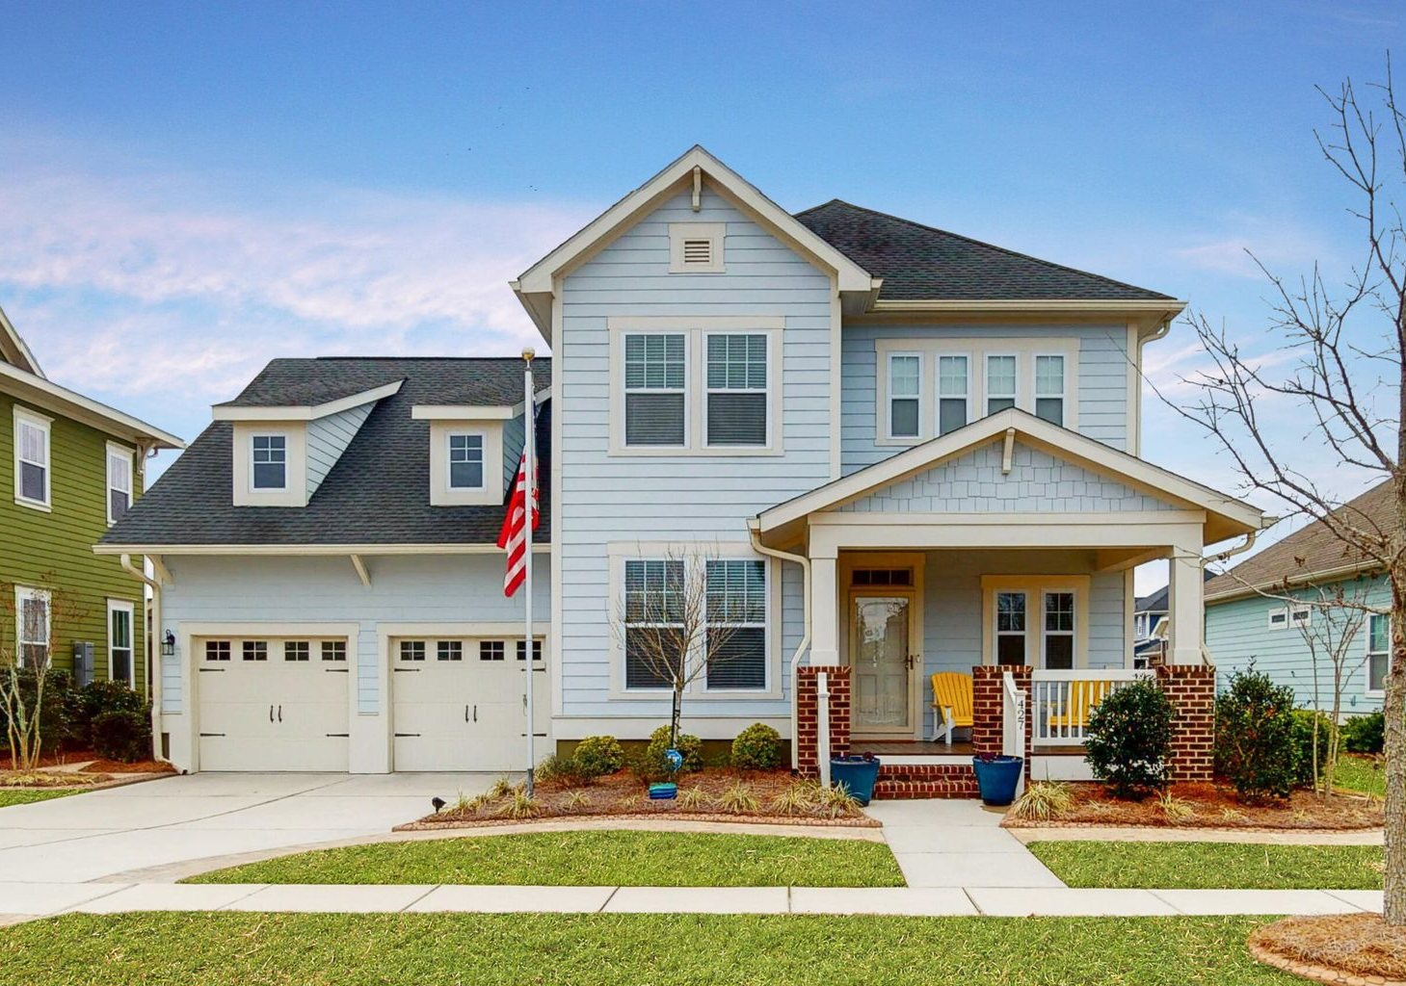

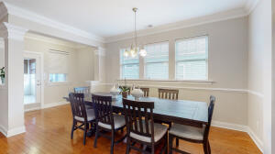
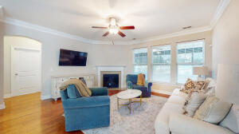
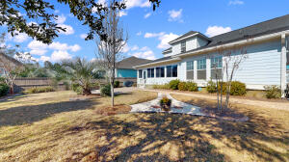
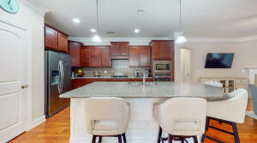

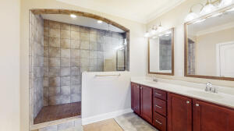
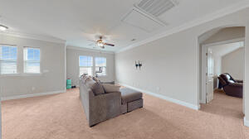
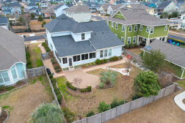


427 Eliston Street
Carnes Crossroads | Summerville, SC 29486 | MLS# 22002326 | $549,900
Come Fall In Love!
Open House
Saturday 12-3
Opportunity is knocking for this beautiful home in the highly desirable neighborhood of Carnes Crossroads. The front porch is the perfect place to relax and visit with your neighbors as they stroll by. Step inside to a light-filled foyer and gleaming wood floors that continue through the main living space. A flex room at the front of the home offers many options. The kitchen is a cooks dream with loads of counter space, gas cooktop and stainless appliances. Seating for 4 at the kitchen island for informal dining or entertain a larger group in the spacious dining area across from the kitchen. First floor owner's suite is a sanctuary with a gorgeous bathroom and spacious walk-in closet. Upstairs is a huge loft, 3 additional bedrooms and a full bathroom. Enjoy spending time in your sunroom With attached TV. Step out back to a fully fenced and beautifully landscaped backyard with a spacious patio. A huge bonus is the Generac whole home system. Its all about the details!
Take a virtual tour: https://my.matterport.com/show/?m=sDQufqau9Yf
Beth Mandell
M 803-463-7734 | O 843-871-2121
bmandell@century21properties.com
www.bestcarolinahomedeals.com
Century 21 Properties Plus of Summerville | 118 W Richardson Ave | Summerville, SC 29483

