Slide 1
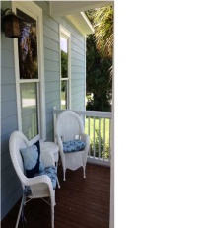
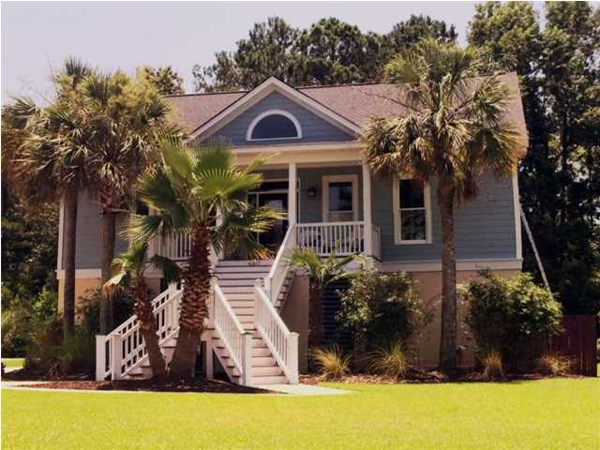
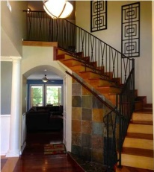
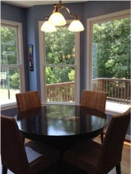
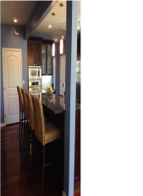
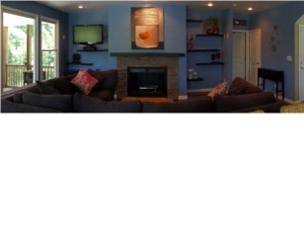
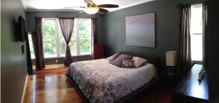
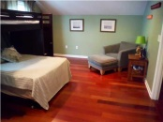
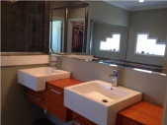
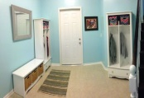
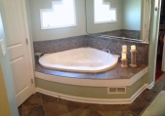
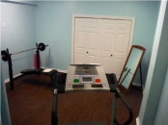
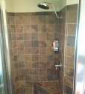


4287 Jacobs Point Ct
Reduced Price
Jacobs Point
MLS# 1416774 ~ $400,000
Custom built luxurious home ~ 4 bedroom 3.5 baths, 3379 sq. ft.
Extraordinary eat-in kitchen has dark stained cabinets with expensive Blue Pearl granite countertops accented with glass mosaic tiled backsplash
Stainless kitchen appliances include Viking six burner gas cooktop, Kitchen Aide Oven, built-in microwave oven, and dishwasher.
Nine foot island has built-in wine refrigerator, breakfast bar, and tons of storage.
Great-room is open to kitchen and has slate look tile surrounding gas fireplace and opens to large screened porch and deck perfect for summer grilling!
Master suite is on the main floor and easily accommodates a king sized bed with tons of space plus his and her closets!
Master bath has huge shower with subway slate like tile floor, heated whirlpool tub for two, and unique, floating cabinets with dual sinks.
Staircase has gorgeous iron spindles leading to Media/playroom which separates the spacious upstairs bedrooms.
Hall bath has travertine natural stone plus another unique cabinet with sink.
Office/Mother-in law suite with bamboo floors and full bath is on lower level adjacent to garage, work out room, entry way/mud room from garage with sitting area to take shoes and coats off.
5" Brazilian cherry floors are throughout kitchen, greatroom, dining room, master bedroom, upstairs media room, and upstairs bedrooms, no carpet in this house!
Neighborhood dock on Wallace Creek leads to the Intra Coastal Waterway
Stephanie Deaton
M – 843-743-4219
O – 843-769-5100
stephanie.deaton@agentowned.com

