Slide 1
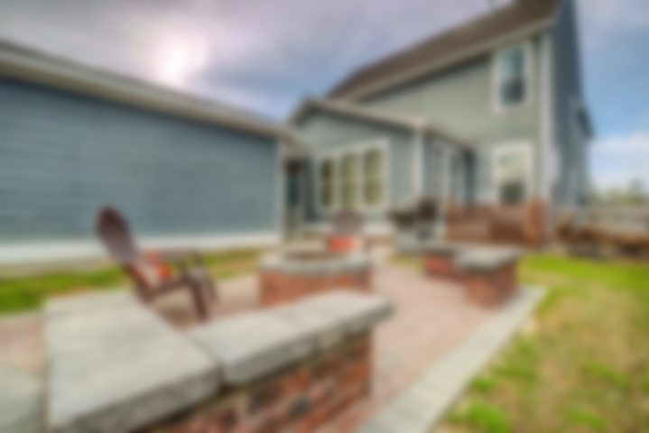
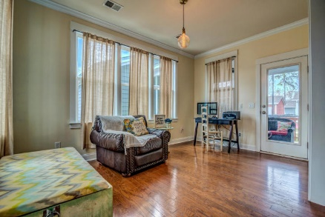
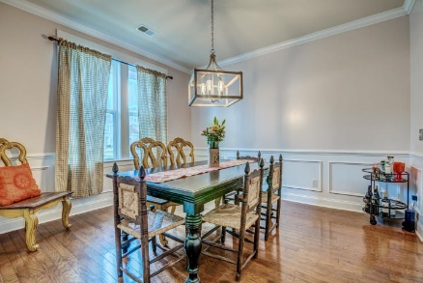
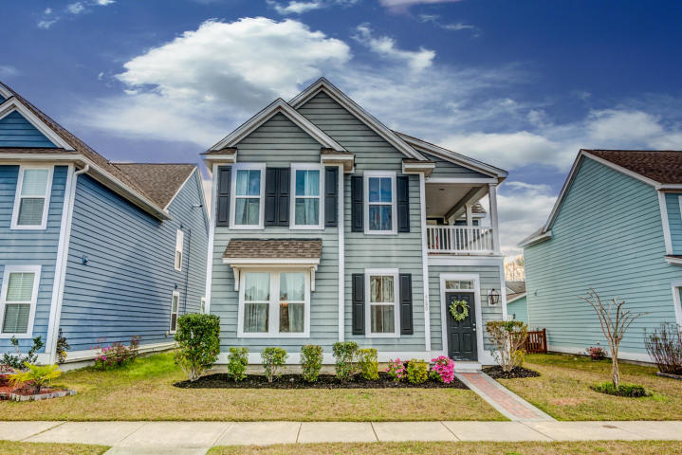
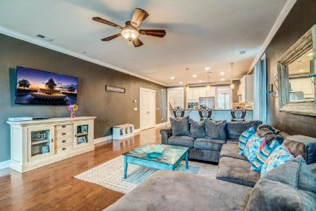
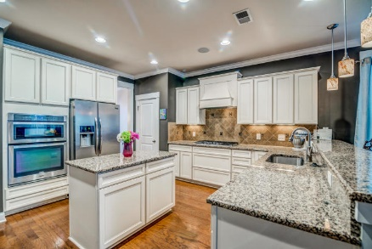
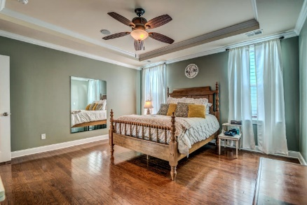
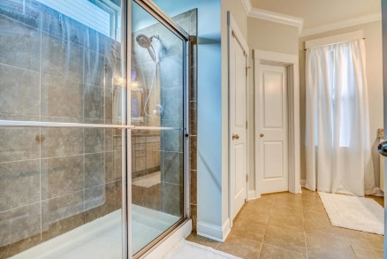
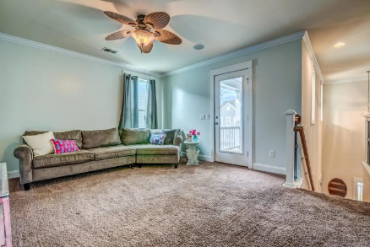
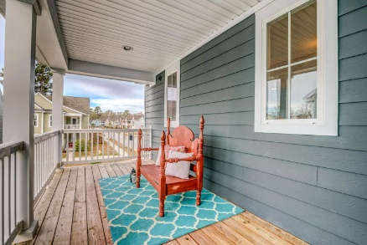
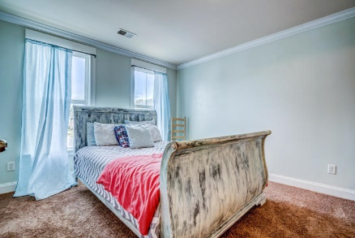
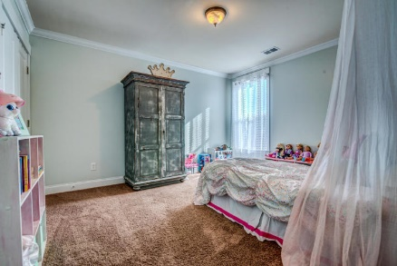
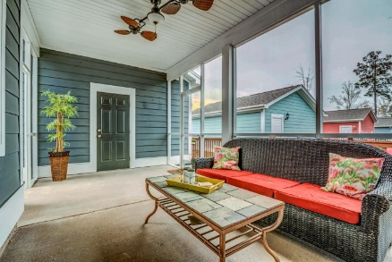
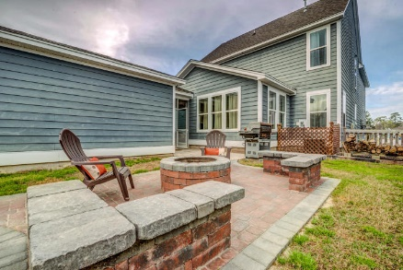
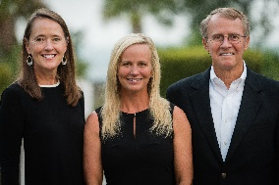

4290 William E Murray Blvd Carolina Bay Charleston, SC 29414 MLS# 20007491 $415,000
Motivated Seller… Move in Ready!!
Southern charm abounds in this idyllic Charleston single located in an exceptional West of the Ashley neighborhood. Greeted by a traditional gas lantern, step through the "false door" onto a private front piazza, perfect for lounging on those lazy summer afternoons. Inside, you'll be impressed with the mix of coastal influence and traditional design elements found throughout, such as wide-plank hardwood floors and crown moulding.
Home is located in one of Charleston's most sought-after neighborhoods in West Ashley. Carolina Bay offers plenty of amenities including miles of walking trails, a 3 acre park, 3 swimming pools, oyster pavilions and community fire pits. Conveniently located to daily shopping and dining needs and Roper hospital, this neighborhood is also just a short drive to the area beaches as well as the world-class dining and shopping of downtown historic Charleston.
Asking $1,200,000
MLS# 17023051
3,692 SqFt
4 Bed/3½ Baths
Short Drive to Historic Downtown Charleston & Beaches
Don Dawson 843-514-0452 ddawson@carolinaone.com Carolina One Real Estate • 2713 Highway 17 North • Mount Pleasant, SC 29466
www.TeamDawsonSC.com

