Slide 1
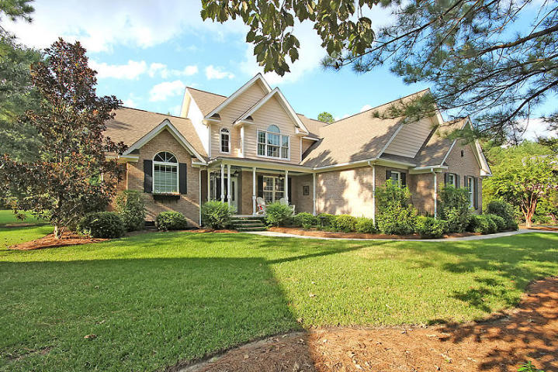
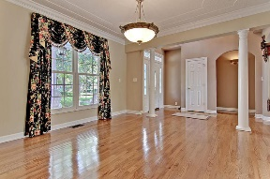
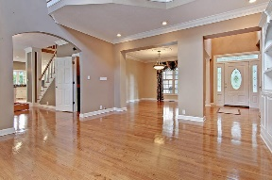
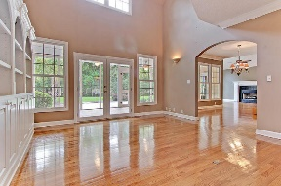
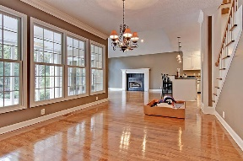
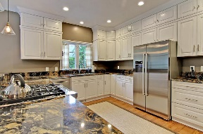
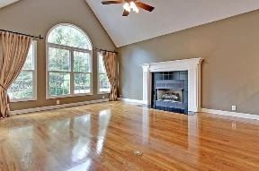
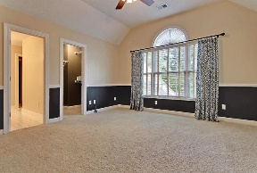
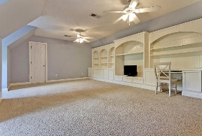
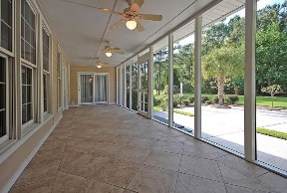
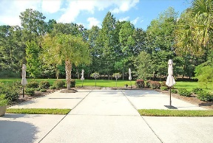
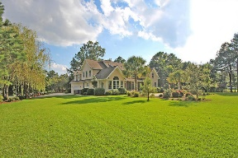



Be Wowed By This Coosaw Beauty!
4291 Persimmon Woods
Coosaw Creek Country Club
North Charleston, SC 29420
MLS# 16025827
$499,000
4 Bedrooms | 3½ Baths | 3,900 sf
This custom built, 3,900 Sq. Ft. home is in IMMACULATE, move-in condition and guaranteed to impress buyers! This home has a fantastic floor plan, great curb appeal situated on a cul de sac, and a backyard big enough to host a soccer game! Walk in and immediately notice the gorgeous wood floors and the large dining room to your right. This room flows in to the living room which has a vaulted ceiling, lots of natural light, book shelves and cabinets that offer great storage. From there, you walk in to the large eat in kitchen area. Off of this area, is a spacious closet that was used as a wine room, but can be used for extra storage. The kitchen has been completely renovated and is a chef's delight! Tons of cabinet space, gorgeous granite counter tops, gas cooktop, pantry and breakfast bar. The kitchen overlooks the family room which has a fireplace, wood floors and access to the HUGE screened in porch. The tiled porch is perfect for entertaining. Off the porch is a massive patio great for grilling and entertaining outdoors. The master suite completes the first floor. This room is very spacious! There's a sitting area that can be used as office, work out space or even a nursery if needed. The master bath has been completely renovated. His and her closets, oversized shower stall, tub and dual vanities. The tile work is gorgeous! When you head upstairs you'll find a bedroom that is the size of the whole length of the house, plus a large walk in closet. Another bedroom has its own full bathroom attached. In the hall, there's another large full bathroom and the fourth bedroom. The bonus room is a must see! Tons of storage, built in desk, window seat storage, plus additional attic space storage off this room. This home is ready for you to move in to today! It really has it all! Close to Boeing, Bosch, AFB, Airport...once you drive your short commute home and drive through those gates, you'll know you made the right choice. This community has an active clubhouse, with many events, great restaurant, pool-side food service, an awesome neighborhood swim team, playground, tennis courts and basketball courts. With the club membership, unlimited golf for all household members! What more can you ask for! Come see this home today!!
Larry & Kathy Mazalatis
Larry Cell 843-693-0529
Kathy Cell 843-693-0159
Office 843-871-9133
AGENTOWNED PREMIERE GROUP | 1800 TROLLEY RD | SUMMERVILLE, SC 29485

