Slide 1
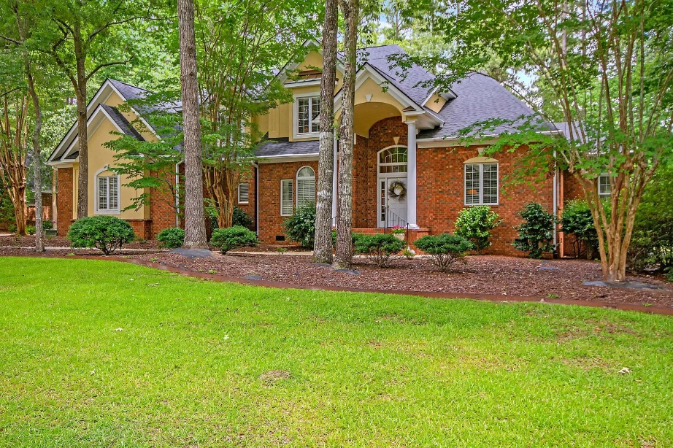
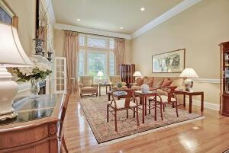
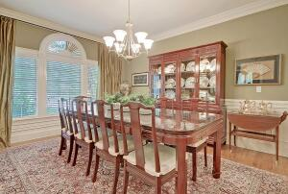
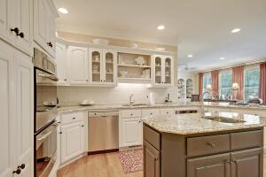
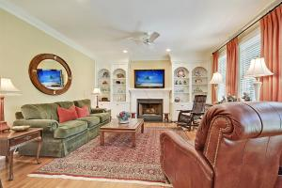
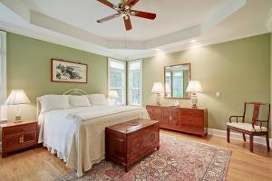
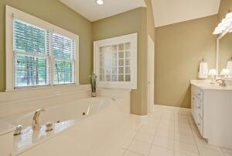
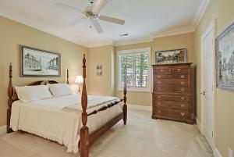
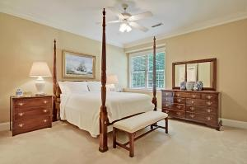
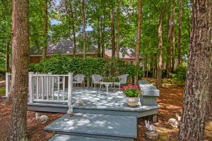
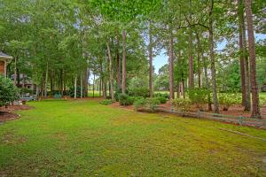
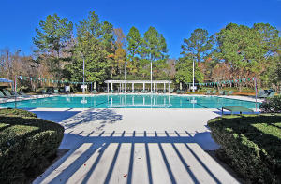
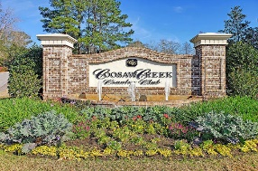
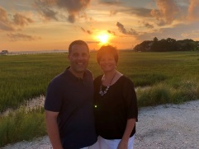

On Golf Course~Gated Community~3 Car Garage~1 Acre!
4296 Club Course Drive
Coosaw Creek Country Club
North Charleston, SC 29420
MLS# 21017613
$649,900
4 Bedrooms | 3/2 Baths | 3,989 sf
Welcome to 4296 Club Course Drive in the beautiful gated golf course community of Coosaw Creek Country Club. This lovely home is located on a one acre lot along the 9th green. Upon entering, you'll notice the grandeur of the foyer and living room giving this home a 'wow' feel. You'll also notice all the crown molding, transom windows over doorways and wood flooring. To your right, behind french doors with a transom window, is the home office with a coffered ceiling. To your left is the dining room, which is a great size for entertaining and also has french door access. The living room has a gas fireplace, high ceilings, large windows offering beautiful views of the golf course and french doors leading to the kitchen. First, a quick stop at the bar, which has a wine cooler and is a great addition to a home that's already perfect for entertaining. The kitchen itself offers ample cabinetry, an island with a vegetable sink, gas cooktop, wall oven and microwave, large walk in pantry, built in desk area, breakfast bar and a large eat in kitchen area. All of this overlooks the family room which has a gas fireplace, yes, this home has two fireplaces, and built in shelving and cabinetry. Off the kitchen is the large laundry room as well as access to the three car garage. There are two half baths on the first floor of this home as well. The master suite, also located on the first floor, is a lovely room with tray ceilings, two walk in closets and a master bath that offers a large jetted tub, separate shower and water closet as well as dual vanities. Head upstairs and first, you'll find bedroom #2 with its own full bathroom. In the hall, there's a large closet for storage as well as a huge attic space that has pull down steps and is just a few feet off the ground. There are two more very large bedrooms with big closets that share a jack and jill bathroom offering separate vanities for added privacy. Lastly, step outside and enjoy the yard! There is a large detached deck and a small walking path through a wooded garden. This yard provides a sense of privacy in a park like setting, while still living on a beautiful golf course. This home has been well maintained and is ready for you to move right in! Coosaw Creek is an amazing place to live! The neighborhood has 24 hour 7 day a week gated security, unlimited golf for all household members, and the location, wow...close to it all! Boeing, Bosch, AFB, Volvo, Mercedes are all a short drive away. Come live the good life in a golf course community that has tons of activities and events, great food in the restaurant, great community pool with an award winning swim team, tennis courts, basketball courts, playground and the most beautiful golf course you'll ever play on!
Larry & Kathy Mazalatis
Larry Cell 843-693-0529
Kathy Cell 843-693-0159
Office 843-871-9133
AGENTOWNED PREMIERE GROUP | 1800 TROLLEY RD | SUMMERVILLE, SC 29485

