Slide 1
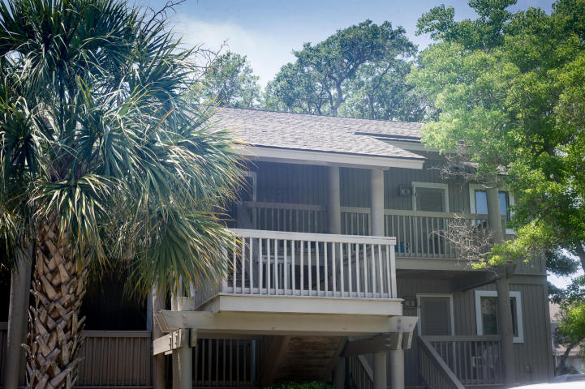
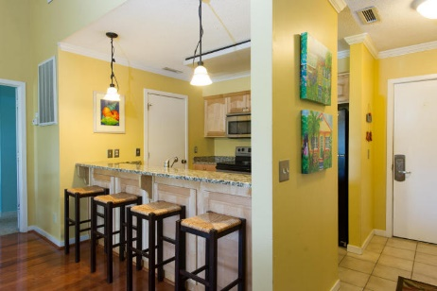
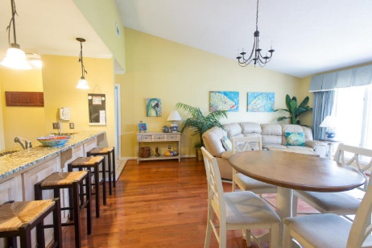
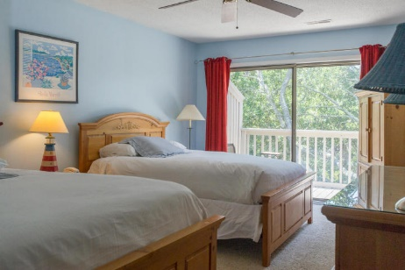
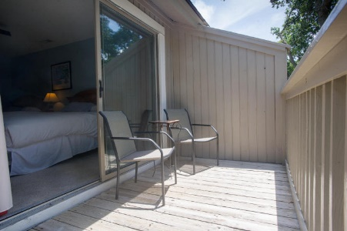
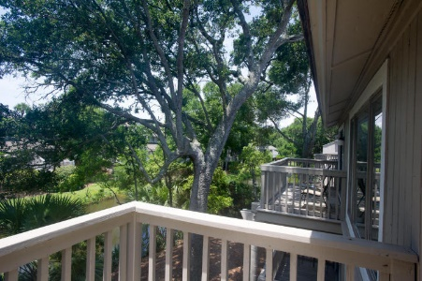
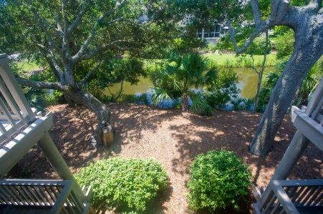
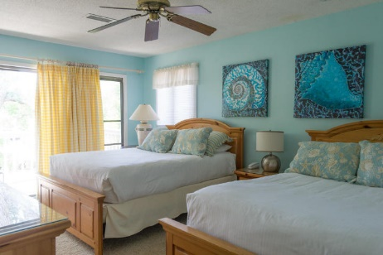
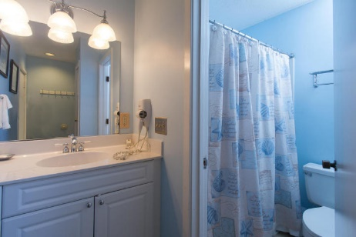

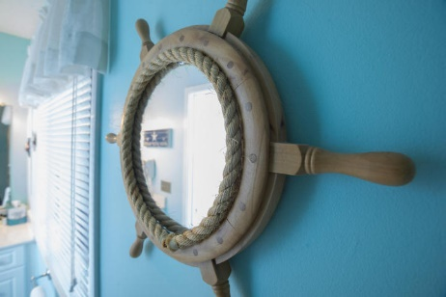

42 Lagoon Villas Isle of Palms ~ MLS# 15019111 ~ $385,000
Great Wild Dunes Condo!
This is a great unit! One of the nicer ones in Lagoon Villas with beautiful hardwood floors and granite counter tops in the kitchen. This turn key unit is a great income producer and is one of the more requested units by vacation renters in Lagoon Villas. This condo is being sold fully furnished and priced to sell. It wont last long! With two small decks overlooking the lagoon, this is in a great location in the complex and is ready for the next owners. Sellers say the condo pays for itself!
Carey Nikonchuk
(843) 276-1701 M
cnikonchuk@gmail.com
www.palmettoproperty.net

