Slide 1
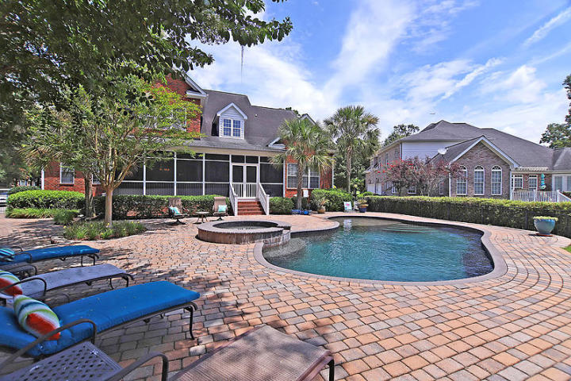
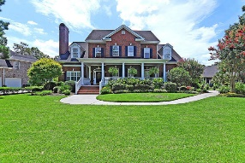
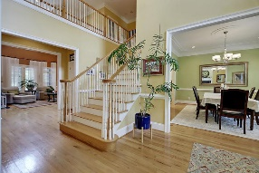
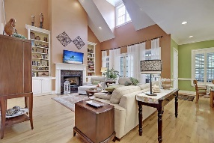
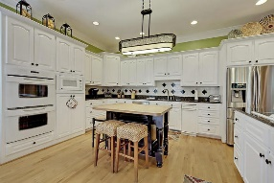
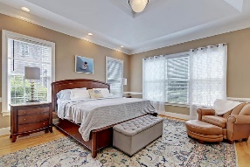
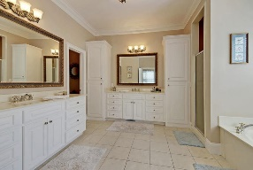
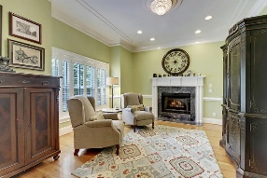
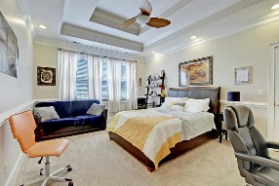
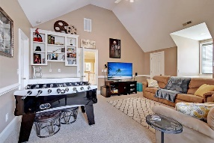
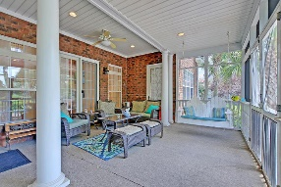
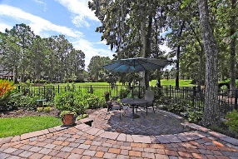
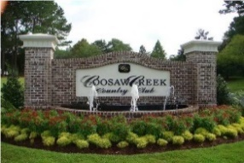


Gated Community · In Ground Pool · On Golf Course!
4304 Persimmon Woods Dr
Coosaw Creek Country Club
North Charleston, SC 29420
MLS# 19022035
Reduced to $599,000
5 Bedrooms | 4½ Baths | 4,550 sf
Looking for an amazing outdoor living area in a gated golf course community? Then look no further! This is the home of your dreams! No reason to leave home when you have all the room you need, a stunning in-ground pool and spa, outdoor kitchen area and garden all over looking the golf course. This custom built home has so many wonderful extras. The curb appeal will impress you right away! Lush landscaping and a large front porch welcome you. Upon entering the two story foyer, you will notice the ample natural light and beautiful hardwood floors. To your left, is a formal living room or office, with it's own gas fireplace! To your right is the very large dining room. Notice all the attention to detail in this home. The trim work, the ceilings, the built ins. The great room has vaulted ceilings, built in cabinetry, a gas fireplace and large windows overlooking your oasis out back. The kitchen is open to the family room and has two islands, a double oven and a large eat in area. Off the kitchen you will find a walk in pantry, desk space and a huge laundry with tons of cabinetry and a sink! Finishing off the first floor is the master bedroom. The master has access to the back porch, views of the pool and golf course, and a large master bathroom. The master bathroom offers a separate tub and shower, walk in closet, dual vanities and tons of cabinets and drawer space. Head upstairs to see the remaining four bedrooms. The first bedroom, could be used as another master suite if needed. It has a large walk in closet, wood floors as well as its own full bath. Next, you'll find another large bedroom with tons of closet space connected to a jack and jill bath. Bedroom number four is on the other side and has a beautiful built in desk and shelving space. Down the hall, you'll find bedroom number five. This bedroom can be used in many ways. Home gym, media room, game room, you name it! This bedroom has its own full bath as well! Head back downstairs and out back for the most stunning part of this home, the pool! The large screened in porch has both a seating area as well as a dining area. No detail was left out when designing this backyard paradise! There's a natural gas grill, an outdoor kitchen, a garden area to sit and watch the golfers pass by. Then there's the pool! This salt water beauty, with built in bar stools and hot tub, is a dream come true! Living here is like being on vacation every day. Leave your stresses behind and come live the good life in Coosaw Creek! The neighborhood has 24 hour 7 day a week gated security, unlimited golf for all household members, and the location, wow...close to it all! Boeing, Bosch, AFB, Mercedes, Volvo- are all a short drive away. Come live the good life in a golf course community that has tons of activities and events, great food in the restaurant, great community pool with an award winning swim team, and the most beautiful golf course you'll ever play on!
Larry & Kathy Mazalatis
Larry Cell 843-693-0529
Kathy Cell 843-693-0159
Office 843-871-9133
AGENTOWNED PREMIERE GROUP | 1800 TROLLEY RD | SUMMERVILLE, SC 29485

