Slide 1
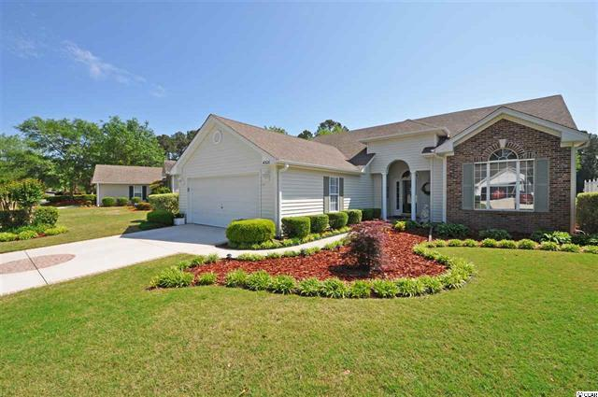
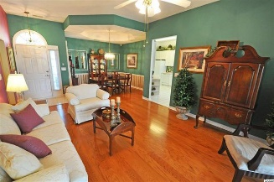
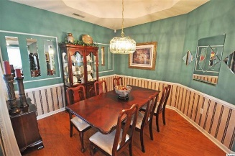
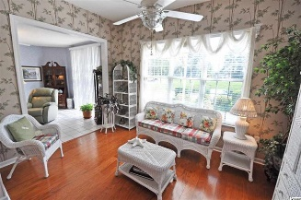
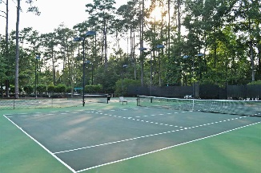
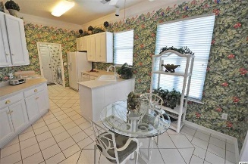
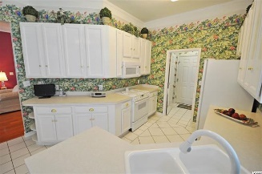
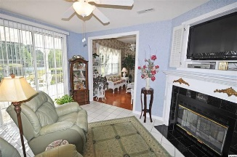
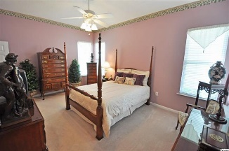
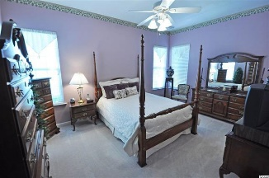
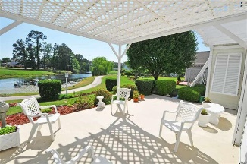


4306 Turtle Lane
The Oaks At Eastport
Little River
MLS #1609291
$244,900
Impeccable Home on Golf Course with Stunning Lakefront Views
It's not cliché; it's real pride of ownership. From the well-loved gardens, front and rear, to the fine brick detail and design on the driveway, no detail has been spared to make this popular, easy-living The Oaks at Eastport Greenbrier-model house a comfortable, absolutely impeccable home of about 1,600 heated square feet. But there's more -- a magnificent panoramic lake view of the Valley at Eastport Golf Course, not just from one room, but five -- the kitchen, family room, Carolina room, living room and even the master bedroom. There is a 2+-car garage with lots of storage, including pull-down-staircase attic-entry. There are hurricane shutters stored conveniently in the garage. All windows are insulated. Come into the home from the garage through the utility room, good traffic pattern, then into the large airy eat-in kitchen, adjoining the family room with cozy fireplace, and that direct view of the wonderful lake. Plus a patio! All appliances, including washer/dryer convey, as do window coverings. The HVAC was replaced about five years ago. Floor coverings are Mexican tile, wood and upgraded carpet. A Simpli Safe Alarm System comes with the home and is monitored month to month; there is no contract. There is a separate Carolina room, perfect for quiet enjoyment, off of the family and living rooms. The living room is the heart of the home, spacious and connected to the more formal beautiful separate dining room, both with 10' ceiling embellishments, and the dining space a great size for family or for intimate couples dining. The entry foyer separates the living/dining area from the 3 bedroom/2 bath split-bedroom floor plan. The master features walk-in closet, lots of space, lake view, and a wonderful master bath with double-sink vanity, garden tub and separate shower. One of the other bedrooms is being used as an office. All rooms are nicely sized. Peaceful lovely Eastport is perfectly located, nestled on the golf course, with owners' pool, clubhouse and Grill. It is close to shopping, restaurants and everything the North Strand and the historic hamlet of Little River have to offer. Major highways are easily accessible as well. Enjoy a visit to Eastport and to this great house on Turtle Lane soon! Pride of neighborhood and of home ownership immediately shows...
Deborah Collins
843-424-9013
dctidewater@yahoo.com
Connie Ross-Karl
702-306-2643
conniesross@aol.com
NEW WAY PROPERTIES MYRTLE BEACH

