Slide 1
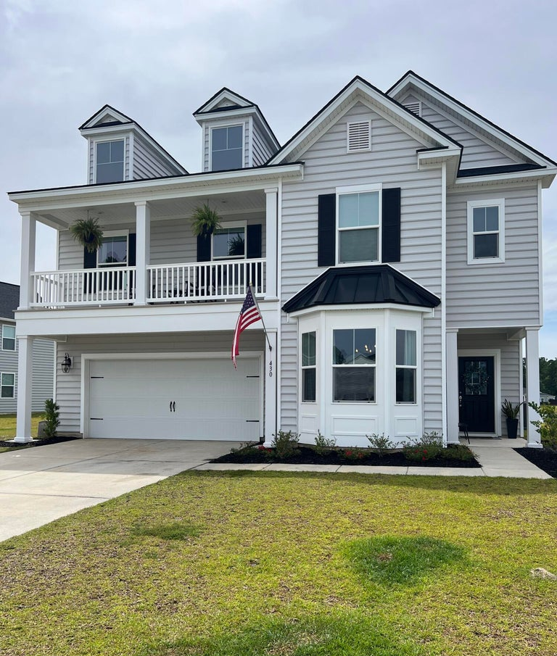
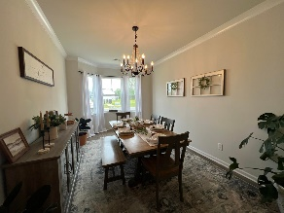
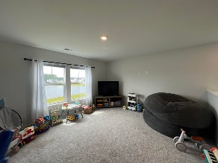
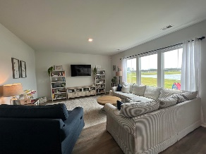
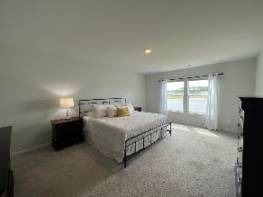
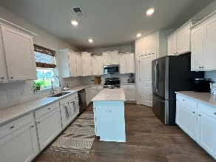
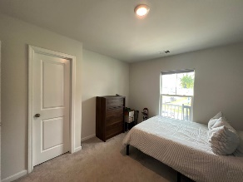
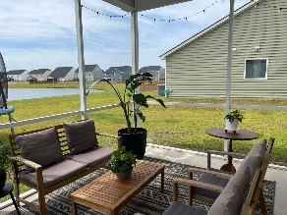
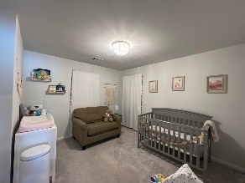

For Rent in Cane Bay
430 Squire Pope Road
Cane Bay Plantation | Summerville, SC 29486 | MLS# 23014090 | $2,450
Beautiful 4 bedroom and 2½ bathroom home on a pond site in Cane Bay. Home is located in the Lindera Preserve section that features resort-style amenities. Downstairs features open floor plan with white counters and cabinets, stainless appliances, LVP floors, welcoming foyer and separate dining area. Screen porch and backyard feature expansive pond view. Main bedroom is spacious and has en suite bathroom with double vanity and soaking tub. 3 additional bedrooms, loft and laundry room are located upstairs as well as access to the 2nd floor front porch. Application fee is $60 per person. All occupants over 18 and guarantors must apply. Property Manager will screen all applicants. Proof of income 3 times the rent and driver's license or state or federal issued id required.
Security deposit equal to one months rent and Lease Initiation fee of $100 due at the time of accepted application. All applicants must complete a profile with PetScreening.com to certify that they have no animals, give information about their pets or verify service or emotional support animals. Pet rent will apply to pets. Pet rent is $30 for the first pet and $20 for the second pet.
All ROG Coastal Property Management residents are enrolled in the Resident Benefits Package (RBP) for $45.95/month which includes renters insurance, credit building to help boost your credit score with timely rent payments, $1M Identity Protection, HVAC air filter delivery (for applicable properties), move-in concierge service making utility connection and home service setup a breeze during your move-in, our best-in-class resident rewards program, and much more! More details upon application.
Lindsey Blackburn 843-364-4451 | lindsey@rogcoastal.com
ROG Coastal Property Management | 1510 Old Trolley Road | Summerville, SC 29485

