Slide 1
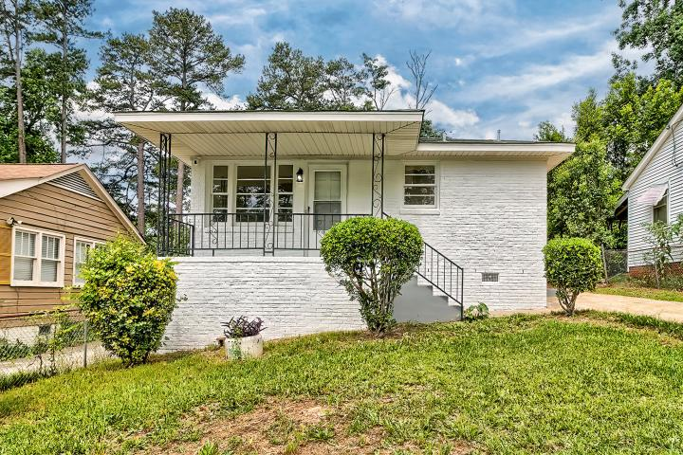
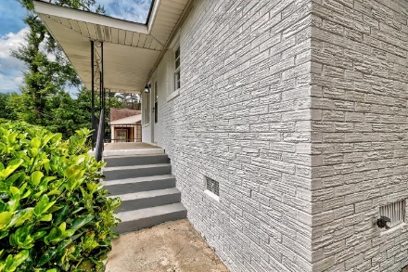
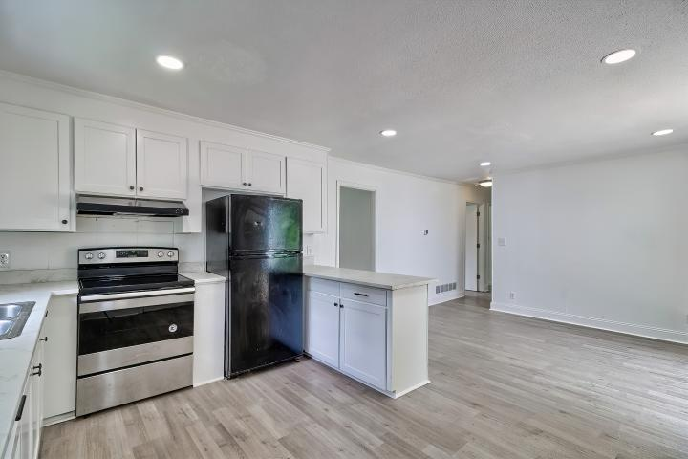
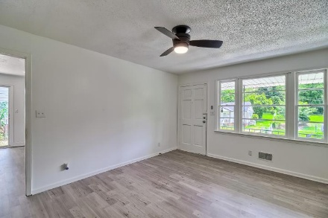
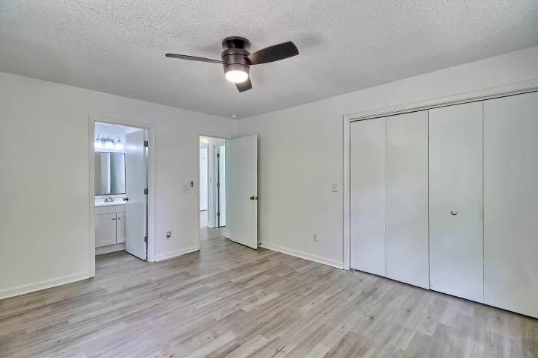


Move in Ready! Like New!
4313 Ryan Avenue
Monticello Terrace | Columbia, SC 29203 | $194,900 | Mls# 594108
3 Beds | 2 Baths | 1,181 Sq Ft
Take a look at this beautiful single-story brick home! This cute home features a formal living room, eat-in kitchen, and spacious backyard. You will also find 3 spacious bedrooms and 2 full bathrooms. This charming single-story home offers a beautiful interior and exterior. The living area flows seamlessly into the kitchen and the main living spaces, bedrooms, kitchen, and bathrooms showcase luxury vinyl plank flooring and new paint. Generous storage throughout adds to the home's functionality. Perfect for both owner-occupants and investors. The property is ideally located just minutes from I-20, Downtown Columbia, major hospitals, USC, and Columbia College. Showings by appointment only.
For showings or offers, please contact
Greg Boger
803-960-3016
gboger1@gmail.com
Listed by Randal Longo | iSave Realty

