Slide 1
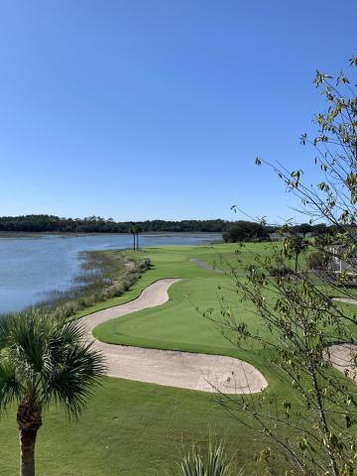
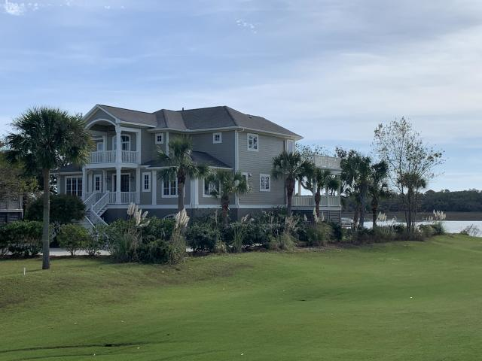
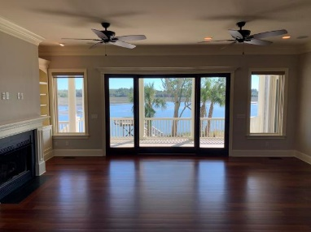
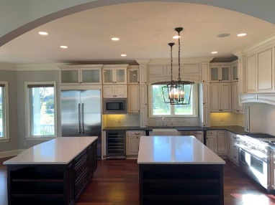
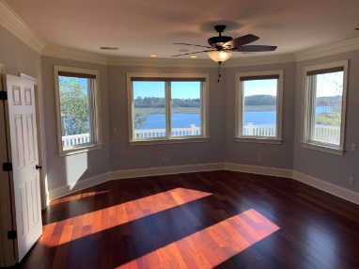
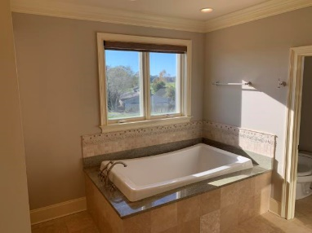
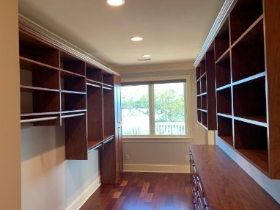
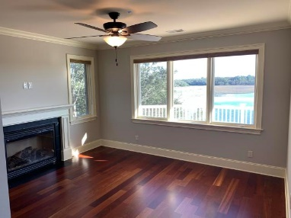
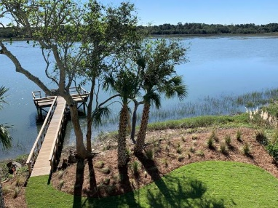
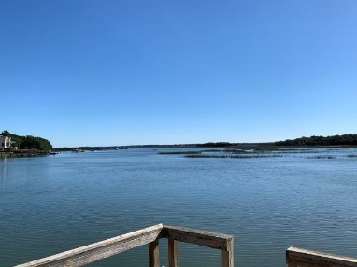
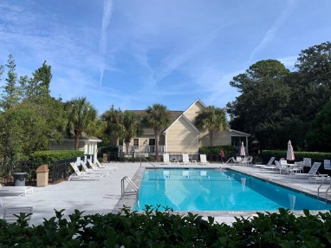
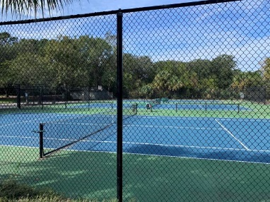

Open House Thursday 11a-2p Check Out This Beautiful New Home And Enjoy A Light Lunch
AGENT OPEN HOUSE
Thursday Nov 21st
1pm-5pm
$500 CASH drawing at 5pm
4314 Daufuskie Place Court
Kiawah River Estates | Johns Island, SC 29455
MLS# 19031305 | $1,350,000
Waterfront in Kiawah River Estates with Amazing waterfront, marsh and golf course views!! 4/5 bedrooms and 4.5 baths. 4133 Square feet.
Gate code 1040
Bryan Weatherford
(843) 345-1330
bhweatherford@gmail.com
The Boulevard Company, LLC
806 Johnnie Dodds Blvd
Ste 100
Mt Pleasant, SC 29464

