Slide 1
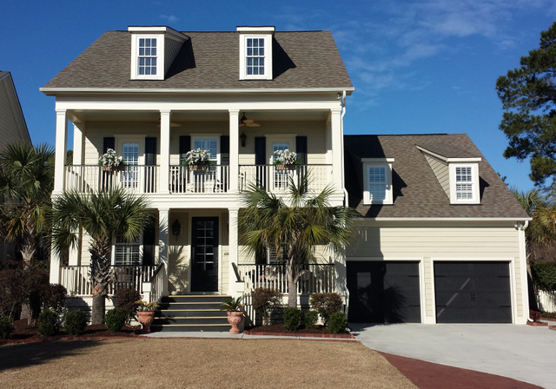
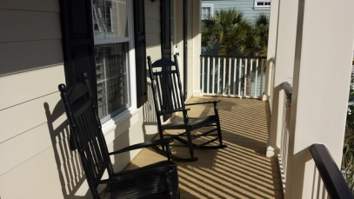
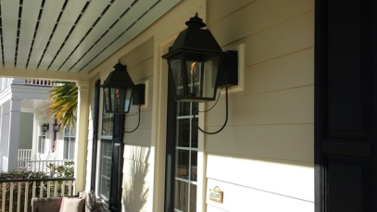
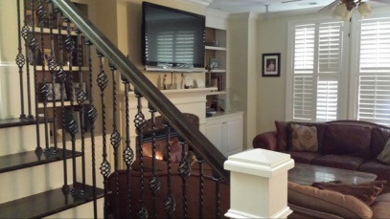
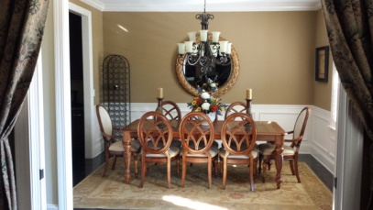
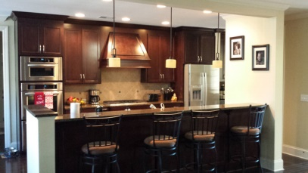
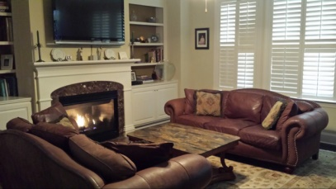
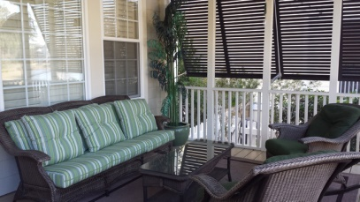
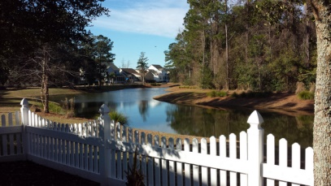

Open House Sunday 1-4
4320 Savoy Street
Hamlin Plantation - Mount Pleasant - MLS# 15003042 - $679,000
The Hamlin Plantation home you have been waiting for! This gorgeous 3 story property has over $100K in upgrades and is in a prime location in Waverly! It offers a beautiful view of Savoy Green in front and a pond/lagoon view in back. The double front porches, Charleston gas lanterns, beautiful banisters, custom landscaping, and inside/outside speaker system make this home truly magnificent. The wood trim has been freshly painted. As you enter the home you will notice all hardwood floors except 3rd floor. There is a suite on each level including a guest suite on the 1st floor. The kitchen features gorgeous granite counters, stainless appliances & opens to the great room w/fireplace. The Lowcountry pond view is stunning with a panorama of wildlife. This special home dressed to impress!!
Kurt Seelig
843-906-8528
kurt@seeligrealestate.com

