Slide 1
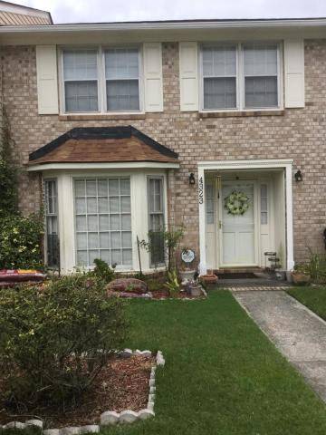
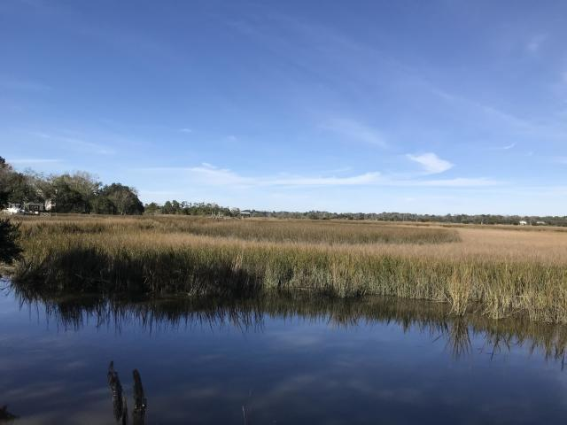
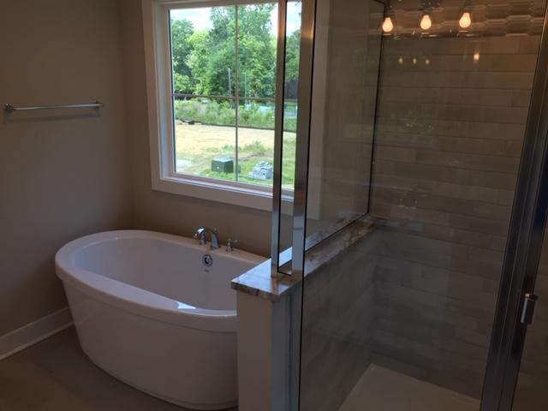
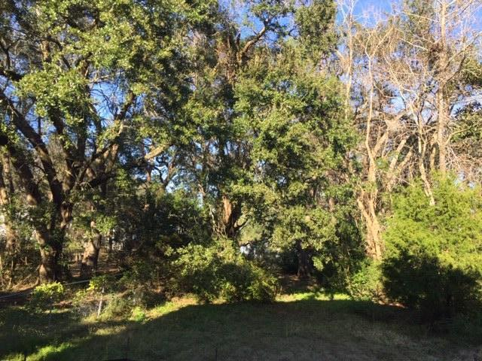
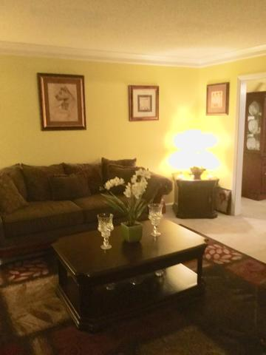
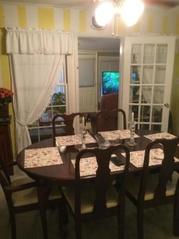
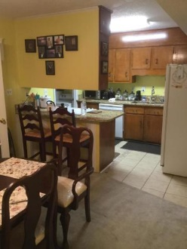
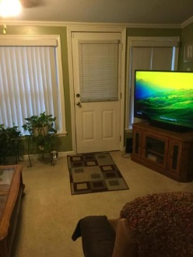
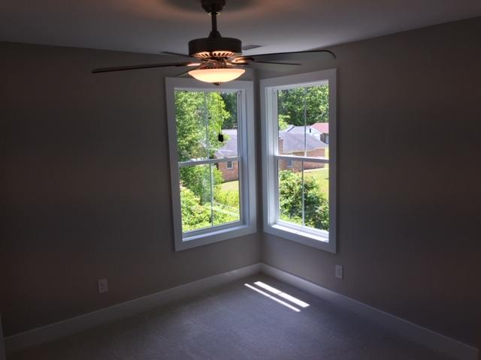
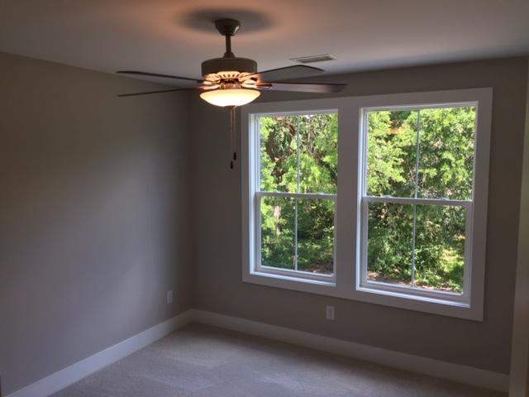
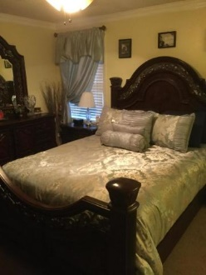
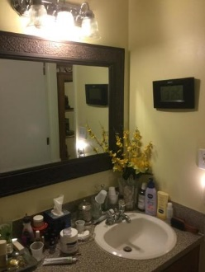
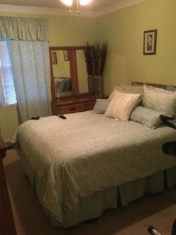
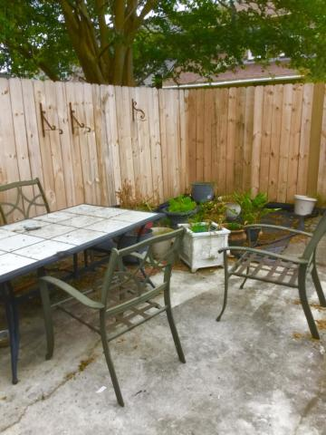


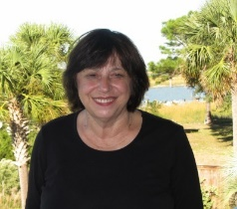
MAKE US AN OFFER!
4323 Briarstone Court
Ashley Villas
North Charleston, SC 29418
MLS# 20021285
$153,500
2 Bedrooms :: 1½ Baths :: 1,442 sf
PRICE TO SELL!!!! THIS LOVELY MAINTAINED TOWNHOME IN ASHLEY VILLAS. LOCATION IS KEY. CLOSE TO OUTLET MALL, AIRPORTS. GREAT AREA TO CALL HOME. ROOF AND HVAC WERE REPLACED IN 2019. LIVING AREAS ARE LARGE FOR GREAT ENTERTAINING. PRIVACY FENCED IN THE BACKYARD WITH LITTLE MAINTENANCE. CHECK IT OUT !!!!
Eric Draper
(843) 442-7118
eric.draper@gmail.com
Judith Hartin
843-834-1972 | jnhartin@comcast.net
www.coastalpropertiescharleston.com
Metro Realty Group LLC | 1231 Columbia Ave | Irmo, SC 29063

