Slide 1
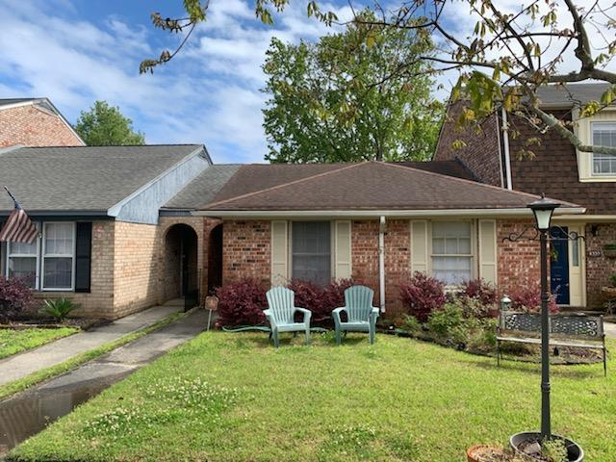


1 Story Townhome in Fabulous Location!
4333 Briarstone Court
Ashley Villas · North Charleston, SC 29418
MLS# 19009630 · $114,900
1 story townhouse in fabulous location. 2 bedroom 1.5 bath with tiled bathrooms and wood flooring in living area. Wood burning fireplace in family room. Large attic for extra storage. Patio overlooking private fenced in yard. Low HOA's!!!
Michael Dew
O 843-769-5100
M 843-870-7000
michaeledew@gmail.com
www.michaeldewrealestate.com
AgentOwned Charleston Group
902 Savannah Hwy
Charleston, SC 29407
Real Estate ● Mortgage
Insurance ● Business Brokerage

