Slide 1
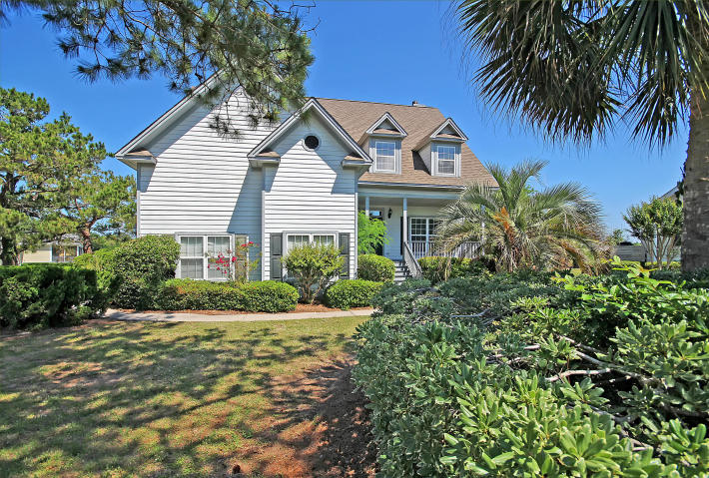
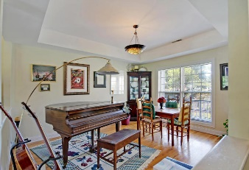
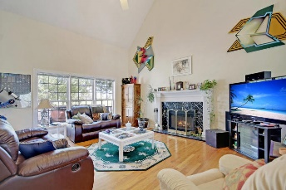
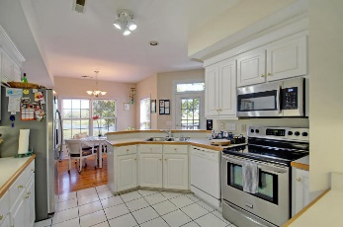
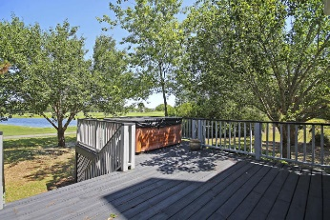
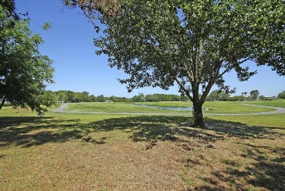
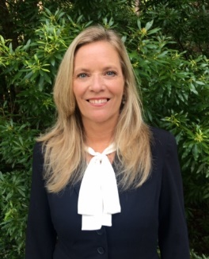

OPPORTUNITY IS KNOCKING!
$15,000 Agent Bonus
with ratified contract by 4/15/18
4335 Hope Plantation Dr
Kiawah River Estates
Johns Island, SC 29455
MLS# 18013430
$479,000
SLAP! SLAP! DO I HAVE YOUR ATTENTION?
Appraisal in hand value $618,000.00! Listing price $479,000.00. This fully detached home is situated on a quiet tree lined street and surrounded by a large, professionally landscaped, private golf course lot with a gorgeous pond view. This Magnificent 3000 sq. ft. Kiawah River Estates home offers cathedral/vaulted ceilings, a cozy fireplace, has 3 large bedrooms upstairs and several large rooms on the main floor including a spacious master bedroom suite that includes tray-ceilings, a Hollywood style master bathroom with a garden tub, separate large walk-in shower, ceramic tile, and a huge private walk-in closet. Greet neighbors on a beautiful front porch or relax on the back deck as the golfers enjoy their game. Professional Home Inspection and Appraisal provided upon request. Home priced according to cosmetic condition. Age, sqft, taxes, acreage, HOA dues, and schools are approximate buyer to verify any and all information deemed necessary.
Ginger Sanders
(843) 822-4618
ginger.sanders.remax@gmail.com
RE/MAX Pro Realty, 9209 University Blvd, Charleston, SC 29406

