Slide 1
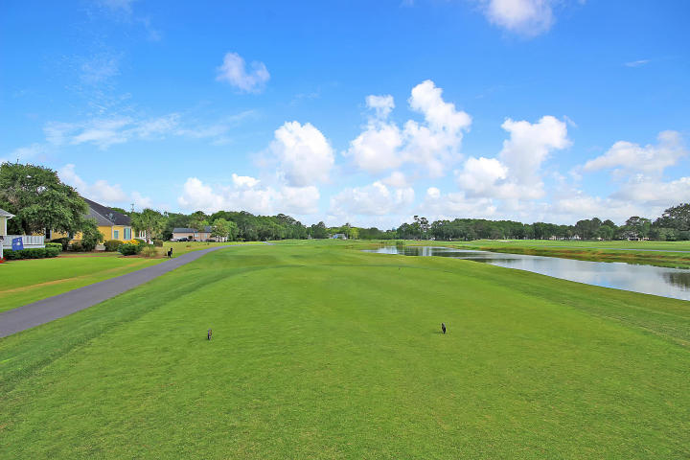
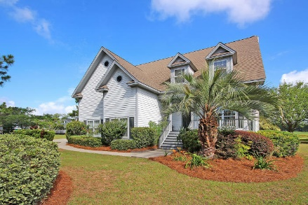
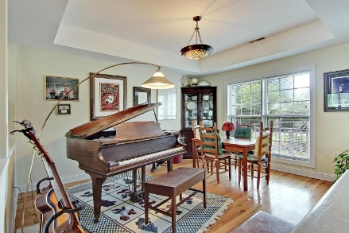
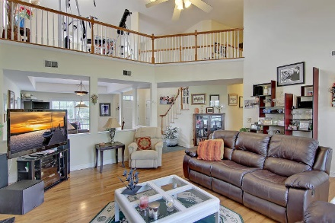
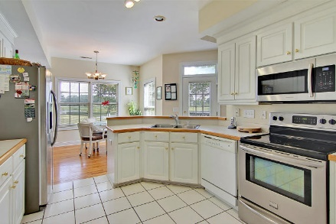
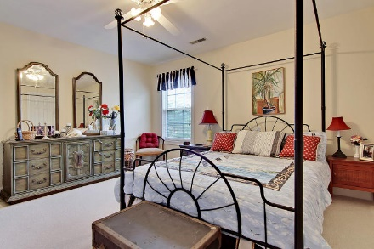
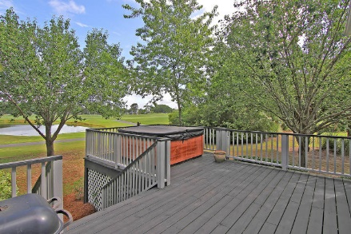
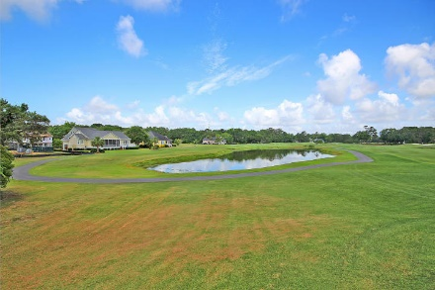
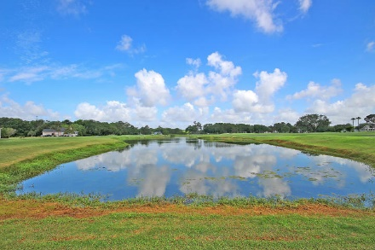
Enjoy Kiawah Golfing, Beach, Boating!
Reduced $200k!
4335 Hope Plantation Drive Kiawah River Estates ~ Johns Island, SC 29455 ~ MLS# 17014875 ~ $545,000
Lowest price per square foot in gated community of Kiawah River Estates. This ​cul-da-sac home on golf course backs to a pond and has one of the best long views on Oak Point Golf Course, one of 5 golf courses included in world famous Kiawah Island Golf Resort. Just 5 minutes away is the beautiful beaches of Kiawah and wonderful dining and shopping at Freshfields and Bohicket Marina. From the community crabbing and floating dock you can launch your kayak and paddle around with dolphins or explore the marshes and creeks. From the homes living room, kitchen and backyard deck enjoy peaceful views where at night the sky reveals a million stars.​This wonderful floor plan has a first-floor ​​owner's retreat, a loft area that overlooks the room and an enormous frog which makes a great flex room, or bedroom along with 2 others upstairs.
Enjoy a sparkling community pool, 3 tennis courts, half basketball court, and community house with meeting and workout rooms. Membership is available at the Kiawah Island Golf Resort Governor's Club and Seabrook Island Club. 50 year roof installed on the home in 2010.
Lisa Quick lisa@mattoneillteam.com 843-452-6688

