Slide 1
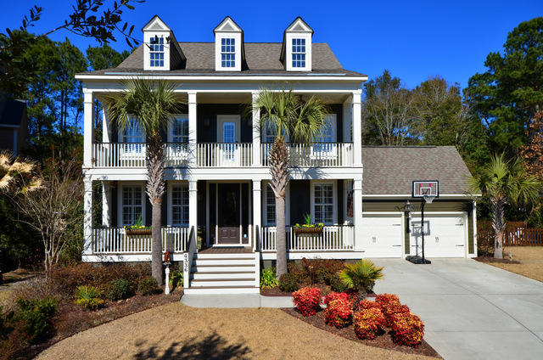
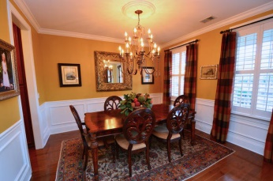
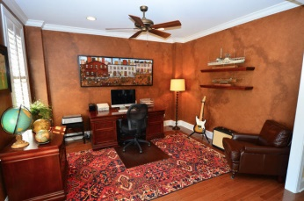
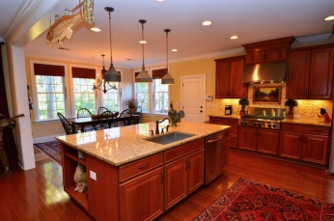
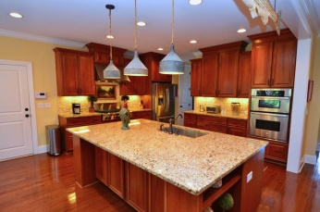
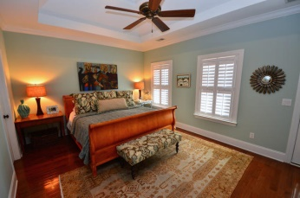
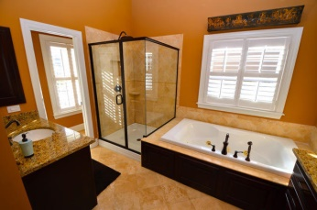
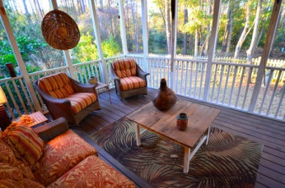
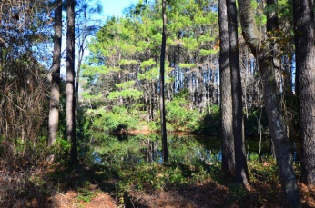

Priced to sell in Hamlin Plantation!
4336 Savoy Street
Mount Pleasant - MLS# 15006660 - $635,000
Enjoy a Lowcountry Lifestyle in this 3 story, 5BR, 4.5BA Hamlin Plantation home that features stunning double porches and loads of upgrades! As you enter through the front door into the foyer, you will sense the attention to detail throughout. The kitchen features a travertine backsplash, stainless appliances, gourmet 6-burner stove, oversized sink, large island, and loads of cupboard space. Home features hardwood floors on the 1st & 2nd floors, & upstairs laundry. This Chesapeake model sits on a quiet street & offers true privacy. Backyard features a picturesque wooded view teaming with wildlife around a natural pond setting, and the front overlooks 'Savoy Green'. Enjoy the backyard view from a nicely appointed screened porch. This is truly a beautiful home in a very special location.
Check out the Virtual Tour here:
http://www.realestateshows.com/764147
Kurt Seelig
843-906-8528
kurt@seeligrealestate.com

