Slide 1
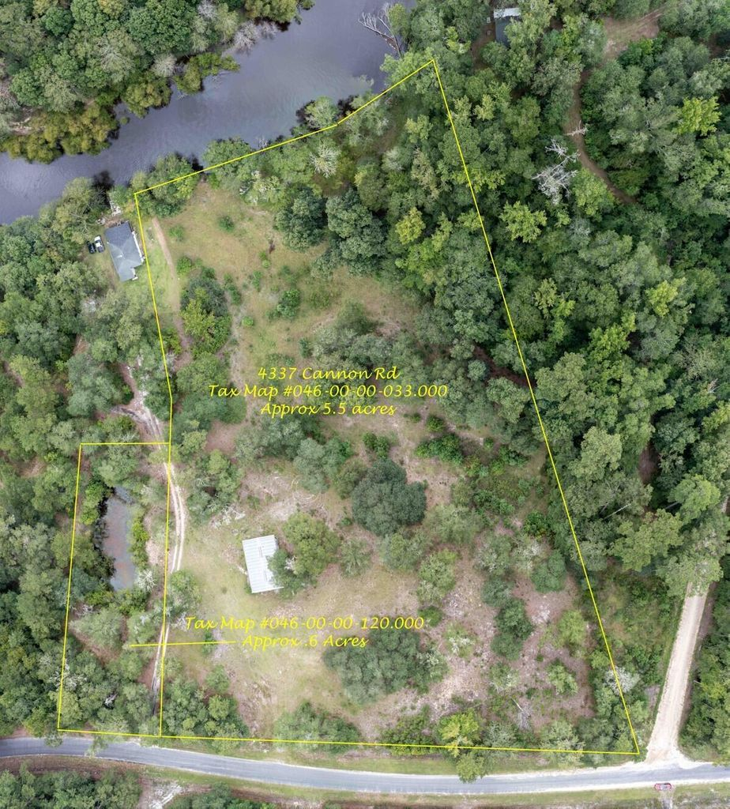
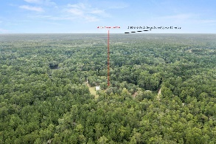
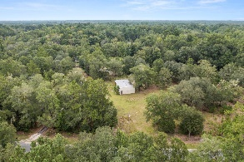
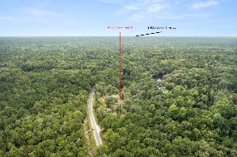
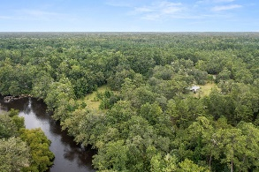
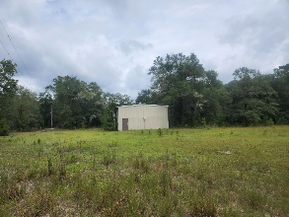
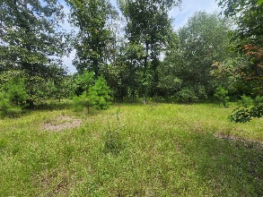
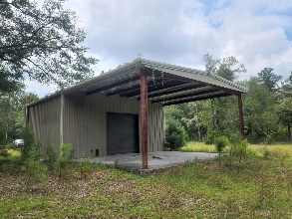
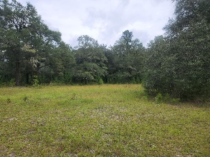

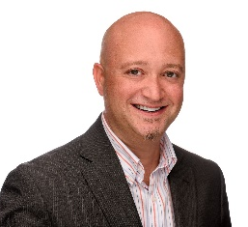
4337 Cannon Road
Round O, SC 29474 | MLS# 22022007 | $325,000
Welcome to paradise!
Brokers Open House
Friday August 19th
12-2pm
If you have dreamed of living on the river, this is the perfect location! 2 lots totaling 6.09 acres and offering over 300 + ft of river front on the Edisto! Property offers a 24x30 high ceiling workshop that features 2 bay doors, large lean to, power, well, and septic! There is also a small pond located on the smaller second lot. This is the perfect location to build your dream home or for just a weekend retreat! Hurry and schedule your exclusive showing today before this grand opportunity passes you by!
Brandon Ray
(843) 499-1928
brandon.ray@carolinaone.com
www.therightrayhome.com
Carolina One Real Estate
900 N Main St
Summerville, SC 29483

