Slide 1
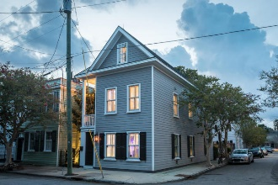
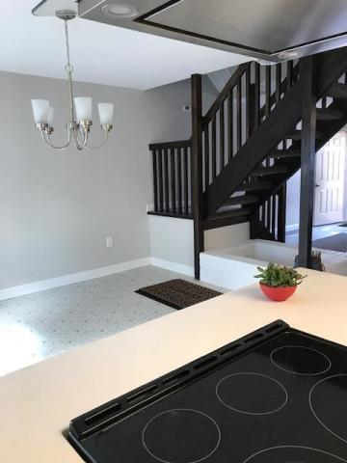
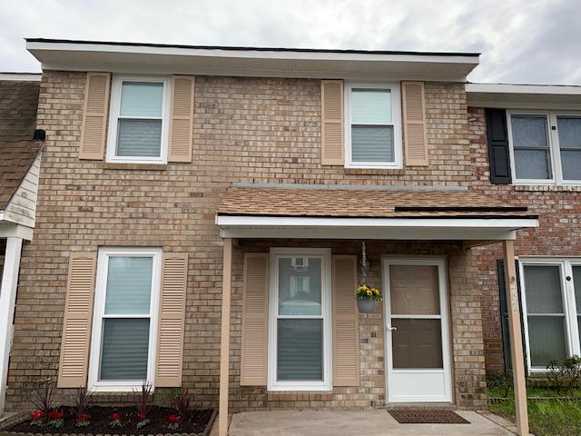
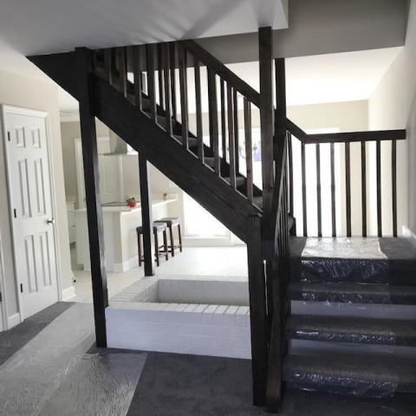
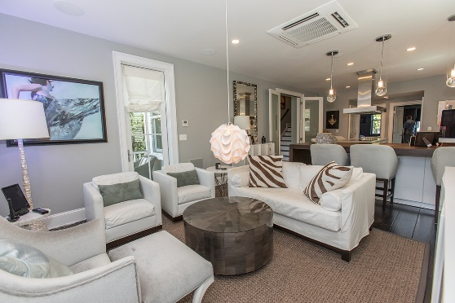
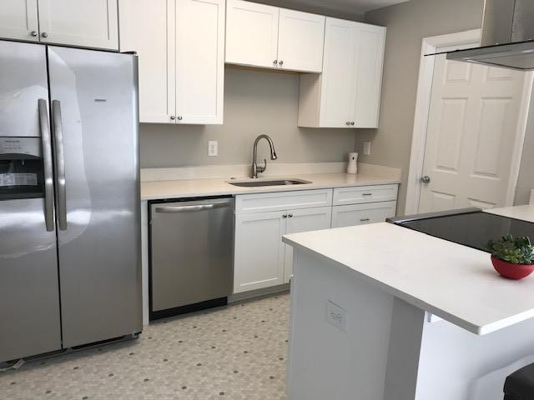

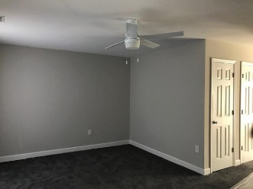
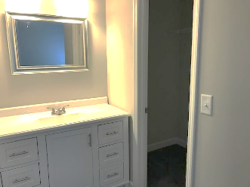
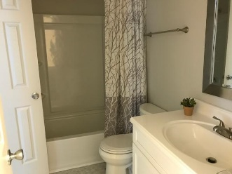
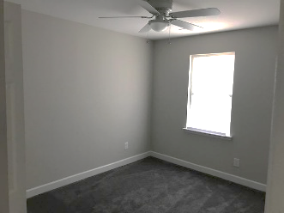

Total Renovation! Like New!
4345 Briarstone Court
Ashley Villas · Charleston, SC 29418 · MLS# 20006130 · $179,000
3 bed 2 bath town home in Ashley Villas. Completely rebuilt after total fire loss in 2019. Everything is new!! Beautiful kitchen with stainless steel appliances and island mount range hood. Modern open stair case leading to upstairs bedrooms. Private fenced in back yard with patio. New plumbing, new electrical, new roof, new HVAC etc. Must see!!
Michael Dew
O 843-769-5100
M 843-870-7000
michaeledew@gmail.com
www.michaeldewrealestate.com
AgentOwned Charleston Group
902 Savannah Hwy
Charleston, SC 29407
Real Estate ● Mortgage Insurance ● Business Brokerage

