Slide 1
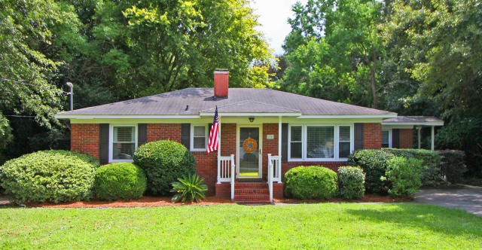
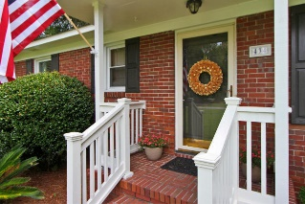
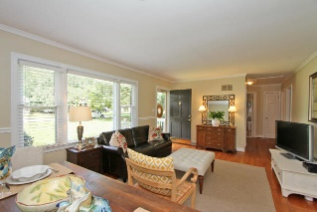
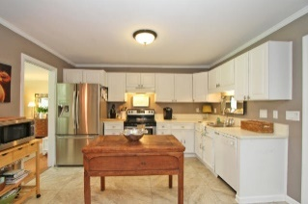
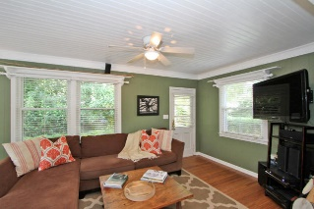
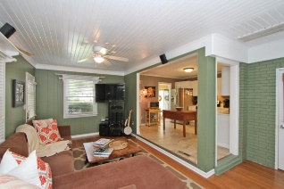
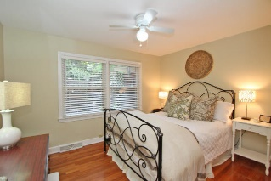
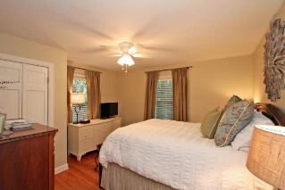
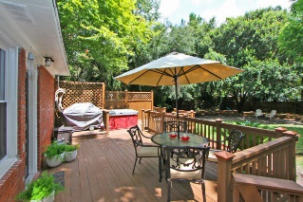
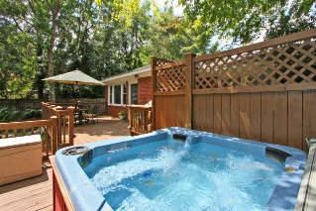
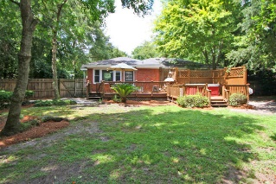


434 Carol Street
Woodland Shores Annex Charleston MLS# 15025738 $309,900
Open House Sunday
Join me from 1:30-3:30
Rare Find! James Island Charmer!
You can't be the location of this James Island Charmer! Nestled on a large lot with a private fenced back yard on a quiet tucked away street 10 minutes to downtown and Folly and minutes to shopping, restaurants, The Municipal Golf Course, The James Island County Park, and more! As you walk into this adorable home you are greeted by a large bright living/dining room with lots of natural light and neutral paint. The kitchen features white cabinets, 18 inch laminate tile, and neutral countertops, opening up to a spacious den with a connecting half bath/laundry room. There are 3 spacious bedrooms with ample closet space and a full bath featuring a pedestal sink and bamboo blinds. In the back yard you will find your own private oasis with a large deck, gas grill, and hot tub. Home is currently zoned for Murray LaSaine but residents have option to opt for Harbor View Elementary. If square footage and schools are important please verify. This info is to the best of the listing agent and owners knowledge. Agent has ownership interest.
Sarah Ellen Lacke
Cell - (843) 607-4330
sarahellen.lacke@carolinaone.com
www.selacke.com
Carolina One Real Estate 1265 Folly Rd Charleston, SC 29412

