Slide 1
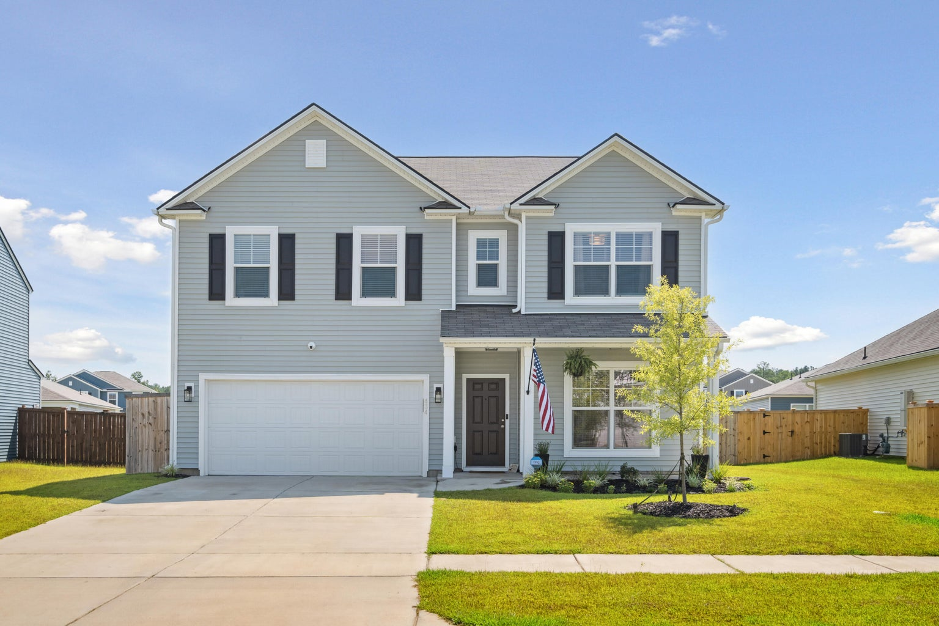
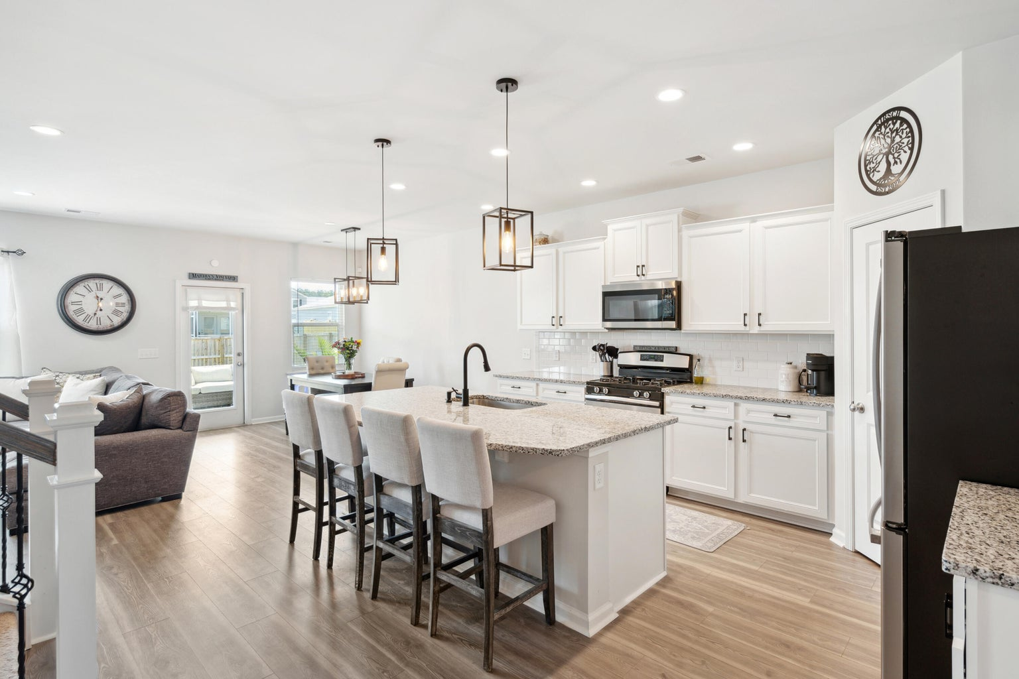
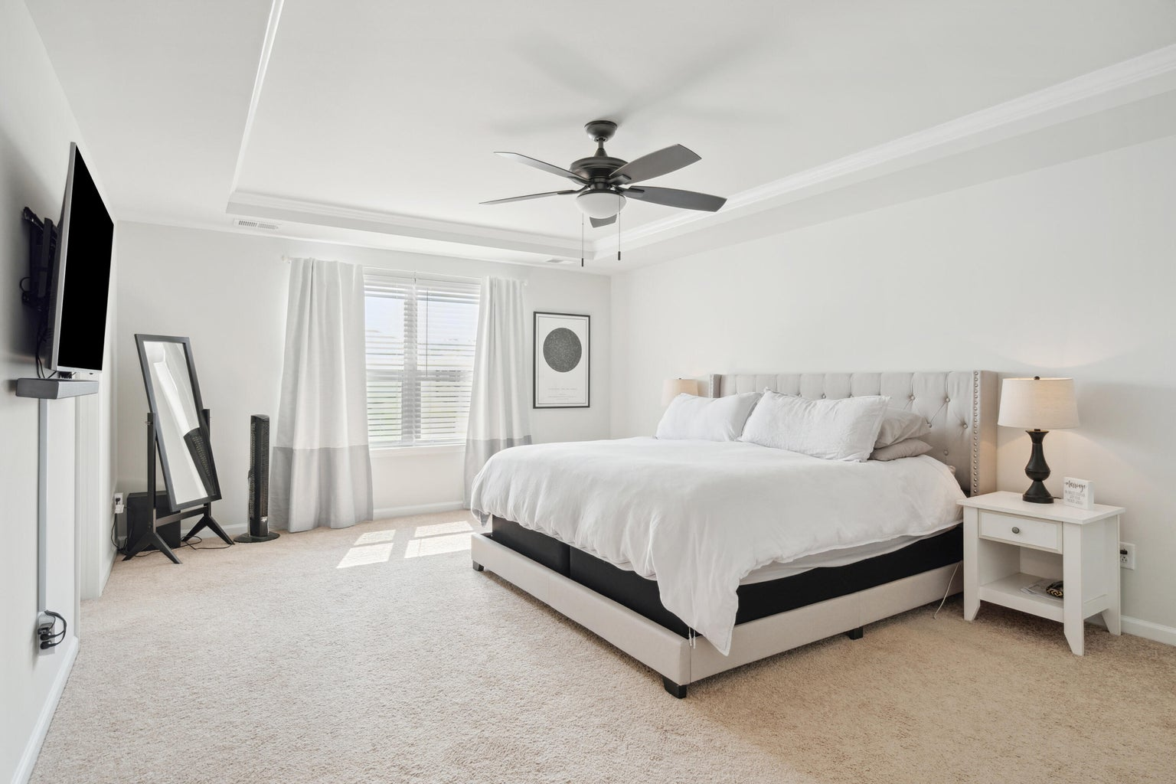
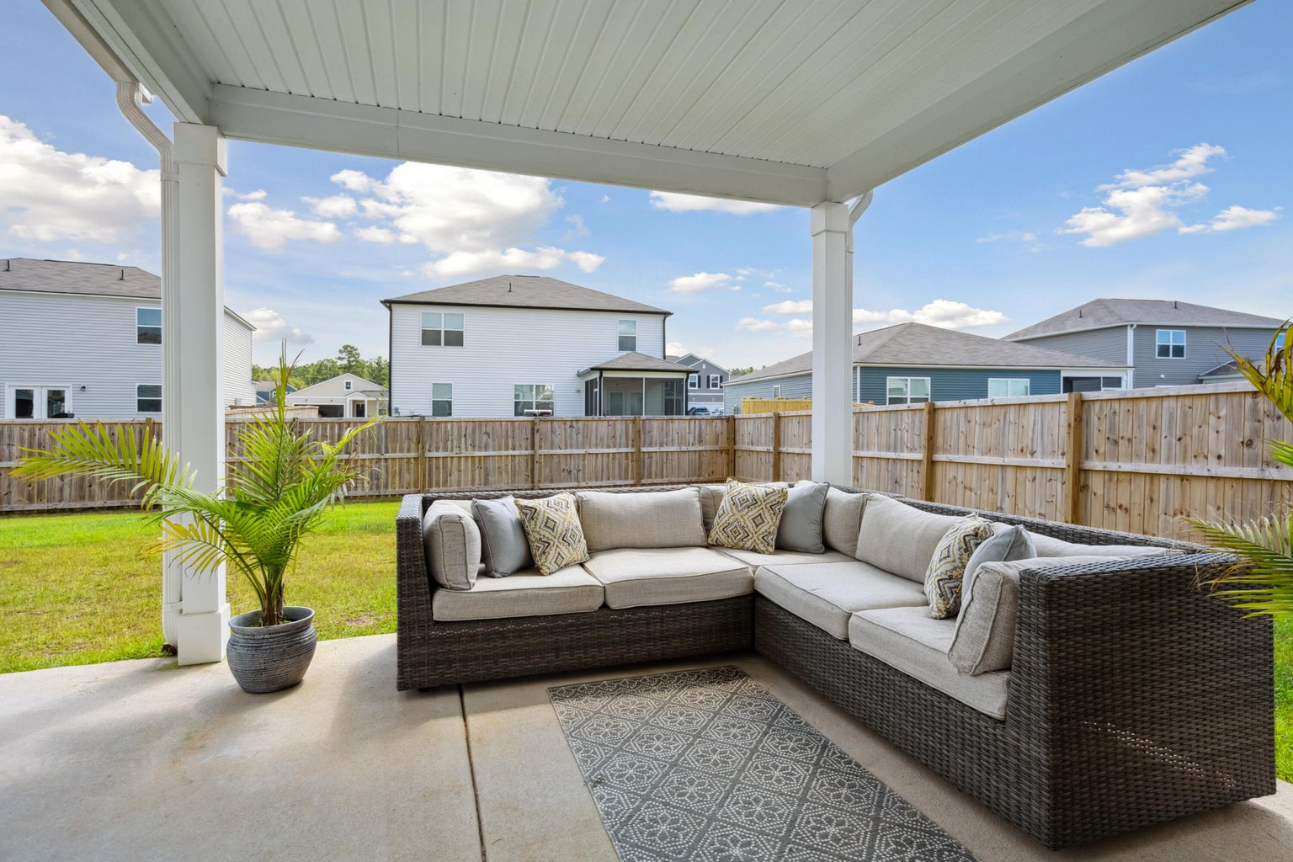


MOVE-IN READY IN NEXTON!
434 Ambrose Drive
Summerville, SC 29483 | MLS# 23019030 | NEW PRICE $452,900
MOVE IN READY LIKE NEW HOME in highly desirable Bradford Pointe in Nexton! From the LVP flooring, to the neutral paint colors, updated lighting, beautiful kitchen, and covered back porch, 434 Ambrose Drive has it all and lives large with 4 bedrooms and 2.5 baths. Upon entering you are greeted by a great flex space that can be used as an office or separate living area. Off of the flex space is a stunning white eat-in kitchen that opens into the den and features a glass door leading to the outside covered patio and spacious backyard, perfect for grilling out and playing in the yard. The layout makes it the ideal home for entertaining! There is also a half bath and a second flex space downstairs where you can have an additional office, play area, or catch all room. Talk about great spaces!
Upstairs you will find a loft, laundry room, 3 bedrooms, and 2 full baths. This home has all of the space you could need with 2 offices, a loft, and 4 bedrooms! The current owners also have a home gym in the garage which is perfect! Don't forget about the full fenced backyard! What more could you ask for!
Bradford Pointe is a great walkable community with sidewalk lined streets, a pool, basketball court, playground, and soccer field. You are also just minutes away from all of restaurants and shops of Nexton. You can't beat the location! Don't miss out on this gem!
SARAH ELLEN LACKE
843-607-4330
sarahellen@theexchangeco.com
www.theexchangeco.com
The Exchange Company, LLC | 49 Calhoun St | Charleston, SC 29401

